Slide 1
You Tube Intro

Slide 2
Program Learning Outcomes
Program Learning Outcomes
“We C.A.R.E.”
“Our mission is to provide a system of services that support achievement of educational goals for a diverse student population.”
The values that guide our work:
Communicate! To convey information in an honest, accurate, timely and direct manner, both internally and externally.
Advocate!
To support our students with solutions that are thoughtful and creative, with the goal of improving student success and retention.
Respect! To consistently treat everyone in an ethical, respectful, truthful and trustworthy manner.
Empower! To provide an environment for our students that promotes lifelong learning, personal growth, personal accountability and civic responsibility.

Slide 3
Welcome/Facilitators
Michael White
Eileen Apperson – Williams
Renee Dauer
Paula Ramos
Marjorie Facio
Amber Fowler
Emilie Gerety
Adelfa Lorenzano
Nate Saari
Ana Ramirez
George Sanchez

Slide 4
Agenda
Welcome – Michael White
What is an Assembly? – George Sanchez
What were our concerns? – Emilie Gerety
How have they been resolved? – Fernando Gonzales
Classified Standards – Team Leaders
Program Learning Outcomes – Eileen Apperson-Williams
Integrated Planning Follow Up – Michael White
Meditation Techniques – Thomas Hueber
MW
Notes:
Work stations – Ana & George, Appropriate Dress – Adelfa & Paula, Positive Work Ethic – Lisa & Marjorie, Customer Service – Renee & Amber

Slide 5
What is an Assembly?
Dialogue within our division!
Addressed concerns and accomplishments
We C.A.R.E.
Established division goal of evaluating/improving customer service
Discussed Integrated Planning
GS

Slide 6
One year ago…
… we wondered if people knew why they were here.
We C.A.R.E.
Communicate! - To convey information in an honest, accurate, timely and direct manner, both internally and externally.
Advocate! - To support our students with solutions that are thoughtful and creative, with the goal of improving student success and retention.
Respect! - To consistently treat everyone in an ethical, respectful, truthful and trustworthy manner.
Empower! - To provide an environment for our students that promotes lifelong learning, personal growth, personal accountability and civic responsibility.
EG

Slide 7
One year ago…
… we were concerned about the lack of communication within our division.
Blackboard
Coffee Klatches
Division Assemblies
Emails
EG

Slide 8
One year ago…
… we felt our use of technology was a little bit behind the times.
SARs and eSARs
NextGen scholarship software
NextGen job placement software
EG

Slide 9
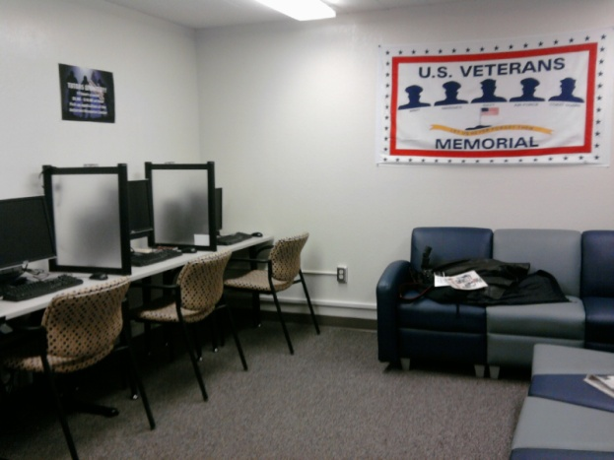
One year ago…
… we didn’t like that our veterans services were not organized.
Veterans Support Team
Veterans Webpage
Veterans Resource Center
EG

Slide 10
One year ago…
… we were worried that we did not provide consistent customer service to our students.
“Work areas should be neat, clean and free of clutter”
“Help the students as much as possible”
“Dress should be professional and appropriate for department”
“Train student aides”
“Discuss what we can do, not what we cannot”
“Make students the priority”
“Return phone calls and emails”
“Document communications”
EG

Slide 11
Program Learning Outcomes
What are they?
Outcomes that state what students should know after using your services
Focus has shifted from instructional support to “student learning”
Do the students seeking our service have an “in the moment” epiphany?
How many describe a “before and after” type of experience?
How is this useful for our program’s improvement?
Common assessment methods in Student Services.
Surveys (attitudes and perceptions of students, staff, employers)
Demonstration
Staff journals, interviews, focus groups
Review of annual goals
EAW

Slide 12
Mapping PLO’s
Tutorial Center Program Learning Outcome (PLO)
The student will be able to apply appropriate study strategies to improve class performance.
Reedley College General Education (Institutional) Learning Outcome (GELO)
Assess current knowledge, skills, and abilities to further develop them and apply them to new situations (Personal Development)
Reedley College Mission Statement
Reedley College provides an accessible, student-centered educational environment featuring high-quality learning opportunities. We offer basic skills enhancement, associate degree programs, career technical education, and transfer-level courses as an integral component for life-long learning within a diverse local and global community.

Slide 13
Classified Standards
Directions: Develop a standard for classified staff to follow. It should be simple and clear. When your group finalizes their standard, transfer it onto a t-shirt to present at the end of the activity (be creative!).
(Example)
Group “C” – Work stations
Group “A” – Appropriate Dress
Group “R” – Positive Work Ethic
Group “E” – Serving Students
EG

Slide 14
And the award goes to…
Most likely to test into English 252.
Most likely to take finger painting lessons.
Most likely to write a novel.
Best effort on a standard.
EG/MW
Notes:
English 252 – dictionary & thesaurus; Anime Club – paper & markers; too long – thick book & pens; best – 1st place ribbons

Slide 15
Integrated Planning
This semester’s activities:
Light switch campaign
Division Emails
Pop Quiz – Ryen may be out this week
Coming next semester:
Campus wide
Team aspect
MW

Slide 16
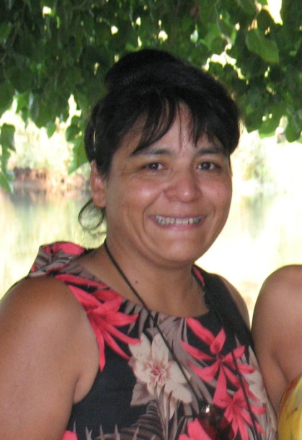
Integrated Planning
Our Fall 2010 IP Tournament of Champions winner is (drum roll please)…
Liz Huebert – DeFore MW

Slide 17
Summary
How we address concerns
Program Learning Outcomes
Every space is a learning space
Classified Standards
Integrated Planning
Date of Accreditation Visit: October 2011
MW

Slide 18
Meditation
Now take a deep breath.
It’s time to relax.
PR

