Slide 1
Student Services Strategic Action Plan 05.06.11
Agenda
Norms
Defining Strategic Actions
District, Campus and Division integrated planning
Title V Projects update – the “bigger picture”
Actions – describe what we are GOING TO DO!!!

Slide 2
Norms
Norms
Be polite & respectful
Listen carefully
No side bar conversation
Use parking lot for issues off topic
Be rigorous
Create a culture free of intimidation during open discussion
Be careful not to dominate the discussion
Be curious
Clarify jargon
No cell phones
Keep a sense of humor
Be concise
Ask questions when you don’t understand
Value alternative view points
Be collaborative

Slide 3
Strategic Actions are …
Usually used in military situations or in business, it means to formulate a plan based on the "Big Picture", not just to react to the current one.
In business for example, if you are trying to sell coffee and it seems like the trend is that people in your area are switching to tea, you would start changing your strategy to compete with the people selling the tea.
In war, it means gathering information from the enemy obtained by spying or the like- and possibly altering what military action would be planned.

Slide 4
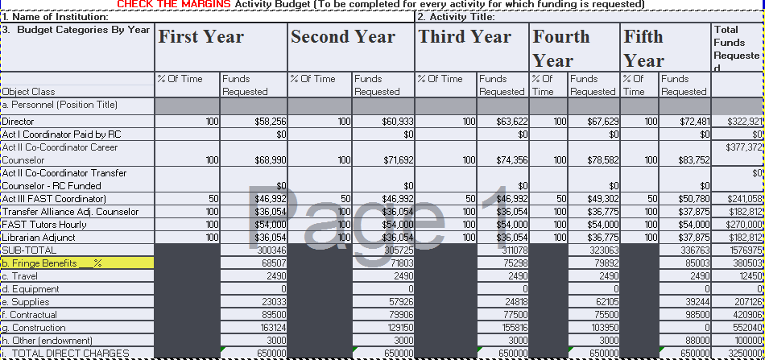
Title V Budget

Slide 5
Pieces of the “Puzzle”
Emphasis on “completion” and student success
Access, Success, Equity – 2020 Vision
“Student achievement in quality degree, certificate and transfer programs.”
Coordination of grant projects - Title V, SSS, etc
Need for logically-assigned office space for grant personnel
Availability of SARs, ESARs, Career/Job X software programs
Hershey imaging system
Personnel – GF and Grant - funded
Need for counseling space
Enhanced Financial Aid presence in SS
New modular

Slide 6
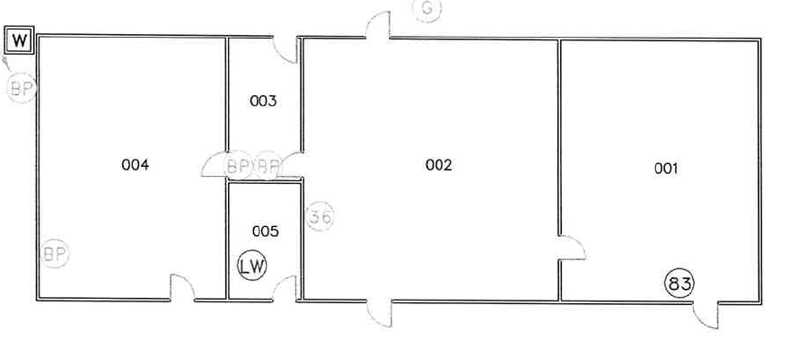
This will Give us some Context
I located the blueprints for the INC building and determined that the only wall that is fixed in the building is the wall I pointed out to you. That is the wall on the north side of the offices (between 003/005 and 002). All of the rest of them can come down without any structural changes. I also determined the windows on the south side of the building (Where the steps are) were originally designed as a single door opening.
The office wall I referred to above is designed as a shear wall. Shear walls are wall assemblies that are built to provide shear strength. These walls are designed to provide shear strength in-order to resist lateral loads. They are generally designed with wind and earthquake issues in mind but are also designed to support the building. In-order to open this wall a structural engineer will need to provide a design that will replace the existing shear wall system with large openings. This is a common process and can de done. I also believe they will be able to modify the building to accept the requested double door at the south end of the building; of course these are questions for the structural engineer and the architect.

Slide 7
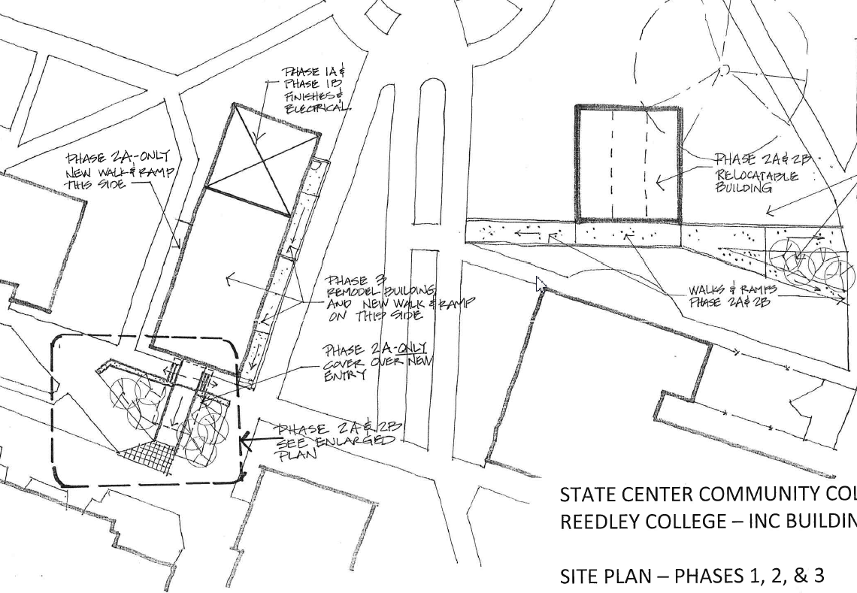
Future Career, Transfer and Student Success Sites

Slide 8
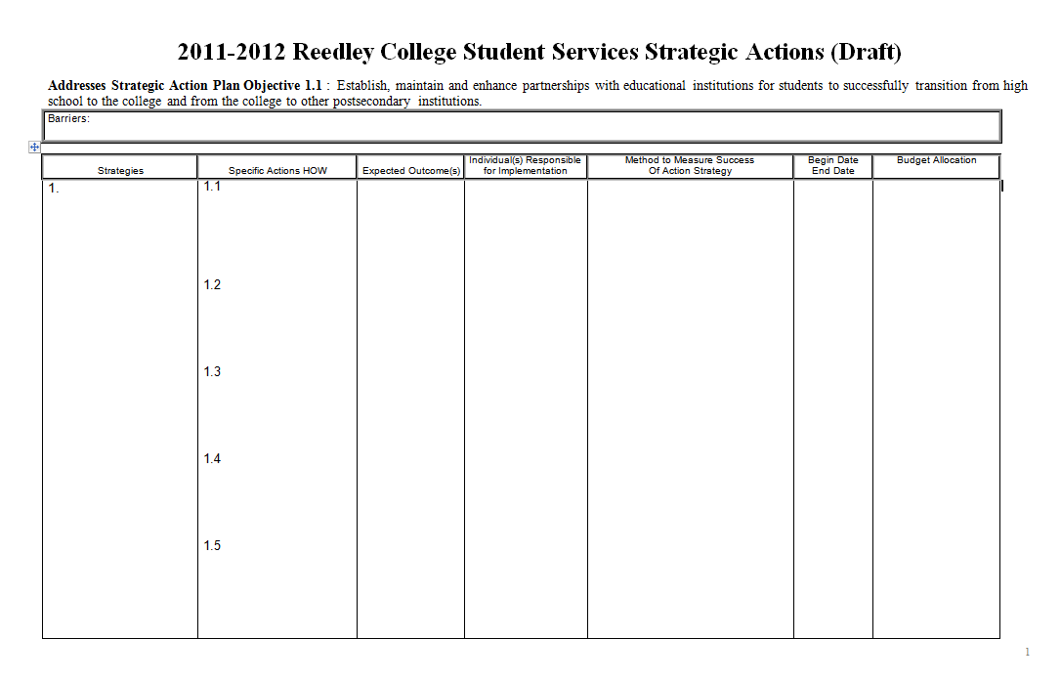
What you will find at your Stations

Slide 9
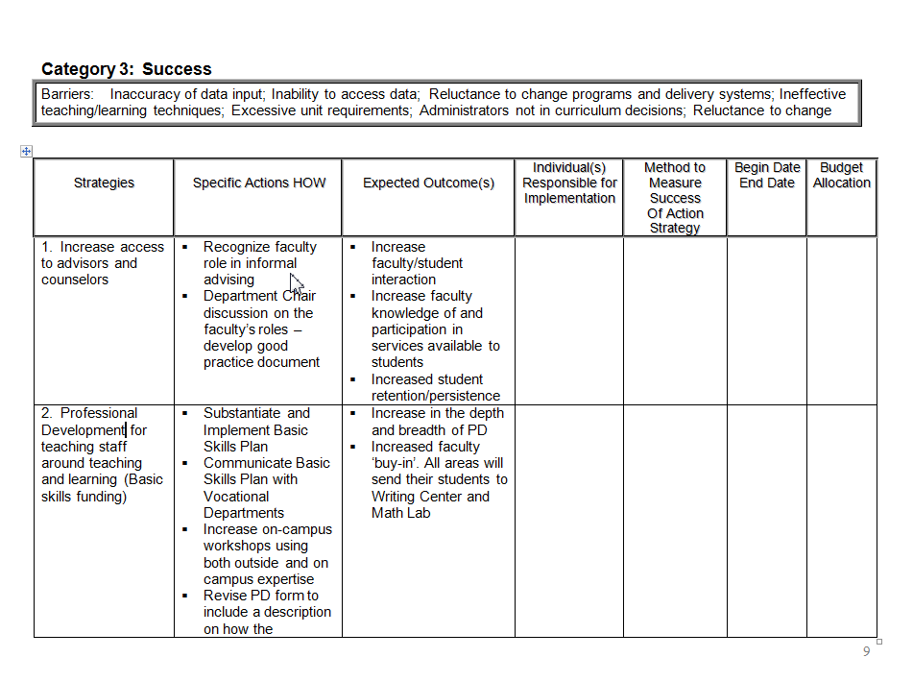
Example from 2009

