Slide 1
MOR Curriculum Committee Orientation
Created by Nancy Marsh,
Curriculum Chair,
RC Instructor of Child Development
August 2015

Slide 2
Title 5 of the California Code of Regulations [§ 55002 (a) (1)] includes the following provisions regarding Curriculum Committees:
Every college or district must have one.
The committee must be either a committee of the Senate or a Committee, including faculty, mutually agreeable to College and Senate.
The committee makes recommendations on curriculum (including compliance of courses with state standards) directly to the local governing board through the district Educational Coordinating and Planning Committee (ECPC).
The committee must comply with shared governance requirements. This means, on curriculum issues, that the college must consult collegially in accordance with the Shared Governance Policy of the Board of Trustees.

Slide 3
Mandated Duties:
Curriculum committees must review new and existing courses to determine that they:
Meet standards for quality and for establishing prerequisites as defined in Title 5, Division 6, Chapter 6 of the California Code of Regulations,
Meet intersegmental expectations for submission to IGETC, CSU-GE, or UC,
Qualify as a CSU Elective,
Include documentation of prerequisites, corequisites, and advisories according to current Title 5 language, to be voted on separately from course outlines.
Make recommendations regarding programs and program changes

Slide 4
Locally defined duties of the Curriculum Committee:
Define local standards.
Determine GE status of courses.
Determine AA/AS and transfer degree requirements.
Recommend to the SCCCD Board of Trustees approval of new courses and programs.
Scrutinize and approve or remove prerequisites, co-requisites, and advisories and their documentation.
Recommend to receiving institutions courses and programs for transfer/articulation.
Review existing curriculum.
With administration and senate, maintain conditions of delegation.
Carry out other locally defined duties as articulated in SCCCD Board Policy, Administrative Regulations, and Clovis Community College Center Academic Senate resolutions.

Slide 5
Duties of Curriculum Committee Members
Attend all Curriculum Committee meetings or designate a proxy.
Act as a liaison between the Curriculum Committee and the department which he/she represents.
Act as a resource to faculty members in their departments who are crafting new curriculum/revising existing curriculum.
Review all curriculum submitted by department prior to Tech Review and Curriculum Committee meetings.
Attend meetings during the academic year on Thursdays from 3:15 until no later than 6:00 pm.
Volunteers for Tech Review committee.
All other duties as determined by academic departments or the Academic Senate.

Slide 6
Tech Review Subcommittee
Made up of Curriculum Chair and no less than 2 currently serving committee members, at least 1 whom is well versed in the proper use of the English language.
Reviews proposed curriculum for technical issues such as grammar and syntax, and to assure all required components of COR are complete.
Meets weekly during the academic year on Thursdays, immediately following regularly scheduled curriculum meetings and ending no later than 6:00 pm.
Items are placed on Tech Review agenda after pre-launched on CurricuNet.
Meets with originating faculty.
Suggest changes and determine date for completion of changes.

Slide 7
Pre-Launch
Reviewed
Tech Review
Faculty attend
Curriculum New Business
Faculty attend
Put on Tech Review Agenda
Changes determined
Date for completion
Changes determined
Date for completion
Movement of Curriculum
Changes Were Made
Changes Not Made
  Committee approves
  Moves to Pre-ECPC, ECPC, BOT
  Pulled and moved to Old Business for further discussion
  Faculty Contacted
Curriculum Consent Agenda

Slide 8
The Course Outline of Record
The course outline of record (COR) is a legal document that must contain certain required elements that are outlined in
§55002 of Title 5
The COR is a legal document and thus serves as a legal contract between the faculty, student, and the college
All CORs must be approved by the local academic senate (curriculum committee) and the local governing board

Slide 9
Basic Elements of a COR
Title 5 requirements (sec. 55002)
  Title 5
Need/Justification/Goals
Chancellor’s Office Data Elements
  http://extranet.cccco.edu/Divisions/TechResearchInfoSys/MIS/DED.aspx
Title 5 Standards for Approval (COR as a whole)
  § 55005. Publication of Course Standards
Discipline Assignment(s)
  http://californiacommunitycolleges.cccco.edu/Portals/0/FlipBooks/2014_MQHandbook/2014_MQHandbook_ADA.pdf

Slide 10
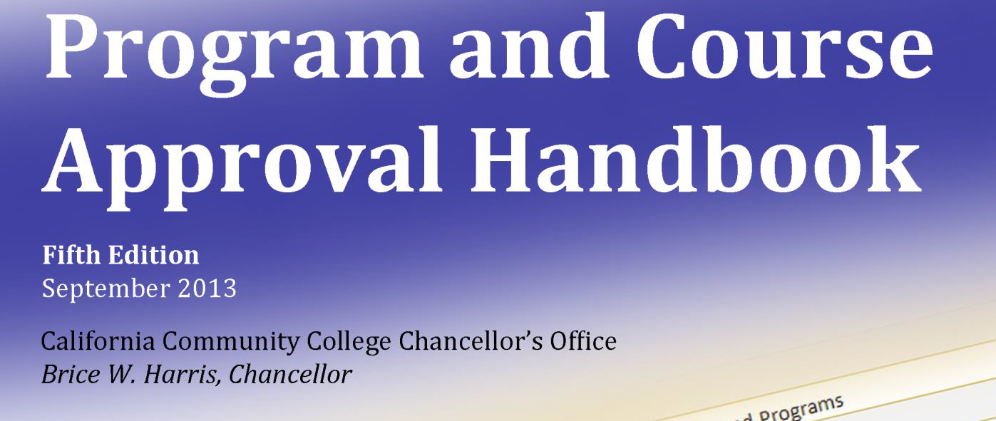
Helpful COR published guidelines #1
http://extranet.cccco.edu/Divisions/AcademicAffairs/CurriculumandInstructionUnit.aspx

Slide 11
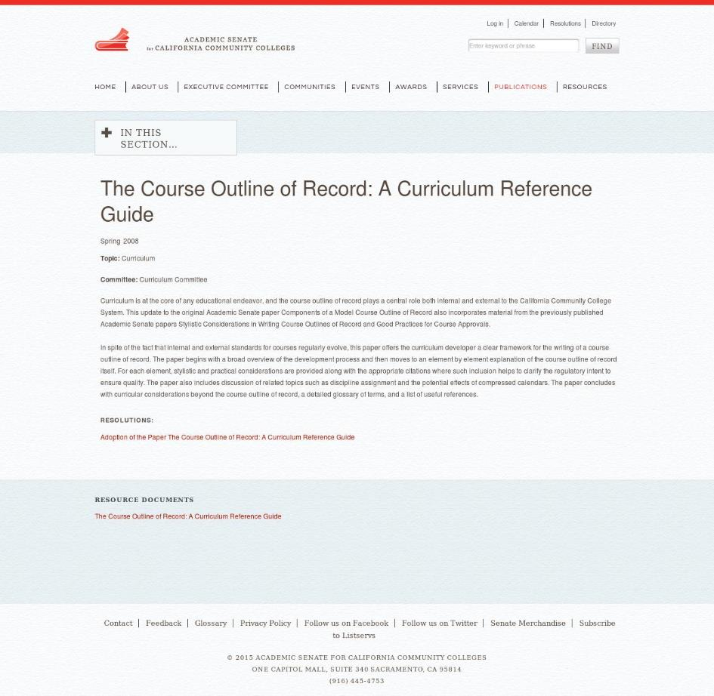
Helpful COR published guidelines #2
http://www.ccccurriculum.net/course-outline-of-record/
Or
http://asccc.org/node/175016

