Slide 1
New Full-Time
Faculty Orientation
Wednesday,
August 9, 2017
9:00 a.m.

Slide 2
Widely Important Goal (WIG)
We Motivate and Inspire Students to Succeed!

Slide 3
Overview
Welcome/Introductions-Dale van Dam/Claudia Habib
Ice Breaker/Team Building Exercise – Marie Harris
Student Conduct, Wellness Concerns, Plagiarism-Shannon Solis
Academic Senate-Stephanie Curry
SLOs/Canvas Updates/OER-Amanda Taintor
Accreditation Updates –Dale van Dam
Nuts and Bolts (including roster management and census date awareness)-David Clark
Faculty Handbook Overview-Todd Davis
Tenure Process-Marie Harris
Flex Day Requirements-Dale van Dam/Sarina Torres

Slide 4
Nuts and Bolts
Just the essentials!

Slide 5
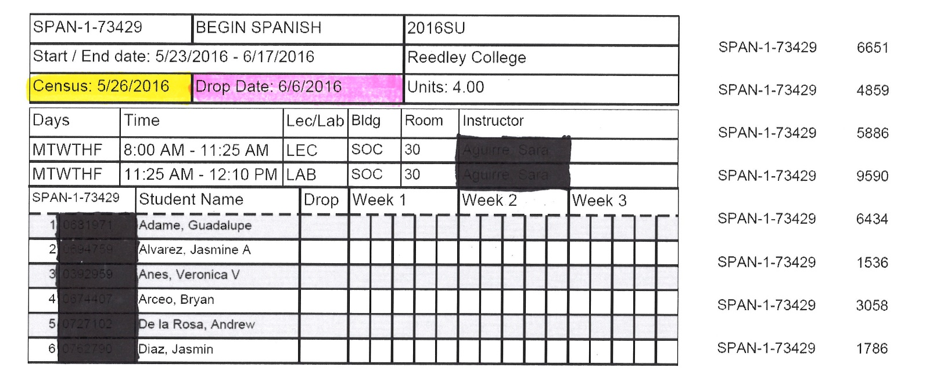
Roster Example
CENSUS DATE (location in yellow)
  Certify Roster ON this day
  Last day for student to add with add code
  Last day to drop to avord a “W”
DROP DATE (location in pink)
  Final Drop Date: Last day to drop with a “W.” Letter grades must be assigned after this date(A, B, C, D, F or I)

Slide 6
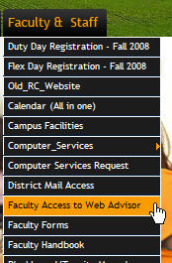
WebAdvisor
Grades
Roster Updates
Early Alert
Grades - Data Submission
Attendance submission
  http://www.eduforms.com/
  cgi/forms/forms.cgi?sch
  =Faculty

Slide 7
Course Outline of Record
It is extremely important that the Course Outline of Record (COR) be followed, as it has been approved by the department, the Curriculum Committee and the CCCCO.
It also assures consistency among instructors and from one semester to the next.
http://www.curricunet.com/reedley/

Slide 8
Participation Points vs. Attendance Points
PARTICIPATION POINTS: a good way to encourage regular attendance. You must provide, detailed in your syllabus, precisely how these participation points will affect the student’s grade.
Be careful to refer to it as PARTICIPATION POINTS in your syllabus and not as attendance points

Slide 9
Syllabus
A copy of each class syllabus is to be sent
via e-mail to your division aide no later than
Wednesday, August 16.(Even if there are no
changes from the previous semester)
Be sure to include:
Instructor’s Full Name
Label it: “Syllabus”
Class Name and schedule #’s – example: ENGL-1A-23456
Semester – “Fall 17”
Class Meeting Days, Time, and Location
Refer to Faculty Handbook for a sample

Slide 10
First Class Session
In the first week it would be wise to wait 10 minutes before taking attendance.
Take the time to distribute and go over the class syllabus.
If students are sent to purchase books during the first class meeting, have the students make their purchase and then return to class.
“No Show” students should be dropped to make room for students waiting to add. Add from the waitlist in sequence, #1 first. Waitlisted students must go through the same add procedure (with the authorization code) as walk-ins.
Class should meet the entire class period.

Slide 11
Important Dates
August 14 (M) Start of Fall semester
August 16(W) Syllabi due to Deans office
August 25 (F) Last Day to Drop full-term class to get refund
September 1 (F) Last Day to register for full-length class or drop to avoid a “W”---ALSO KNOWN AS CENSUS DATE (rosters must be certified on this date)
September 4 (M) Labor Day (no classes held, campus closed)
September 15(F) Last day to change a fall class to/from a Pass/No-Pass grading basis
October 13 (F) Last day to drop a full-term class
October 16-December 15 (M-F) Short-Term classes, second nine weeks
November 10 (F) Veterans Day (no classes held, campus open)
November 23-24 (Th-F) Thanksgiving holiday (no classes held, campus closed)
December 11-15 (M-F) Final exams week
December 18 (M) Grades due by noon

Slide 12
2017-2018 Faculty Handbook
Colleagues
AAUP Statement
Emergency procedures
Syllabus
Roster management
Classroom care
Absences
Staff development
Mail room Tiger One card
Tutorial Center

Slide 13

Colleagues

Slide 14
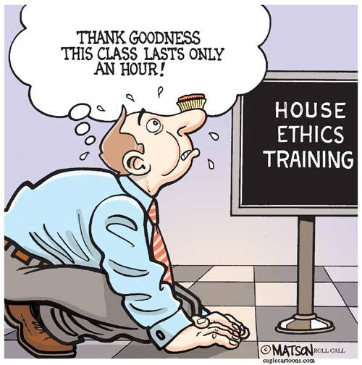
AAUP Statement
Ethics

Slide 15
Emergency Procedures
1st to Know: sign up through WebAdvisor
SCCCD Police Ex. 5911 or 244-5911
  Oakhurst faculty only dial 911 directly
New Red SCCCD Emergency Procedure Posters in every classroom

Slide 16
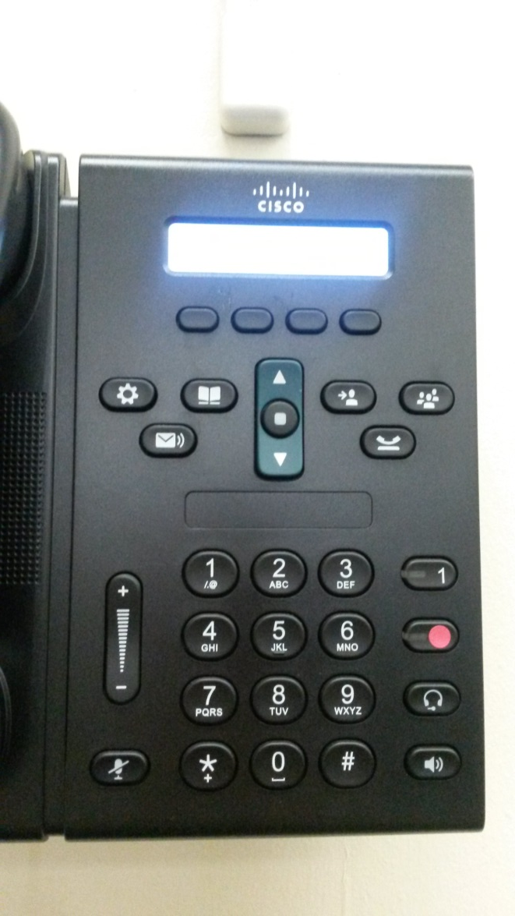
Emergency Button
Pushing the Red Button take you directly to the SCCCD Police
You will NOT hear anything, they will remain quiet while assessing the situation
If needed, they may call you back
This button is ONLY for emergencies

Slide 17

Care of Classroom
Check classroom
Turn off the lights
Leave computers/media in state you found them
Clean the white boards
Reset the alarm
Lock doors
Repairs submitted via online: “schooldude”

Slide 18
Absences
REEDLEY CAMPUS
Before 8 am, call 638-0306 or 637-2531
8 am – 5 pm, contact your dean’s office
After 5 pm, call the administartor on duty – 779-5447
MADERA & OAKHURST CCC
All Madera CCC Classes: 675-4817 or 675-4800
All Oakhurst CCC Classes: 683-3940
After 5 pm: 675-4881
Fill out an academic absence form within 2 days

Slide 19

Staff Development

Slide 20

Communication/Mail
We don’t use Facebook
RC email
Tiger One card -→Mail Room/Alarms
Text Messages

Slide 21
Tutorial Centers
REEDLEY CAMPUS
General Tutorial Center (Call the Learning Center) – Library LRC 111
Reading & Writing Center – HUM 58
Math Center – FEM 1
Communications Lab – SOC 38
MADERA CAMPUS
General Tutorial Center (Call the Learning Center) – R1A
Reading & Writing Center – AM 154
STEM Center – R4A

Slide 22
Tenure Process
Four year process
Review regulations and timelines
Committee: supervisor, two peers
Classroom visits and student evaluation
Self-evaluation included
Professional activities
Duties and responsibilities

Slide 23
Tenure Process
Four-year process, contract guided
Week 1-5:
Committee is established; supervisor and 2 peers
First meeting: review regulations and timelines
Supervisor starts Duties and Responsibilities Evaluation

Slide 24
Tenure Process
Week 6-13:
Classroom visitations (each member) and student evaluations (minimum 1 class)
List of professional activities
Copies of classroom records

Slide 25
Tenure Process
Week 14-16:
Self-evaluation
Committee meeting
Week 17-18:
Employment recommendation to president

Slide 26
Faculty Responsibilities
40 hour work week
177 days/year
1 Duty day per semester required (Thursday meeting before ea. semester starts)
2 “Flex Days” (10 total hours)
Office hours 3-5 hours/week
  Incl. non-teaching days
40% of total load must be face-to-face
LGI load factor – per number of students above 50, at census

Slide 27
FLEX
Flex Day Responsibilities

Slide 28
Flex
Your contract is 175 teaching days and 2 Flex Days
600 minutes of Flex activities are required per academic year-10 hours total
Documents: Blackboard-Office of Instruction/Flex/Flex Reporting
  Flex Reports due no later than Friday, May 18th to Sarina Torres
Reported by O. of I. per instructor to the CCCCO
Today’s activities CAN be counted for Flex

Slide 29
Flex
Activities may be on “Flex Day” (Friday before start of each semester) planned by Academic Senate or during the academic year, but not in the summer
  List of activities for Fall 2017 Flex Day in packet and emailed
Activities may be on your own, or with department members
  Workshops, conferences, program review activities, acceleration, assessment etc.
    List of approved activities on Blackboard (RC Office of Instruction)
  Must be outside your teaching time and office hour time

Slide 30
Questions???

