Slide 1
Budget Development Process

Slide 2
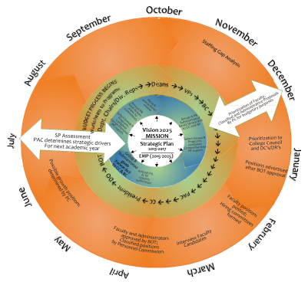
Integrated Planning Cycle

Slide 3
President’s Advisory Council
President’s
Cabinet
Budget Committee
President

Slide 4
Budget Guidelines
Manage resources to fund Strategic Initiatives that directly support student success, program growth, and Vision 2025
Align with the strategic plan of the college including Vision, Mission and Program Review
Achieve Strategic Goals - ensuring sufficient resources for student success, expanding services (growth) and institutional support
Maintain a college reserve of no less than 3%
Continuous improvement (assessment and evaluation) of process to ensure effectiveness in allocating resources
Align categorical/restricted programs with Strategic Goals; to the degree possible, use those funds to support on-going College expenditures even if on a one-time basis. Make maximum use of “flexibility with Categorical funds” as allowed

