Slide 1
State center community college district and State Center Federation of Teachers Local 1533, CFT/AFT, AFL-CIO
Collective Bargaining Agreements July 1, 2018 – June 30, 2021

Slide 2
SCFT Full-Time CBA

Slide 3
Overview of Major Provisions and Significant Contract Changes
SCFT Full-Time Collective Bargaining Agreement
Waiver of Bargaining
New Employee Orientation
Safety
Hours, Workload, Class Size
Faculty Evaluations
Transfer and Reassignment
Leaves with Pay
Compensation
Faculty Early Retirement Program (FERP)

Slide 4
Waiver of Bargaining
Article V

Slide 5
Section 2 Beginning Negotiations
This contract shall not be subject to reopening on any item for the duration of the Agreement or unless mutually agreed to in writing by both parties
This contract will run through June 30, 2021
Initial proposals for a successor contract shall not be presented earlier than July 1, 2020

Slide 6
NEW EMPLOYEE ORIENTATION
Article IX

Slide 7
Section 3 New Employee Orientation
The Federation shall be notified at least 10 days in advance of any District or College new employee orientations meetings
The Federation shall be entitled to 5 to 10 minutes on the orientation agenda
The Federation shall be entitled to one 30 minute period immediately before or after the orientation meeting to meet with new hires
Human Resources shall conduct the new employee orientations for full-time faculty

Slide 8
Safety
Article XI - B

Slide 9
Section 3 Reporting Violations
Unit members are required to report safety concerns to one of the following
Supervisor
Districtwide Facilities and Safety Committee (DWFSC)
Campus Committee
The Director of Environmental Health & Safety

Slide 10
Hours, workload, class size
Article XII

Slide 11
Section 1 Work Week
All faculty work 40 hours per week
5 hours per week on average shall be dedicated to extracurricular involvement in district governance and service to the campus and district (not community)
Non-instructional faculty have 35 hours of assigned time
Instructional faculty work 5 days per week
Full-time instructors shall be assigned 14-16 LHE per week
May be extended to 12-18 by mutual agreement
Assignments may not exceed 9 hours per day
Overload limited to 40% (6 LHE) per semester

Slide 12
Section 1 Office Hours
All instructional faculty are required to hold 5 office hours per week
Unless this causes member to exceed 22 hours per week
Office hours are in 50 minute increments
See Table XII.1 for Office Hour Chart
Shall be scheduled any time 2 hours before or after unit member’s scheduled classes for the day
Not before 7am or after 9pm

Slide 13
Office Hours (Cont.)
May have one virtual office hour per week
Those with online/hybrid (more than 50% online) classes will have one virtual office hour
Must be through interactive medium; not by phone
Office hours will be prorated for those with released time or split instructional/non-instructional assignments
Example = 6 LHE/15 LHE= 40% of an instructional load
40% x 5 office hours = an adjusted office hour requirement of 2

Slide 14
Section 2 Professional Obligation
Each faculty member acknowledges that their primary employment obligation is to the District/College and that any part-time employment that a faculty member has outside of the District/College will not interfere or take precedence over an assignment made by the District/College
This includes department meetings, committee obligations, etc.

Slide 15
Section 5 Large Group Instruction (LGI)
All sections will be assigned by management with consideration and collaboration with the full-time unit member
Instances in which a unit member chooses to enroll students that results in LGI, the unit member must get prior approval from his/her Dean in order to be compensated

Slide 16
Section 11 Department Chair Reassigned Time
Unit members who are serving as department chairs shall be given reassigned time per academic year according to the following table based on the FTEF of the previous academic year
The District reserves the right, in its sole discretion, to remove a unit member as department chair at any time
FTEF/year | REASSIGNED TIME (in FTE)
0 < FTEF < 50 | 0.2
50 < FTEF < 75 | 0.3
75 < FTEF < 100 | 0.4
100 < FTEF < 125 | 0.5
FTEF > 125 | 0.6

Slide 17
Section 11 Department Chair Duties
Detailed Department Chair duties are now included in the CBA. Please refer to pages 28 & 29 for details
Annual Review
The Dean will meet with the department chair at least once each academic year to review the performance of the department chair. This review will not be part of the unit member’s evaluation nor will it be included in the unit member’s personnel file

Slide 18
Section 13 Travel Off Campus/Mileage
Total round trip mileage – Round trip mileage from unit member’s home to primary campus
Total round trip is defined as the total mileage from the unit member’s home to the first campus, from the first campus to the second campus, and from the second campus to the unit member’s home
NOTE: Primary campus is defined as the campus where the majority of the load is scheduled, or in the case of non-majority, the campus where the unit member was hired

Slide 19
FACULTY EVALUATIONS
Article XIII

Slide 20
Section 2 Evaluation Process
Contract/Tenure review committee shall consist of 3 members including 2 tenured department members and the immediate supervisor (or his/her designee excluded from the bargaining unit. There will not be a designee for the first semester except in an emergency)
All tenure review evaluations shall occur in Fall of each year, except for the abbreviated evaluation, for the first semester, when hired in Spring
Regular/Tenured evaluation committee shall consist of a peer reviewer and the immediate supervisor, or his/her designee excluded from the bargaining unit
The peer reviewer shall be a tenured faculty member

Slide 21
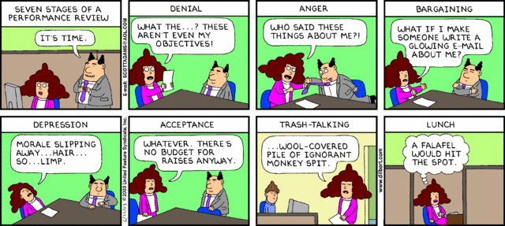
Section 2 Evaluation Process (cont.)
Committee members shall administer a standard District evaluation questionnaire to students in at least 1 of each of the unit member’s preparations
For Distance Education, the student questionnaire shall be made available to students for a minimum of 5 days
Standard District evaluation questionnaires will be used for ALL instructional and non-instructional assignments, except College Nurses

Slide 22
Section 3 Evaluation Criteria
The following Duties and Responsibilities have been added to the evaluation criteria
Participation in curriculum, program review and annual updates, college and/or district committees and other shared governance activities
Assessing student learning outcomes as a function of the departmental program review process
For Records evaluation, counseling processes and forms have been added.
All relevant input outside the evaluation process must have been previously addressed with the unit member
For Coaches, the immediate supervisor will also consider relevant input from the Athletic Director

Slide 23
Section 3 Evaluation Criteria (cont.)
New evaluation criteria have been added for all faculty on special assignment
Coaches
Coordinators
Counselors
Librarians
Nurses
All timelines have been adjusted by at least a week. Please review carefully
NOTE: The timeline for third contract evaluations takes place during the Fall semester

Slide 24
Section 4 Evaluation Timeline
Tenure-track faculty hired in the Spring will receive an abbreviated evaluation process for that “zero semester” which does not count toward his/her first contract year for the purposes of tenure review
Student questionnaires for all classes
One classroom visitation by immediate supervisor and one peer reviewer
Review of the faculty member’s class records
Immediate supervisor will complete a summary evaluation report
NOTE: Committee compensation has changed from an available 10 hours to 5 hours

Slide 25
Section 6 Evaluation of Temporary Faculty
Full-time temporary faculty (which include one-semester and one-year assignments) will be evaluated as follows (Section 6)
Performance during their first semester of teaching or service
Categorically Funded Faculty will be evaluated as follows (Section 6)
Performance during their first semester of teaching or service
Performance during their second and/or third semesters of teaching or service
Performance over every 6 semesters of teaching or service thereafter
Each first year contract faculty, including zero semester (Spring) hires, will have a faculty advisor for the first semester
Advisor will serve as a guide and a role model. Each advisor shall receive up to 5 hours at the top of Schedule B2 Lab rate. Please review this section carefully (Section 2)

Slide 26
TRANSFER AND REASSIGNMENT
Article XVI

Slide 27
Section 1 Transfer and Reassignment
Reassignment is within the same college, including its centers, campuses, and satellites
Transfer is from one college to another. The transfer process remains the same with the following exceptions:
The department is no longer required to interview all transfer applicants
If the transfer request is rejected, the applicant will be notified by Human Resources
If the recommendation is accepted, the President, Vice President, or designees can interview the candidate
If the President does not accept the recommendation, he/she will meet with the department and discuss the reason(s) for not accepting

Slide 28
Leaves WITH PAY
XVIII

Slide 29
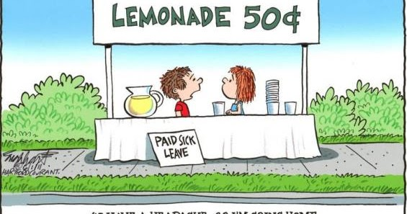
Section 1 Sick Leave
Unit members assigned overload will accrue sick leave at the rate of 1 hour earned for each 18 hours of teaching, counseling, or librarian duties in fall and spring only
If a substitute is hired to cover a distance education class, the member will be deducted sick leave
Language has been added notifying faculty they may take up to 12 weeks of sick leave for the purposes of parental leave within the first year of the child’s birth. This includes half-pay if regular sick leave is exhausted
Supervisors can now request a doctor’s note for 3 or more consecutive days absent (used to be 5 days)

Slide 30
Section 1 Catastrophic Leave Bank (Formerly known as Sick Leave Bank)
Catastrophic illness or injury is an illness or injury that is expected to incapacitate the unit member or the unit member’s parents, spouse/domestic partner, children or other member of the immediate household
The program does not cover the following
Stress-related Illness
Elective Surgery
Normal Pregnancy
Workers’ Compensation Claims
Disabilities resulting from current use of Alcohol or Drugs
Intentionally Self-Inflicted Injuries
Normal Illness such as Colds, Flu, Allergies, Headaches, etc.

Slide 31
Catastrophic Leave Bank (Cont.) (Formerly known as Sick Leave Bank)
Eligibility to use Catastrophic Leave Bank days requires that a participating unit member have
Exhausted his/her personal sick leave days as well as all hourly sick accumulated and converted to daily sick leave
Been incapacitated or absent for at least 30 days

Slide 32
Section 5 Personal Necessity Charged to Sick Leave
Formerly known as Personal Emergency leave
Limited to no more than six days in one fiscal year
Two (Gone Fishing) of the six days may be granted for any reason deemed appropriate by the unit member AND with prior approval of the supervisor
No more than two unit members off at any one time in any work unit under this provision

Slide 33
Section 6 Sabbatical Leave
Prior to entering upon a sabbatical leave or grant leave (Section 7), unit member must do one of the following
File a suitable bond indemnifying the District for any salary paid to unit member in the event unit member fails to return and/or render 2 full years of service
Enter into a written agreement with the District to fulfill the obligations of the leave (agreement in HR)
Unit members on sabbatical leave may not perform any work for the District including, but not limited to teaching, service on committee including search committees, grant work, etc. However, they may teach summer school

Slide 34
CompenSATION
Article XXI

Slide 35
Section 1 Salary
The following COLA has been negotiated for the 2018-19, 2019-20, and 2020-21 fiscal years
3.00% if COLA ≥ 2.50%
2.50% if 2.00% ≤ COLA < 2.50%
2.00% if 1.50% ≤ COLA < 2.00%
1.00% if 1.00% ≤ COLA < 1.50%
0.75% if COLA < 1.00%
NOTE: “COLA” means funded COLA

Slide 36
Exhibit A and Section 10 Salary Schedule B & Special Pay Rates
A new Salary Schedule B has been added to the full-time agreement:
Overload and Intersession Lecture
Overload and Intersession Lab
Overload and Intersession Non-instructional
Training/Orientation on non-duty days will be paid at $25.00 per hour
Special Projects (see contract) will be paid at the unit member’s Schedule B2 lab rate per hour
Program review work when a program does not have a full-time faculty member shall be paid up to 10 hours at the unit member’s Schedule B2 lab rate

Slide 37
Section 4 Stipends
Head Coaches will receive 10% of annual salary and 177 duty days
Assistant Coaches will receive $3,200. Stipends may not be split. Number of Assistant Coaches determined by management
Department Chairs will receive $1,894 per year
$2,082 will be given annually to those with earned doctorates or MFAs
Faculty Mentors to Faculty Interns shall receive $1,861.50 per semester
Music Instructors with full responsibility for student performing and competitive groups requiring travel and competition v. other institutions shall receive $1,894 per year. Authorized assignments only

Slide 38
Section 11 Faculty Mentors to an Intern
Unit members will not be required to serve as a Faculty Mentor
Shall have no more than one intern at a time
Will receive mileage if intern is located at a different site
There is now a duties and responsibilities section for Faculty Interns and Faculty Mentors as well as the Faculty Intern application process. NOTE: Full-time faculty cannot be Faculty Interns. Please review this section carefully

Slide 39
Faculty early retirement program
Article XXII

Slide 40
Section 4 Reduction to Part-Time Employment Status Prior to Retirement (FERP)
New language has been added for those who are members of CalPERS
These members have a limit of 70 years in age
All requests require Board approval in the fiscal year prior to starting the program
The term of the reduced load is for the entire contract year
Unit members cannot start the program in the Spring semester
Unit members on the reduced workload program are ineligible for overload
The same office hour proration provision located in the Office Hour section applies to those on the reduced workload program

Slide 41
SCFT Part-Time CBA

Slide 42
Overview of Major Provisions and Significant Contract Changes
SCFT Part-Time Collective Bargaining Agreement
Waiver of Bargaining
New Employee Orientation
Safety
Hours, Workload, Class Size
Evaluation of Faculty
Leaves with Pay
Compensation

Slide 43
Waiver of Bargaining
Article V

Slide 44
Section 2 Beginning Negotiations
This contract shall not be subject to reopening on any item for the duration of the Agreement or unless mutually agreed to in writing by both parties
This contract will run through June 30, 2021
Initial proposals for a successor contract shall not be presented earlier than July 1, 2020

Slide 45
NEW EMPLOYEE ORIENTATION
Article IX

Slide 46
Section 2 New Employee Orientation
The Federation shall be notified at least 10 days in advance of any District or College new employee orientations meetings
Since this is done at the campus level, the college must notify the Federation
The Federation shall be entitled to a 5 minute period on the orientation agenda
The Federation shall be entitled to one 30 minute period immediately before or after the orientation meeting to meet with new hires

Slide 47
Safety
Article XI - B

Slide 48
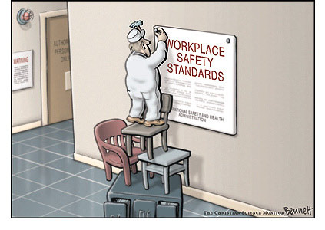
Section 3 Reporting Violations
Unit members are required to report safety concerns to one of the following
Supervisor
Districtwide Facilities and Safety Committee (DWFSC)
Campus Committee
The Director of Environmental Health & Safety

Slide 49
Hours, Workload, Class Size
Article XI - C

Slide 50
Section 5 Office Hours Overview
Requires approval
May be face-to-face or online
No more than 20% can be online
Minimum of
(1) 50 minute session; or
(2) 25 minute sessions
Must be scheduled when students are reasonably expected to be available AND may not be scheduled consecutively
Must be communicated to students on an updated syllabus or notice on the college’s learning management system (Canvas)
Location must be identified in collaboration with administration

Slide 51
Section 5 Office Hours Eligibility/Approval
Eligibility
Must teach at least 5 LHE for the District
Must complete and submit the request form by the 1st week of each semester to the Office of Vice President of Instruction
Approval
Determined by the Deans of the Office of Instruction with the Vice President of Instruction based on:
Demonstrated student need in a course which requires significant help outside of class
Significant chance of contributing to individual student success

Slide 52
Section 5 Office Hours Compensation
Time sheet must be submitted by the end of week 18
Office hours will be paid the next pay date after the end of the semester
Office hours will be paid at a rate of $30.00 per hour
Maximum Office Hours per Semester
10 office hours for the first year
12 office hours for the second year
14 office hours for the third year

Slide 53
Section 7 Part-Time Employment - Assignment
“Comparable Assignment” will be defined as:
To be as close as possible to a unit member’s average load over the previous three (3) like semesters (fall to fall or spring to spring) in which the unit member had load, not including summer

Slide 54
Section 7 Part-Time Employment Assignment
Unit members will establish re-hire preference in a department/discipline on a given campus based on the following:
First date of hire
The unit member’s hiring for a fifth semester
Service teaching at least six (6) sections OR working 864 hours in non-instructional positions
Breaks in service, performance during prior service, availability, and program needs

Slide 55
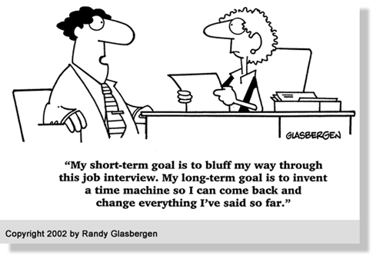
Section 8 Full-Time Employment Vacancy
The top two (2) highest ranked of all current unit members, based on the recommendation of the screening committee, will be invited to interview
“Current” means the unit member has an active assignment with the District during the academic year

Slide 56
Evaluation of Faculty
Article XII

Slide 57
Section 1 Evaluation of Faculty
Additional evaluation criteria added
“Demonstration of commitment to the profession (Code of Ethics)”
Specific criteria have been added for the following assignments:
Instructors
Counselors
Librarians
Nurses
Coaches
Coordinators

Slide 58
Section 1 Evaluation of Faculty
Unit members will be evaluated (at least) as follows:
Performance during their first semester
Performance during their second and/or third
Performance at least once every 6 semesters
More frequent evaluation may occur in the event job performance is less than acceptable as determined by the immediate supervisor
Specific evaluation process has been added for instructional faculty, counselors, librarians, nurses, coaches, and coordinators

Slide 59
Section 1 Evaluation of Faculty
Evaluation Committee
For the first semester, the committee shall consist of the immediate supervisor, or his/her designee, and/or a peer reviewer identified by the department chair
For the second and/or third semester, the committee shall consist of the immediate supervisor, or his/her designee excluded from the bargaining unit, and a peer reviewer identified by the department chair
Thereafter, the committee shall consist of the immediate supervisor, or his/her designee excluded from the bargaining unit, and/or a peer reviewer identified by the department chair

Slide 60
Leaves With Pay
Article XIV

Slide 61
Section 1A Sick Leave Provisions
Sick leave will accrue at the rate of 1 hour earned for each 18 hours of teaching, counseling, or librarian duties in fall and spring semesters and summer
A sick leave allotment credit equal to the unit members’ entitlement will be given each fall and spring semester

Slide 62
Section 1B Catastrophic Leave
Participation/Requirements
Participation is voluntarily
To participate:
Members must contribute 2 hours of sick leave during the first full month following the signing of the collective bargaining unit agreement; OR
Contribute 2 hours of sick leave during the 1st month of a unit member’s employment; OR
New participants may join the program annually in September
Eligibility of Use
Participating unit members must be qualified for re-hire preferences;
Exhausted his/her personal sick leave hours; AND
Been incapacitated or absent for more than 30 consecutive calendar days

Slide 63
Section 3 Bereavement Leave
May be granted without loss of salary, or other benefits
A leave of absence not to exceed 3 working days (5 working days if out-of-state travel is required) per occurrence due to death of his/her immediate family
An extension of Bereavement Leave may be requested by the unit member; without salary for the time covered by the extension
Except if it’s extended under Personal Necessity Leave

Slide 64
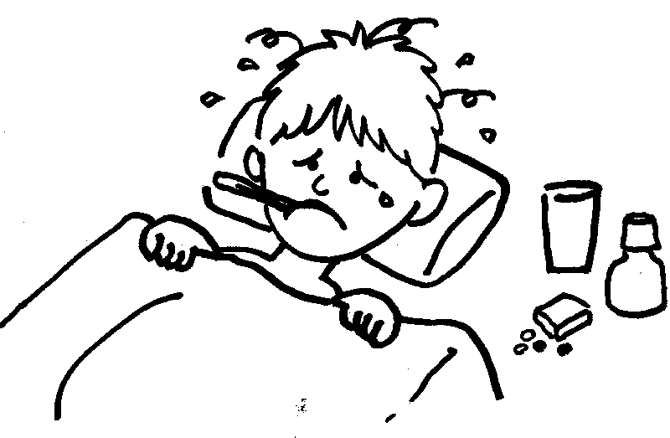
Section 5 Personal Necessity Charged to Sick Leave
Limited to no more than six days in one fiscal year
Two (Gone Fishing) of the six days may be granted for any reason deemed appropriate by the unit member AND with prior approval of the supervisor
No more than two unit members off at any one time in any work unit under this provision

Slide 65
Compensation
Article XVI

Slide 66
Section 1 Salary
The following COLA has been negotiated for
Lecture and Lab Salary Schedules for the 2018-19, 2019-20, and 2020-21 fiscal years
3.00% + 1.00% if COLA ≥ 2.50%
2.50% + 1.00 % if 2.00% ≤ COLA < 2.50%
2.00% + 1.00 % if 1.50% ≤ COLA < 2.00%
1.00% + 1.00 % if 1.00% ≤ COLA < 1.50%
0.75% + 1.00 % if COLA < 1.00%

Slide 67
Section 1 Salary
The following COLA has been negotiated for
Non-Instructional Salary Schedules for the 2018-19, 2019-20, and 2020-21 fiscal years
3.00% if COLA ≥ 2.50%
2.50% if 2.00% ≤ COLA < 2.50%
2.00% if 1.50% ≤ COLA < 2.00%
1.00% if 1.00% ≤ COLA < 1.50%
0.75% if COLA < 1.00%
NOTE: “COLA” means funded COLA

Slide 68
Section 1 Salary
New Class: Class VI for confirmed Doctorate or MFA
New Non-Instructional Salary Table
Part-time Faculty Salary Schedule C3 - Noninstructional
 | Class I | Class II | Class III | Class IV | Class V | Class VI*
Step 1N | $ 38.30 | $ 42.76 | $ 45.05 | $ 47.22 | $ 49.62 | $ 52.05
Step 2N | $ 38.64 | $ 43.16 | $ 45.48 | $ 47.70 | $ 50.08 | $ 52.51
Step 3N | $ 39.02 | $ 43.55 | $ 45.92 | $ 48.12 | $ 50.54 | $ 52.97
Step 4N | $ 39.42 | $ 44.00 | $ 46.39 | $ 48.62 | $ 51.04 | $ 53.47
Step 5N | $ 39.81 | $ 44.44 | $ 46.87 | $ 49.10 | $ 51.55 | $ 53.98
Step 6N | $ 40.21 | $ 44.89 | $ 47.34 | $ 49.59 | $ 52.07 | $ 54.50
Step 7N | $ 40.61 | $ 45.34 | $ 47.80 | $ 50.09 | $ 52.59 | $ 55.02
*Column VI reserved for individuals possessing a doctorate or an MFA

Slide 69
Section 4 Travel Off Campus/Mileage
Total round trip mileage – Round trip mileage from unit member’s home to primary campus
Total round trip is defined as the total mileage from the unit member’s home to the first campus, from the first campus to the second campus, and from the second campus to the unit member’s home
NOTE: Primary campus is defined as the campus where the majority of the load is scheduled, or in the case of non-majority, the campus where the unit member was hired

Slide 70
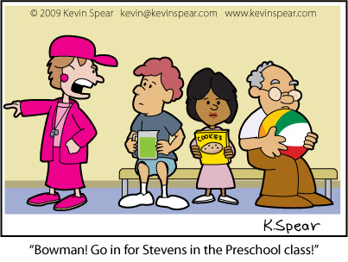
Section 9 Coaching Stipends
Effective July 1, 2018, Head Coaches will receive a stipend of 10% of the Column I, Step 1 annual salary on the full-time faculty salary schedule which equates to $5,565 for the 2018-19 academic year
Assistant coach assignments will receive a stipend of $3,200 only AND the stipend may not be split among coaches
No class assignment is guaranteed, but classes may be assigned by the Dean
The number of assistant coaches for each sport will be set by management

Slide 71
Section 10 Special Pay Rates
Orientation and/or Training: $25.00 per hour
Special Projects: Paid at the unit member’s Schedule C2 Lab Rate per hour
Must be mutually agreed upon by the unit member and management
Program Review Report: Paid at the unit member’s Schedule C2 Lab Rate per hour
For faculty who are asked to complete a program review report
Up to 10 hours only

Slide 72
Section 11 Patient Protection and Affordable Care Act
The District shall implement Affordable Care Act’s (ACA) Look Back Method to identify employees’ Hours of Service
The District shall calculate hours of service by crediting 1 hour of service for each hour of teaching (lecture and laboratory classes) plus an additional 1.25 hours of service for each hour teaching for preparation and grading

Slide 73
Section 12 Faculty Intern Program
All interns are considered temporary (part-time) faculty
Shall be assigned normally no more than one course/prep during the first semester and 67% of a full-time faculty assignment for subsequent semesters
Interns may only work at one college, except in rare instances
Other exceptions may be made by the Vice President of Instruction

Slide 74
Questions?

