Slide 1
Math College Readiness Forum Fall 2012

Slide 2
Goals of Math CRF
Communicating and Working together for:
Students who are “college-ready” when they start college.
Students placed in proper math level at RC.
Students succeeding at math!

Slide 3
Follow-Up from Last Year
“MyMathTest” pre-test developed
Gauges students’ math level
Compares to RC developmental math courses
Matches outcomes for RC developmental math courses
Four tests correspond to:
College Arithmetic
Prealgebra
Elementary Algebra
Intermediate Algebra
Student starts at beginning, must pass each test to advance to next.
Four high schools took part

Slide 4
MyMathTest PreTest
General Specifications:
4 tests; each test includes 14 questions; each test must be completed within a designated time (13-20 minutes).
Approximate time to complete all sections is 60 minutes if a student takes all 4 tests
Students can only take the Pre-Test one time.
Once a student has completed a test, the student can stop and restart by using the same username/password.

Slide 5
MyMathTest PreTest
Designed by RC Math Faculty, aligned with RC course SLO’s
All students start at the arithmetic level test.
If a student correctly answers 70% of the questions on a test, then that student proceeds to the next test.
Real time immediate scoring. Students see their test scores and question results immediately after completing the test.

Slide 6
MyMathTest PreTest
Different questions are generated for each individual test while testing the same content.
Example: 2 – (-18) and 3 – (-14)
Other benefits:
“Study Plan Manager”
provides math practice in areas in which student needs help;
improves awareness of college expectations for math competency.
Pre-test provides a clear recommendation on which Accuplacer placement math test to take.

Slide 7
MyMathTest PreTest
REEDLEY COLLEGE MATH PRE-TEST OUTCOME CHART
Test | Outcome & Accuplacer Test Recommendation
 | PASS | FAIL
1 | Move on to Test 2 | Take RC Accuplacer Arithmetic Test
2 | Move on to Test 3 | Take RC Accuplacer Arithmetic Test
3 | Move on to Test 4 | Take RC Accuplacer Algebra Test
4 | Take College Level Math Accuplacer Test | Take RC Accuplacer Algebra Test

Slide 8
REEDLEY COLLEGE MATH PRE-TEST CONTENT CHART
Test | Content Tested | HS Course Equivalency (in relation to test) | RC Course Equivalency (in relation to test) | RC COURSE SLO's
1 | Arithmetic | Arithmetic | Math 250: College Arithmetic | A. | Apply the four arithmetic operations to integers.
 |  |  |  | B. | Apply the four arithmetic operations to fractions.
 |  |  |  | C. | Apply the four arithmetic operations to decimals.
 |  |  |  | D. | Evaluate integers raised to whole number exponents using the definition of exponents.
2 | Arithmetic/ Pre- Algebra | Pre-Algebra | Math 256: Topics before Algebra | A. | Apply the order of operations and rules of exponents to integers.
 |  |  |  | B. | Simplify and evaluate algebraic expressions.
 |  |  |  | C. | Apply the addition and multiplication properties of equality to solve linear equations in one variable.
 |  |  |  | D. | Factor out the greatest common factor in an algebraic expression.
 |  |  |  | E. | Generate a table of solutions and graph its ordered pairs for linear equations and inequalities.

Slide 9
REEDLEY COLLEGE MATH PRE-TEST CONTENT CHART
Test | Content Tested | HS Course Equivalency (in relation to test) | RC Course Equivalency (in relation to test) | RC COURSE SLO's
3 | Elementary Algebra | Algebra 1 | Math 201: Elementary Algebra | A. | Apply real number operations to simplify and factor algebraic expressions.
 |  |  |  | B. | Solve linear and quadratic equations.
 |  |  |  | C. | Use graphic representation of an equation in two variables to solve appropriate problems.
4 | Intermediate Algebra | Algebra 2 | Math 103: Intermediate Algebra | A. | Simplify and/or factor mathematical expressions into forms more conducive to analysis.
 |  |  |  | B. | Solve equations introduced in Intermediate Algebra (linear, quadratic, exponential, logarithmic, and radical).
 |  |  |  | C. | Graph functions and relations introduced in Intermediate Algebra (linear, quadratic, exponential, logarithmic, and radical).
 |  |  |  | D. | Apply Intermediate Algebra topics (linear, quadratic, exponential, logarithmic, and radical functions) to solve real-life problems.

Slide 10
Last Year’s Results
Total Number of Students taking Math Pre-Test: 682
# of Students Passing Test #1 257
(and proceeding to Test #2):
# of Students Passing Test #2 146
(and proceeding to Test #3):
# of Students Passing Test #3 33
(and proceeding to Test #4):
# of Students Passing Test #4: 8

Slide 11
Last Year’s Results – Test #1
# |  |  |  | Objective | Correct |  | Fraction
1 |  | Subtract real numbers |  |  | 468 |  | 0.69
2 |  | Multiply real numbers. |  |  | 640 |  | 0.94
3 |  | Divide real numbers. |  |  | 551 |  | 0.81
4 |  | Multiply with fractions. |  |  | 256 |  | 0.38
5 |  | Divide fractions. |  |  | 206 |  | 0.3
6 |  | Add unlike fractions. |  |  | 367 |  | 0.54
7 |  | Subtract unlike fractions. |  |  | 314 |  | 0.46
8 |  | Add or subtract decimals. |  |  | 563 |  | 0.83
9 |  | Add or subtract decimals. |  |  | 365 |  | 0.54
10 |  | Multiply decimals. |  |  | 404 |  | 0.59
11 |  | Divide decimals. |  |  | 230 |  | 0.34
12 |  | Evaluate exponential expressions. |  |  | 558 |  | 0.82
13 |  | Use the order of operations. |  |  | 251 |  | 0.37
14 |  | Use the order of operations. |  |  | 315 |  | 0.46

Slide 12
Last Year’s Results – Test #2
# |  |  |  | Objective | Correct |  | Fraction
1 |  | Use the order of operations. |  |  | 208 |  | 0.8062
2 |  | Use the order of operations. |  |  | 153 |  | 0.593
3 |  | Use the order of operations. |  |  | 201 |  | 0.7791
4 |  | Simplify expressions by combining terms. |  |  | 147 |  | 0.5698
5 |  | Simplify expressions by combining terms. |  |  | 103 |  | 0.3992
6 |  | Evaluate algebraic expressions. |  |  | 251 |  | 0.9729
7 |  | Evaluate algebraic expressions. |  |  | 231 |  | 0.8953
8 |  | Solve equations using the addition property. |  |  | 214 |  | 0.8295
9 |  | Use the multiplication property of equality. |  |  | 224 |  | 0.8682
10 |  | Solve linear equations. |  |  | 232 |  | 0.8992
11 |  | Factor out the greatest common factor. |  |  | 78 |  | 0.3023
12 |  | Factor out the greatest common factor. |  |  | 115 |  | 0.4457
13 |  | Complete ordered pairs. |  |  | 172 |  | 0.6667
14 |  | Complete ordered pairs. |  |  | 165 |  | 0.6395

Slide 13
Last Year’s Results – Test #3
# |  |  |  | Objective | Correct |  | Fraction
1 |  | Factor a difference of squares. |  |  | 70 |  | 0.479452
2 |  | Simplify expressions. |  |  | 109 |  | 0.746575
3 |  | Simplify expressions. |  |  | 92 |  | 0.630137
4 |  | Solve linear equations. |  |  | 122 |  | 0.835616
5 |  | Solve linear equations. |  |  | 80 |  | 0.547945
6 |  | Solve quadratic equations by factoring. |  |  | 60 |  | 0.410959
7 |  | Solve quadratic equations by factoring. |  |  | 49 |  | 0.335616
8 |  | Graph linear equations. |  |  | 58 |  | 0.39726
9 |  | Write equations of lines, given slope and y-intercept. |  |  | 27 |  | 0.184932
10 |  | Multiply two polynomials. |  |  | 105 |  | 0.719178
11 |  | Use a combination of rules for exponents. |  |  | 81 |  | 0.554795
12 |  | Use the quotient rule to simplify. |  |  | 72 |  | 0.493151

Slide 14
Last Year’s Results – Test #4
# |  |  |  | Objective | Correct |  | Fraction
1 |  | Factor trinomials with a coefficient of 1 for the squared term. |  |  | 23 |  | 0.69697
2 |  | Factor trinomials using FOIL. |  |  | 16 |  | 0.484848
3 |  | Solve linear equations. |  |  | 17 |  | 0.515152
4 |  | Solve quadratic equations by factoring. |  |  | 7 |  | 0.212121
5 |  | Use the quadratic formula to solve equations. |  |  | 7 |  | 0.212121
6 |  | Solve radical equations. |  |  | 25 |  | 0.757576
7 |  | Use the definition of a logarithm to solve logarithmic equations. |  |  | 18 |  | 0.545455
8 |  | Graph linear functions. |  |  | 25 |  | 0.757576
9 |  | Graph quadratic equations. |  |  | 6 |  | 0.181818
10 |  | Graph exponential functions. |  |  | 24 |  | 0.727273
11 |  | Solve problems about geometric figures. |  |  | 18 |  | 0.545455
12 |  | Solve problems about consecutive integers. |  |  | 16 |  | 0.484848

Slide 15
Some Problems
Students entering answers in incorrect format.
e.g. Typing “x=3” when only “3” was required.
Possible other difficulties with entering answers into computer system
(graphing, math formatting)
Students not prepared to take a math test?

Slide 16
Modifications for this year
Wording on certain questions was modified to be more clear how to type in answer.
Changed problems so that graphing tool and math type editor are not required.
All tests have 14 problems to be consistent. (10 out of 14 required to pass.)

Slide 17
Section Instructors at each School
Once registered, staff at each high school can be defined as “Section Instructors”
Can see test results
Can reset tests if there are technical issues

Slide 18
Demonstration

Slide 19
Interested?
Any comments or suggestions?

Slide 20
How to Get Registered and Started!

Slide 21
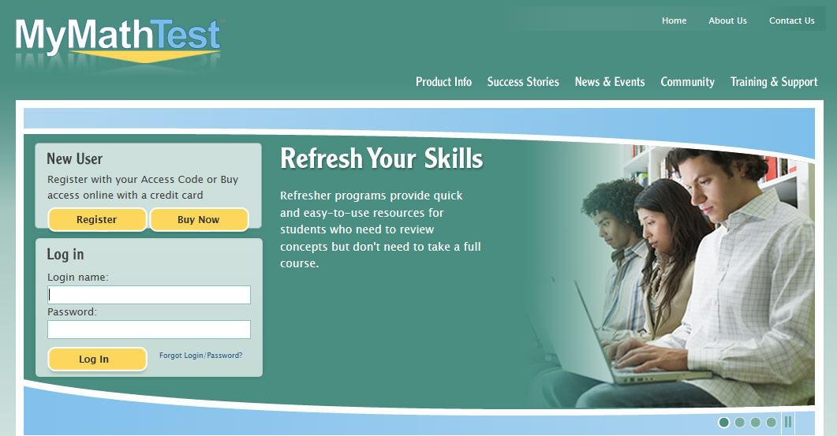
Go to www.mymathtest.com
Select Register.

Slide 22
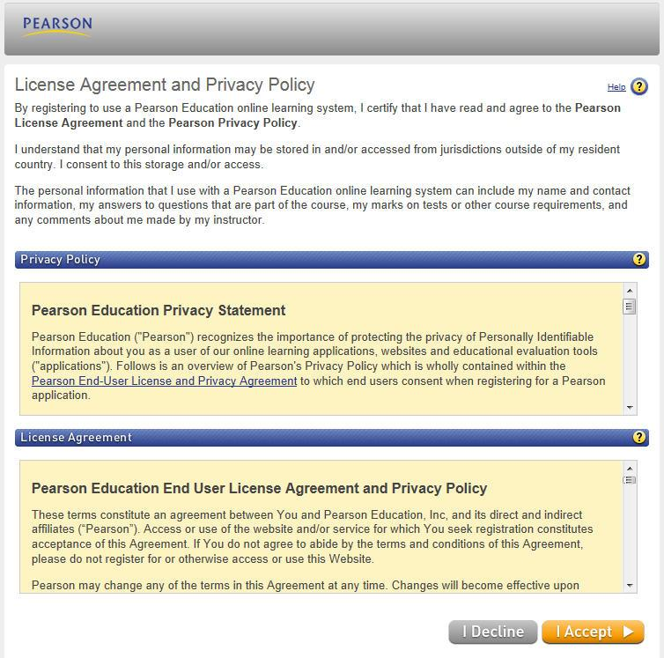
3. On the LICENSE AGREEMENT -Select I Accept.

Slide 23
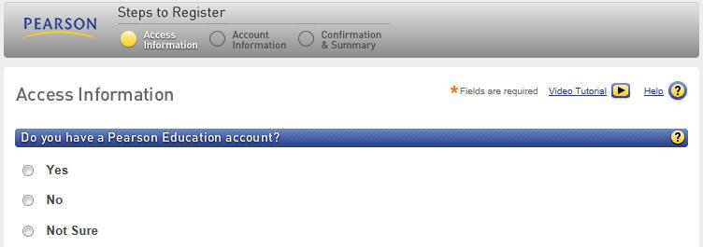
4. On the ACCESS INFORMATION Screen-Select No.

Slide 24
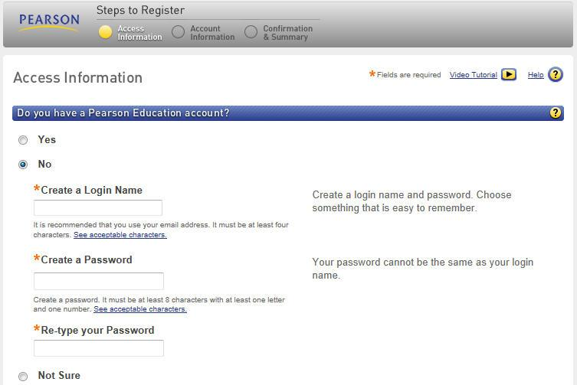
5. Under Create a Login Name type your Reedley College Student ID # & then type/re-type your last name for the password.

Slide 25
6. Enter the Access Code provided to your High School and Click Next.
ACCESS CODE:
ON FORM

Slide 26
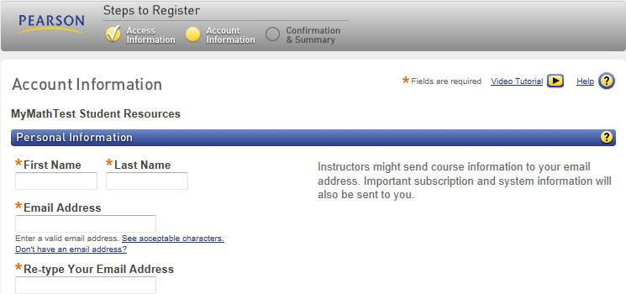
7. On the ACCOUNT INFORMATION Screen-complete the following directions:
In First Name Box, enter your first name only. (Example: Clyde)
In Last Name Box, enter your Reedley College student ID, underscore and your last name. (Example: 0123456_Tigre)
In Email Address Box, enter your free SCCCD email. (Example: tigre_0123456@my.scccd.edu)

Slide 27
7. On the ACCOUNT INFORMATION Screen-complete the following directions:
In School Country Box, enter “United States”.
In School Zip Box, enter “93654”.
In School Name Box, select “REEDLEY CLG”.

Slide 28
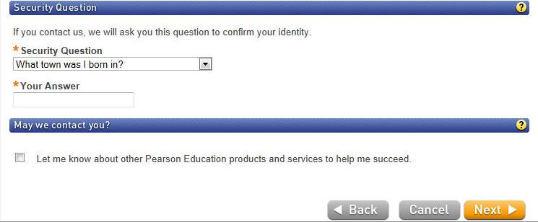
7. On the ACCOUNT INFORMATION Screen-complete the following directions:
In Security Question Box, select “What town were you born in”.
In Your Answer Box, enter the town you were born in and Click Next.

Slide 29
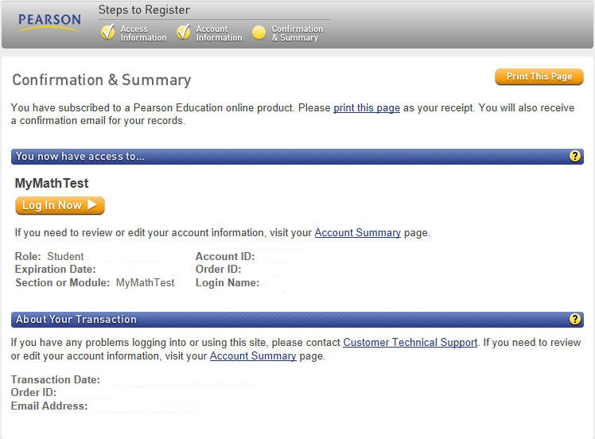
8. On the CONFIRMATION & SUMMRY Screen review all your information and then Click Log In Now.

Slide 30
9. On the Welcome Screen, select Enter MyMathTest.

Slide 31
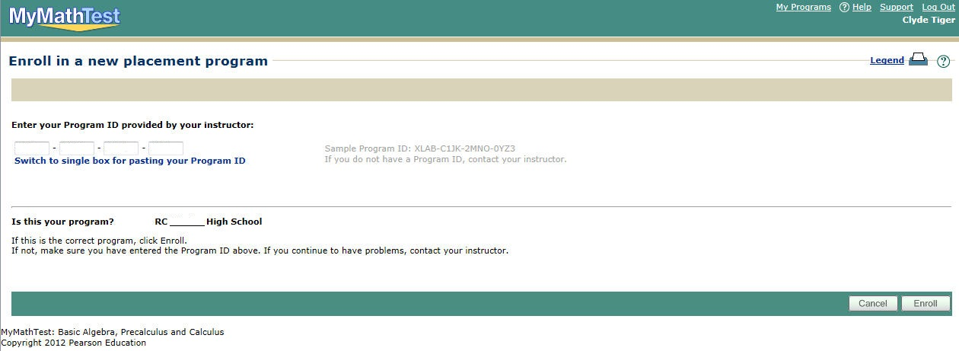
10. On the Enrollment Screen enter the Program ID provided to your High School, review the program that pops-up states your high school, and Click Enroll.
PROGRAM ID: ON FORM

Slide 32
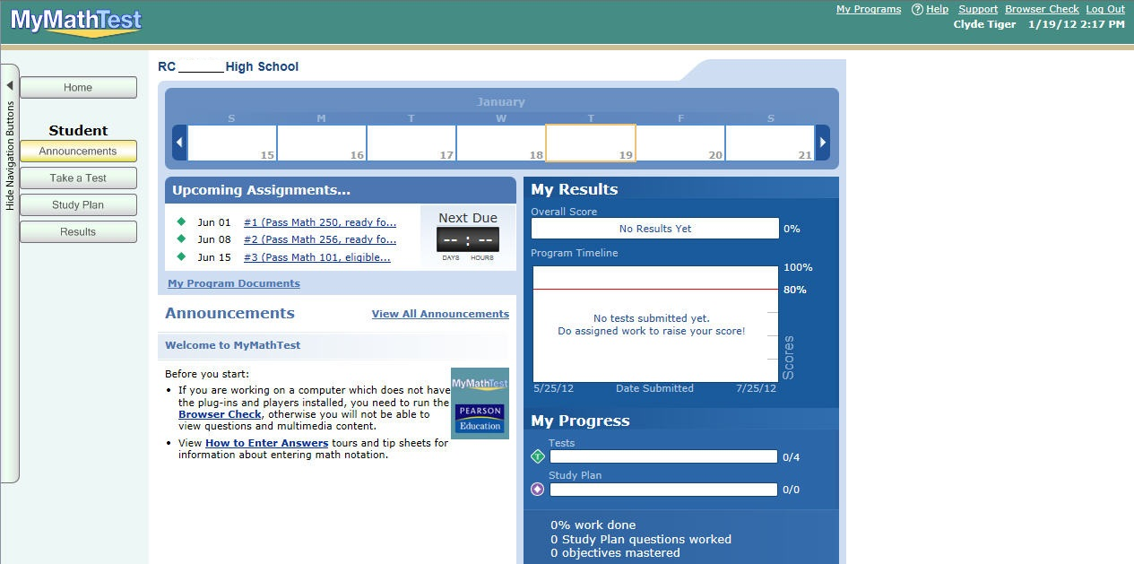
11. Once on the website, select Take a Test.

Slide 33
12. If there is time, try the “Short Practice Test” to learn how the test works.
When ready, select “Test #1 2012-2013”

Slide 34
13. Finally select I am ready to start.
14. Begin Math Pre-Test: Test #1.

Slide 35
MATH PRE-TEST DIRECTIONS:
Only use scratch paper and pencil.
No calculator assistance may be used.
Make sure to Click NEXT to proceed to the next question. If by error you Click SUBMIT, prior to completing the test make sure to answer no when it asks are you sure you want to quit.
Once completed with the test you must Click SUBMIT
Once you have completed as many tests as possible Click RESULTS and you can review your test results and receive your Reedley College (RC) Accuplacer test recommendation.

