Slide 1
Town Hall
LEADERSHIP

Slide 2
Examples of LEADERSHIP
Accreditation response to RC recommendations # 1, 2, and 3
Strategic Planning Workshop, survey and Charrettes
College Council functions, MC/OC integration and committee reporting
Draft Participatory Governance Handbook
Reedley College Budget Committee recommendation tied to Strategic Planning
Research Agenda tied to Strategic Planning

Slide 3
General Timeline for Reedley College President Search
Immediately this fall - recruit and advertise
Late fall – selection committee formed
Early February (approx.) – position closes and paper screening
Late February (approx.) – finalists selected
March (approx.) – interviews/forums, etc.
July 1 start

Slide 4
Current Reedley College Leadership at the Madera Center
Monday | Tuesday | Wednesday | Thursday | Friday
 |  |  | 1 | 2
 |  |  | Michael White – AM | Marcy Davidson
5 | 6 | 7 | 8 | 9
Jan Dekker | Donna Berry | Michael White Jim Chin | Jim Chin | Chris Cortes Marcy Davidson
12 | 13 | 14 | 15 | 16
Mario Gonzales | Donna Berry | David Clark Jim Chin | David Clark Jim Chin | Marcy Davidson
19 | 20 | 21 | 22 | 23
John Fitzer | Donna Berry | Jim Chin | Holiday | Holiday
26 | 27 | 28 | 29 | 30
Jan Dekker | Donna Berry | David Clark Jim Chin | Michael White | Mario Gonzales Marcy Davidson

Slide 5
Madera Center Administrative Leadership Structure
Dean Cuevas “site administrator in charge” for the months of November and December.
Dr. Jim Chin to return as Dean of Instruction at MC and Monica Cuevas will return to Dean of Student Services
Continued evaluation and re-alignment of administrative responsibilities at the Madera Center
ELC
PT Business Manager?

Slide 6
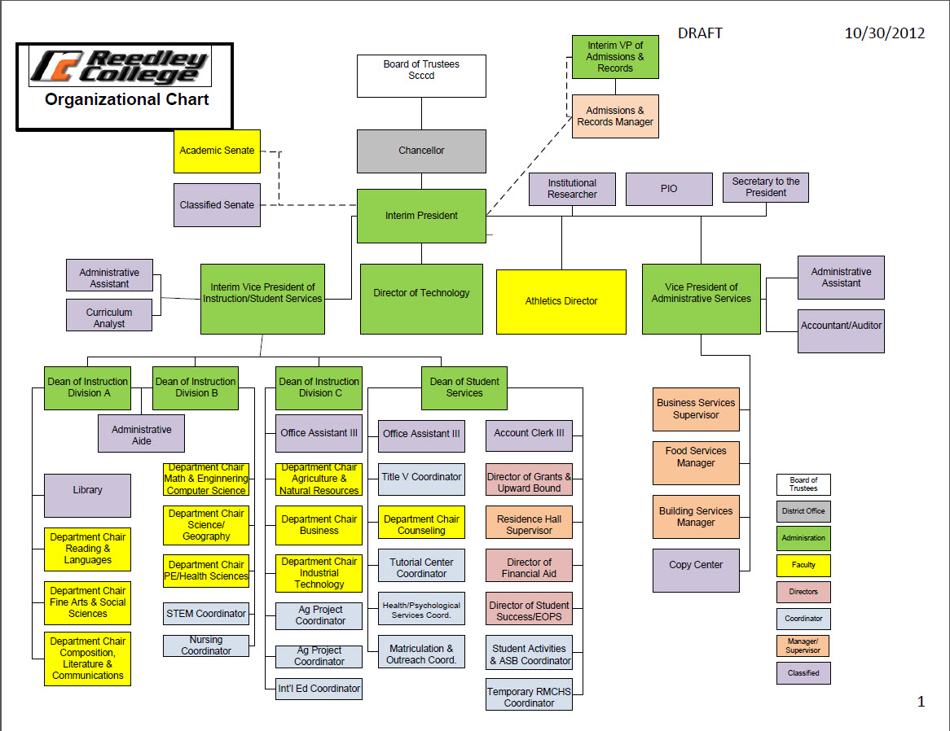
Current Organizational Chart
Reedley College

Slide 7
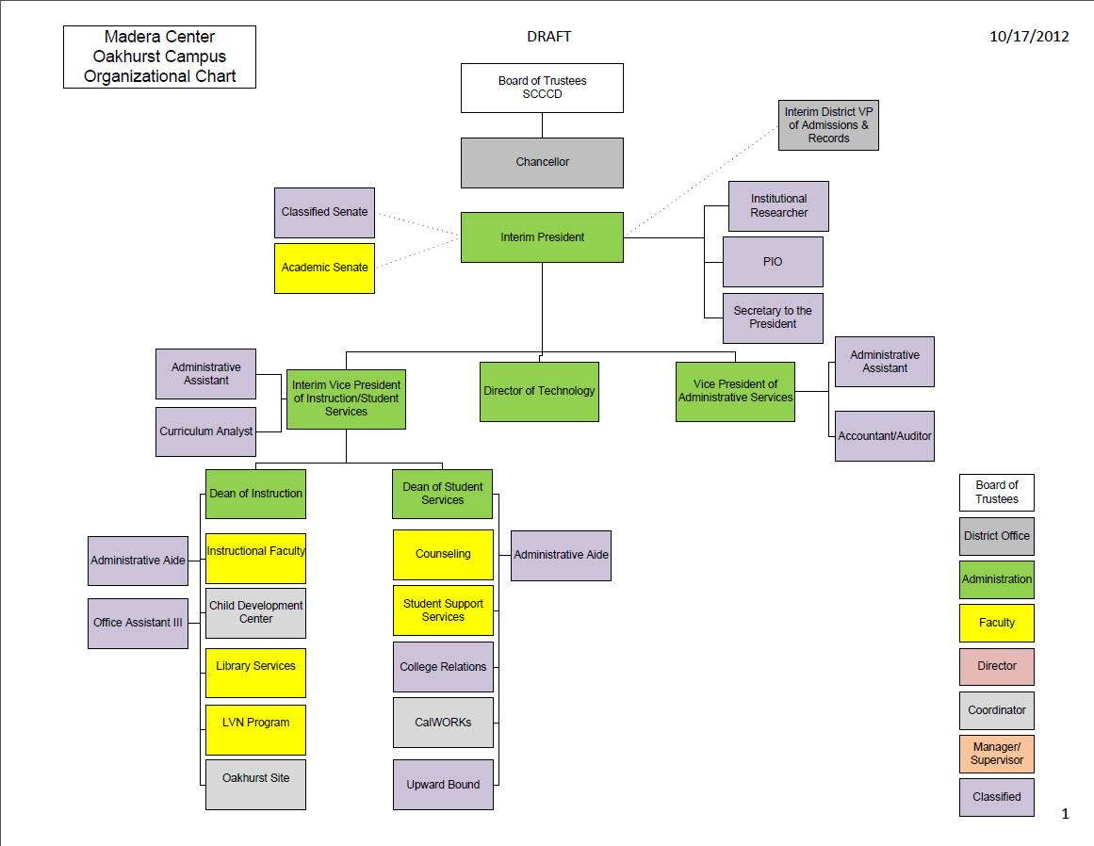
Current Organizational Chart
Madera Center and
Oakhurst Site

Slide 8
What will Drive our Leadership Decisions: Student Success Task Force Recommendations
8 areas of focus and 22 recommendations
1) Increase college and career readiness
2) Strengthen support for entering students
3) Incentivize successful student behaviors
4) Align course offerings to meet student needs
5 )Improve education of basic skills students
6) Revitalize and re-envision professional development
7) Enable efficient statewide leadership and increase coordination among colleges
8) Align resources with student success recommendations

Slide 9
What will Drive our Leadership Decisions: Achieving the Dream
Success is defined by the rates at which students:
Successfully complete remedial or developmental instruction and advance to credit-bearing courses
Enroll in and successfully complete the initial college-level or gateway courses in subjects such as math and English
Complete the courses they take with a grade of "C" or better
Persistence from one term to the next
Attain a certificate or degree

Slide 10
?
Questions/Comments/Open Forum

