Slide 1
2008-2012 Updated Strategic Plan
Presented to Reedley College
Fall Classified Assembly Marilyn Behringer
September 28, 2011

Slide 2
District Strategic Planning Workgroup
Dr. Marilyn Behringer (RC)
Dr. Jothany Blackwood (DO)
Diane Clerou (DO)
Linda Cooley (RC)
Trustee Christopher Coronado 2011-12
Dr. Claudia Habib (FCC)
Veronica Jury (NC)
Dr. Tom Mester (NC)
Dr. Mark Sanchez (FCC)
Robin Torres (DO)
Notes:
Jothany Blackwood
Diane Clerou (DO)
Mark Sanchez (FCC)
Marilyn Behringer (RC)
Robin Torres (DO)
Veronica Jury (RC)
Claudia Habib (FCC)
Linda Cooley (RC)
Tom Mester (NC)
Daniel Gay

Slide 3
ACCJC Standard I B.3
Improving Institutional Effectiveness
requires institutions to “assess progress
toward achieving stated goals and make
decisions regarding the improvement of
institutional effectiveness in an ongoing and
systematic cycle of evaluation, integrated
planning, resource allocation,
implementation and re-evaluation.”

Slide 4
ACCJC Standard I B.3
Both colleges received a recommendation in this area in the 2006 Accreditation visit
The district has developed a planning calendar aligning the colleges and centers’ strategic plans with that of the District's
Resolves recommendation from accreditation
Identifies a timeline for the development of the district’s next Strategic Plan from 2012-2016
Identifies a timeline for the colleges and centers’ strategic plans from 2013-2017
Notes:
ACCJC Standard I B. 3. – Improving Institutional Effectiveness requires institutions to “assess progress toward achieving stated goals and make decisions regarding the improvement of institutional effectiveness in an ongoing and systematic cycle of evaluation, integrated planning, resource allocation, implementation and re-evaluation.”
Both colleges received a recommendation in this area in he 2006 Accreditation visit.
In response to the recommendation, the district has developed a planning calendar that aligns the colleges and centers’ strategic plans with the District's strategic plan. Outcomes were:
Resolves recommendation from accreditation
Identifies a timeline for the development of the district’s next Strategic Plan from 2012-2016
Identifies a timeline for the colleges and centers’ strategic plans from 2013-2017.

Slide 5
2008-2012 Updated Strategic Plan Background
Approved by Board of Trustees on January 11, 2008
Scope: Minor update of goals and objectives to bring the planning activities in the district current
Timeline: February - May 2011
Strategic issues beyond the current scope and timeline were placed in the “issue bin” to be discussed during development of the 2012 strategic plan
The Strategic Plan update and the recommended timeline were presented to the Board of Trustees in June 2011 and approved in July
Notes:
Approved by Board of Trustees on January 11, 2008.
Scope: Minor update of goals and objectives to bring the planning activities in the district current with review and comment process rather than approval process.
Timeline: Project began February 2011 and concluded in May.
Strategic issues that required “vetting” beyond scope and timeline are reserved in “issue bin” to be discussed during development of the 2012 strategic plan.
The Strategic Plan update and the recommended timeline was presented to the Board of Trustees in June and approved in July 2011.

Slide 6
2008-2012 Updated Strategic Plan Background
The updated Strategic Plan is grounded in:
Current trends and demographic data
Internal survey results
Consultation with College Brain Trust (CBT)
Consultation with a District-wide Planning Workgroup and constituency group representatives
Updated goals and objectives to meet the educational needs of students
The Update does not include any major revisions to the District’s vision, mission and values. Minor revisions were supported by trend data and an internal survey
Notes:
The updated Strategic Plan is grounded in:
Current trends and demographic data
Internal survey results
Consultation with College Brain Trust (CBT)
Consultation with a District-wide Planning Workgroup with representatives from FCC, NC, RC, and DO including faculty, staff, students and administrators
Updated goals and objectives to meet the educational needs of students
The Update does not include any major revisions to the District’s vision, mission and values. Minor revisions supported by trend data and an internal survey.

Slide 7
Evaluation of 2008-2012 Strategic Plan
The colleges and centers reported on how they met the goals and objectives of the 2008 Updated Strategic Plan
A comprehensive report of the evaluation of the 2008-2011 Updated Strategic Plan will be presented to the Board in October 2011.
Notes:
The colleges and centers reported on how they met the goals and objectives of the 2008 Updated Strategic Plan by September 9, 2011.
A comprehensive report of the evaluation of the 2008-2011 Updated Strategic Plan will be presented to the Board in October 2011.

Slide 8
District Planning Calendar
July 2011 Recommended Board approval of timeline and update of Strategic Plan
Sept 2011 Colleges will report progress
Aug-Dec 2011 Preparation for development of 2012-2016
Oct. 2011 Report to Board on accomplishment of goals for 2008-2011 Strategic Plan
Feb. 2012 Charette and survey
April 2012 1st draft of 2012-2016 Strategic Plan
May 2012 Final draft of plan

Slide 9
District Planning Calendar
June 2012 Board approval of Strategic Plan for District
July 2012 Implementation of 2012-2016 Strategic Plan
Aug-Jan 2012 Annual Scan
March 2013 Summary of scan, report of progress and minor revisions to the Board
June 2013 Annual Report to the Board
This cycle will repeat annually in 2014, 2015, and 2016 will include a comprehensive assessment, charette and full revision process for the development of the 2016-2020 strategic plan

Slide 10
Colleges and Centers’ Planning Calendar
June 2012 District Strategic Plan is approved by the Board
Aug-Jan 2013 Preparation for development of 2013-2017 Strategic Plan. Colleges and Centers will develop strategic plans that include the District Strategic Plan goals
Feb 2013 Charette and survey
March 2013 1st Draft presented to constituency groups
May 2013 Final draft

Slide 11
Colleges and Centers’ Planning Calendar
June 2013 Board presentation of Strategic Plan for each college and center
July 2013 Implementation of Colleges and Centers Strategic Plans
Aug-Jan 2014 Annual Scan
March 2014 Summary of scan, report of progress and minor revisions to College Council
May 2014 Reports to constituency groups and College Council
This cycle will repeat annually in 2015, 2016, and 2017 and will include a comprehensive assessment, charette and full revision process for the development of the 2017-2021 strategic plan

Slide 12
Resources
Intranet : http://intranet.scccd.net/
Folder for Strategic Plan Update Includes:
Agendas
Minutes
Planning documents
Chancellor’s Office http://www.scccd.edu/
- For additional information
Notes:
Under “Quick Links”
Intranet folder for Strategic Plan Update documents: http://intranet.scccd.net/
Includes:
Agendas
Minutes from Strategic Planning Workgroup meetings, and planning documents

Slide 13
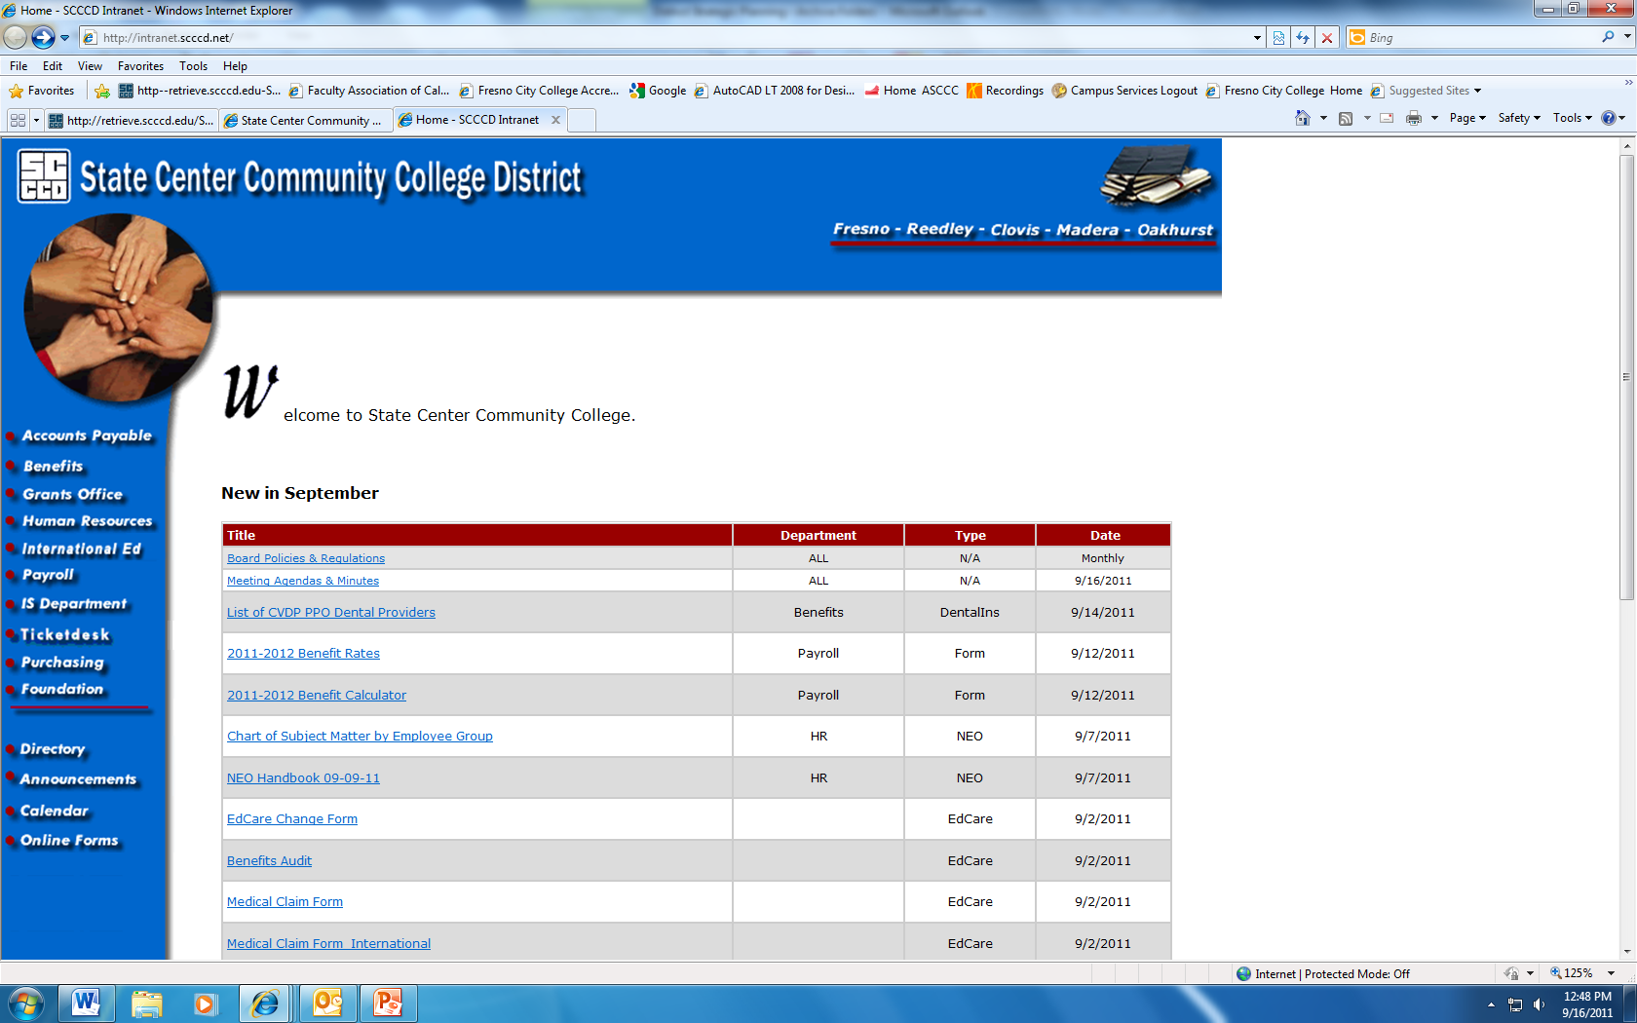
Notes:
In case you are not familiar with the Intranet

Slide 14
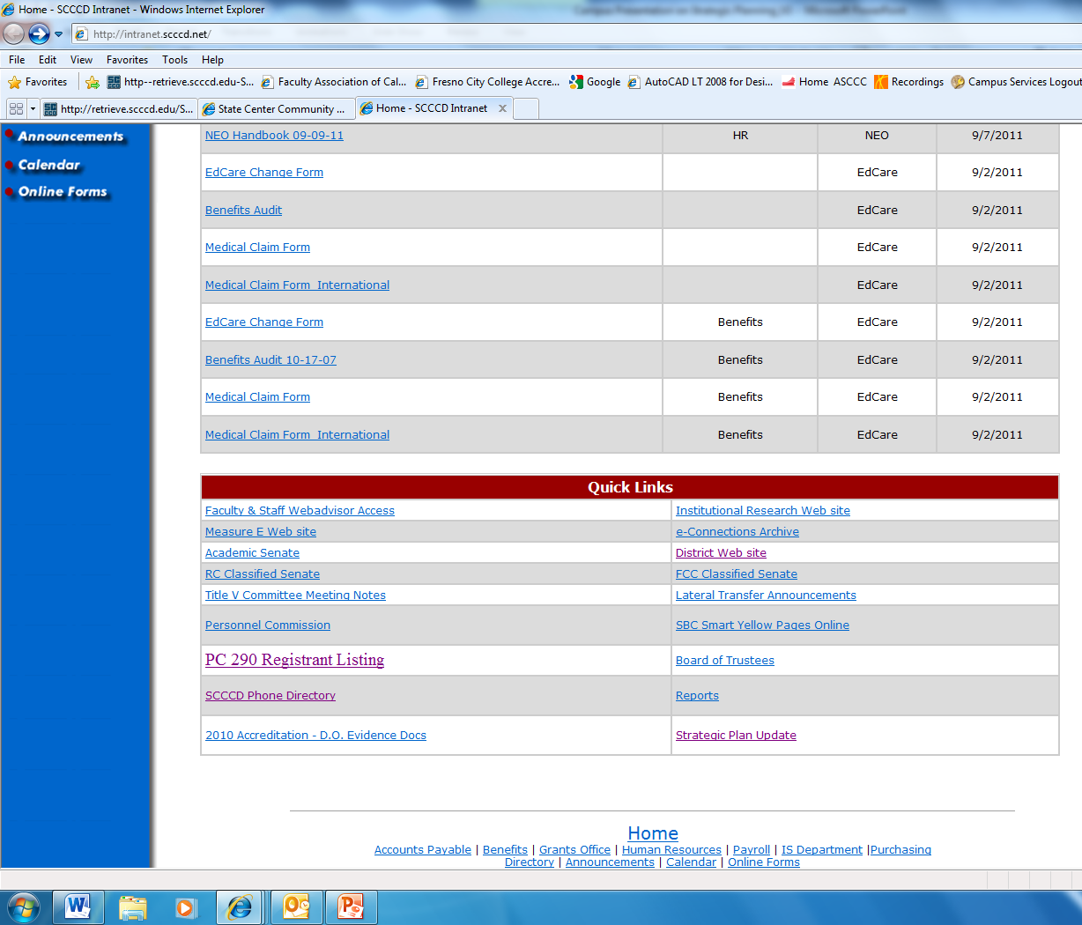
Notes:
Scroll to the bottom of the page for the link

Slide 15
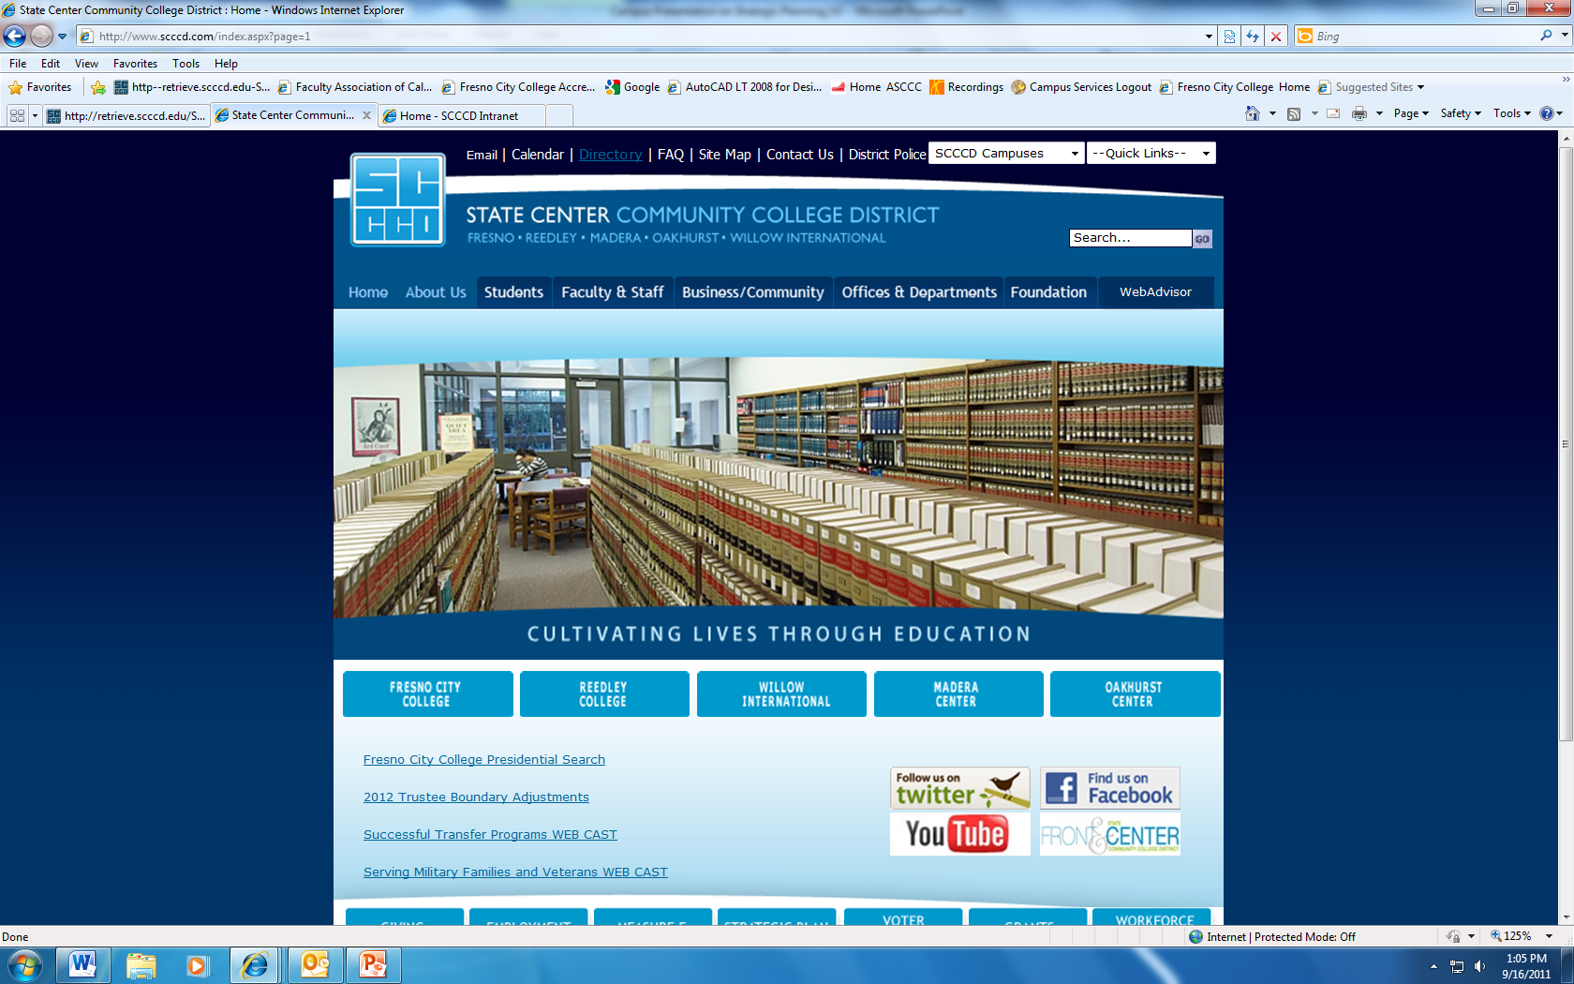

Slide 17
Questions & Answers

