Slide 1
Reedley College Health Services
Need help or have a question about your health?
Find us at…
Student Services Building
Monday – Friday
8:00 a.m. to 5:00 p.m.
559-638-0328, Extension 3328

Slide 2
Services provided include:
Physical Assessments
Personal Health Counseling
Emergency First Aid
Hearing & Vision Screening
TB Skin Testing & Flu Shots
Referral to Local Clinics
Psychological Services & Counseling

Slide 3
Health Services Staff Members
Patricia Jackson PHN, MSN, PNP
Dr. Brian Olowude, Ph.D
Dr. Gareth Houghton, Ph.D
Michelle Detsch, Psychological Intern
Ian Wallace, Psychological Intern
Stan Hutchinson, Psychological Intern
Paula Ramos, Department Secretary

Slide 4
Injuries
For on-campus injuries, please report
to Health Services for first aid
treatment and referral to Health
Care Provider as needed.
For home-injuries, assessment
and minor first aid is available.
For emergencies, call 7-8201

Slide 5
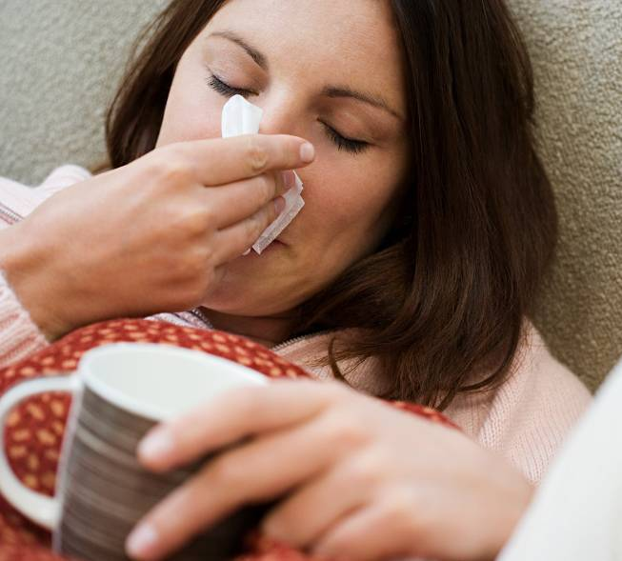
May is National
Allergy Month
You may have allergies, if you notice you have…
Watery, Itchy Eyes
Watery, Itchy Nose
Frequent Sneezing
Chronic Dry Cough
Sinus headache
Frequent Nosebleeds
Difficulty Hearing

Slide 6
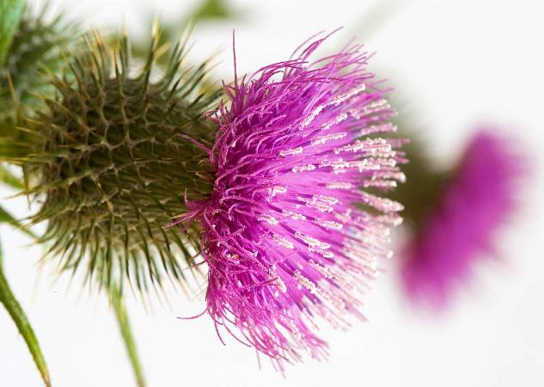


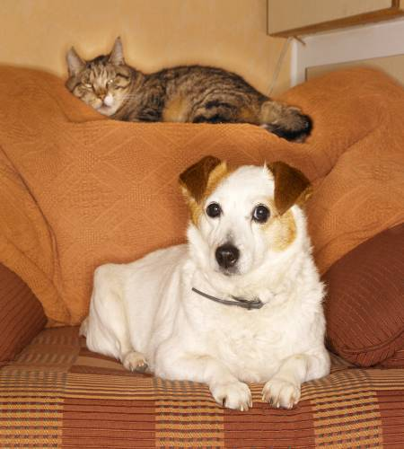
What Causes Allergies?

Slide 7
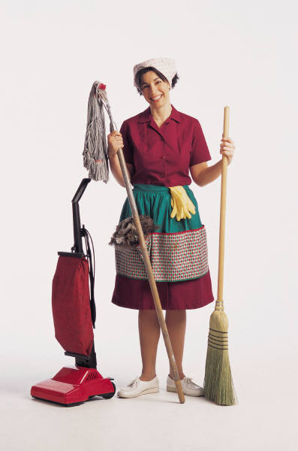
How to Prevent Allergies
Clean your home and furniture frequently.
Keep pets out of the bedroom.
Wash bed linens frequently.
Keep windows closed.
Take an evening shower.

Slide 8


How to Treat Allergies
Identify your allergens and AVOID THEM.
Drink plenty of clear fluids to thin mucous.
Take ibuprofen for headache and to reduce swelling.
Use nasal irrigation with the neti pot or other irrigation device.
Try over-the-counter Antihistamines during your allergy season.
  Benadryl
  Chlor-Trimeton
  Tavist
  Claritin
  Zyrtec
  Ocu-Hist (eye drops)
Try over-the-counter Decongestants if you have nasal congestion.
  Sudafed
  Contac

Slide 9
May is National Stroke
Awareness Month
You may be witnessing a stroke if you notice you or an acquaintance develops sudden:
numbness or weakness of the face, arm or leg, especially on one side of the body,
confusion, trouble speaking or understanding,
severe headache with no known cause,
trouble walking, dizziness, loss of balance or coordination,
trouble seeing in one or both eyes.

Slide 10

Know Your Risk Factors for Stroke
1. Know your blood pressure. If high, work with your doctor to lower it.
2. Find out from your doctor if you have a heart murmur.
3. If you smoke, stop.
4. If you drink alcohol, do so in moderation.
5. Find out if you have high cholesterol. If so, work with your doctor to control it.
6. If you are diabetic, follow your doctor's recommendations carefully to control your diabetes.
7. Include exercise in the activities you enjoy in your daily routine.
8. Enjoy a lower sodium (salt), lower fat diet.
9. “Ask your doctor” how you can lower your
risk of stroke.

Slide 11
STROKE RISK SCORECARD
Risk Factor | High Risk | Caution | Low Risk
Blood Pressure | >140/90 | 120-139/80-89 | <120/80
Cholesterol | >240 | 200-239 | <200
Diabetes | Yes | Borderline | No
Smoking | I still smoke | I’m trying to quit | Non-smoker
Diet | Obese | Overweight | Healthy Weight
Exercise | Rarely | Sometimes | Regularly
Family History | Yes | Not sure | No

Slide 12
May is National High Blood
Pressure Awareness Month
Into which category do you fit?
Category | Systolic |  | Diastolic
Normal | Less than 120 | and | Less than 80
Pre-hypertensive | 120-139 | or | 80-89
High Blood Pressure Stage 1 Stage 2 | 140-159 160 or higher | or or | 90-99 100 or higher

Slide 13
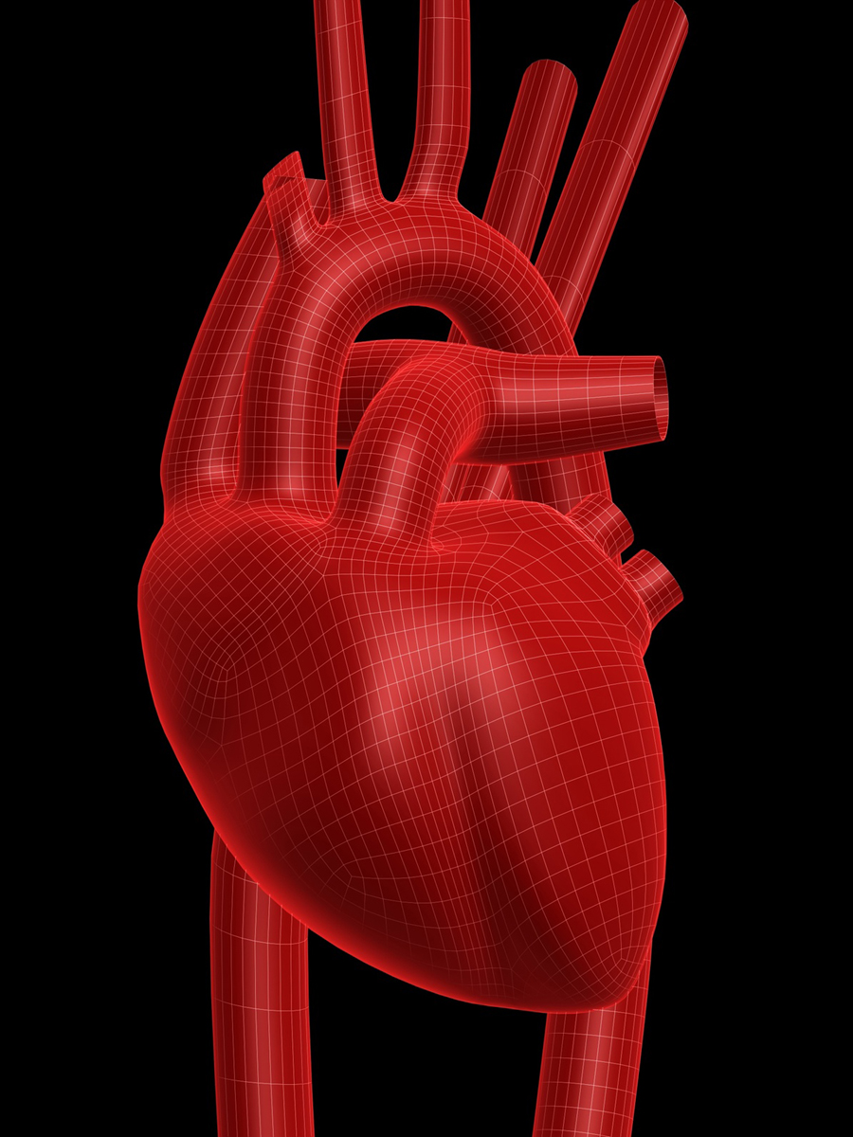
BLOOD PRESSURE
What is blood pressure?
Imagine that your arteries are pipes that carry blood from your heart to the rest of your body. High blood pressure (also called hypertension) occurs when your blood moves through your arteries at a higher pressure than normal.

Slide 14
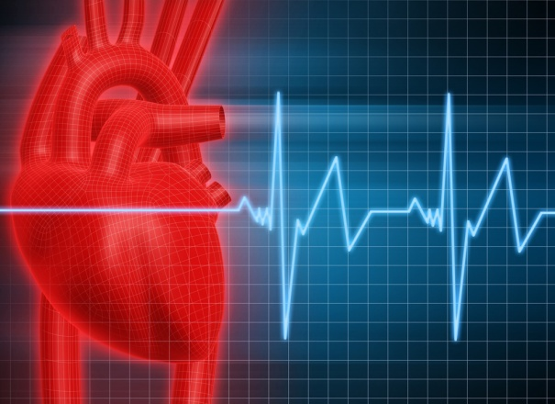
BLOOD PRESSURE……………
What do the numbers mean?
    Blood pressure is really two measurements, separated by a slash when written down, such as 120/80. You may also may hear someone say a blood pressure is “120 over 80.”
    The first number is the systolic blood pressure- peak pressure when your heart is squeezing the blood out. The second number is the diastolic – when your heart is filling with blood..relaxing between beats.
    Normal blood pressure is 120/70 or lower.

Slide 15
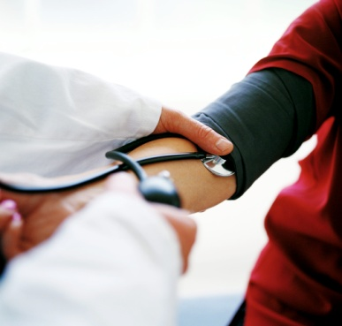
Blood Pressure
How is blood pressure diagnosed?
Blood pressure is measured by putting
a blood pressure cuff around your arm,
inflating the cuff and listening for the
flow of blood. Your doctor/nurse
practitioner/physician assistant will
measure your blood pressure at more
than one visit to see if you have
high blood pressure.

Slide 16
Blood Pressure
What problems do high Blood Pressure cause?
High blood pressure damages your blood vessels thus, increasing your risk for:
Stroke
Kidney failure
Heart disease
Heart attack

Slide 17
Blood Pressure …
How is high blood pressure treated?
LIFESTYLE CHANGES
Don’t smoke cigarettes or use any tobacco.
Lose weight if you are overweight.
Exercise regularly.
Healthy low-fat diet, full of fresh fruits and
vegetables.
Limit salt, caffeine and alcohol intake.
Relax! Reduce your stress with relaxation
techniques.
Lifestyle change, if these changes don’t work you may
also need a prescription medication.

Slide 18

Blood Pressure and Cigarettes
How does smoking affect my blood pressure?
The nicotine in cigarettes and other tobacco
products causes your blood vessels to constrict
and your heart to beat faster, which temporarily
raises your blood pressure.
If you quit smoking, you can drastically lower your
risk of having a heart attack or stroke!
Source: familydoctor.org. American Academy of Family Physicians.

Slide 19
Exercise
How much exercise do I need?
Most people need to exercise 4-6 times
a week for 20-60 minutes at a time.
Talk to your doctor or nurse practitioner/physician assistant about the
exercise that is right for you.

Slide 20
Exercise
How do I get started?
Start slowly! Begin with a 10 minute session of light exercise or a fast walk every day and gradually increase how hard you exercise and for how long.
Sneak exercise into your day: take the stairs instead of the elevator, go for a walk on your lunch break, walk to work or school, do house work at a fast pace or do yard work at home.
Source: familydoctor.org . American Academy of Family Physicians.

Slide 21
How do I stick with exercise?
Choose something you like to do that is physical.
Find a partner to exercise with, it is more fun!
Choose a comfortable time of day…not right after eating or when it is too cold or hot outside.
Don’t get discouraged. It takes time to see changes from exercise…if you take weight off slowly , it will stay off!
Forget “ no pain, no gain.” Mild soreness can be normal, but not pain. Stop if you are hurting or injured.
Make it fun! Listen to music while walking, go dancing, find a sport you enjoy!

Slide 22
Making Exercise A Habit
Stick to a regular time every day
Sign a contract committing yourself to exercise
Put exercise “appointments” into your calendar
Keep a daily log of your exercise
Watch progress. Can you walk the
same distance faster now than when
you began exercising?
Ask your health care provider to write you a prescription for an exercise program.
Think about joining a health club. The cost gives some people an incentive to exercise regularly.

Slide 23

Benefits of Regular Exercise
Reduces risk of diseases: diabetes, heart attack, stroke, obesity and high blood pressure.
Keeps joints, tendons and ligaments flexible.
Decreases stress, anxiety, and depression.
Increases your metabolism ( rate your burn calories) and helps you maintain a normal weight.
Reduces some effects of aging.
Helps you sleep better.

Slide 24
May is National
Physical Fitness & Sports Month
Check out PRESIDENT’s CHALLENGE on FACEBOOK!
This Active Lifestyle program shows you how to make a commitment to staying active and how to stick to it. The program helps you set realistic goals to encourage fitness for a lifetime. The rules are simple. You can choose from all kinds of activities. They also give you a personal activity log to guide you every step of the way.
Because your hard work shouldn't go unrecognized, you can also earn awards. You can earn the Presidential Active Lifestyle Award (PALA) by performing regular activity beyond your daily activity goal of (30 minutes a day for adults/60 minutes a day for youths under 18) at least 5 days per week, for a total of 6 weeks. As an alternative you can count your daily activity steps using a pedometer.
That means if you stick with the program, you can earn an award in a little over a month. So what are you waiting for?
http://www.fitness.gov/

