Slide 1

ASSESSMENT –
The possibilities and best practices
Janet Fulks, ASCCC Bakersfield College
Bob Pacheco, RP, Barstow College

Slide 2
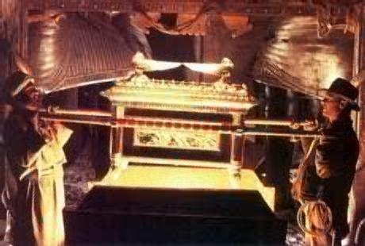

Why did they seek the Lost ARK?
POWER
KNOWLEDGE
Must be handled Carefully
Required an understanding of the ARK

Slide 3
1. Reflection and research on course or program outcomes
2. Clearly defined, measureable student learning outcomes
3. Carefully designed & conducted assessment
6. Improved Practice
4. Analysis of Assessment Data
5. Assessment Report

Slide 4
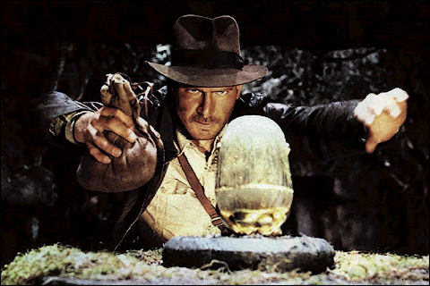
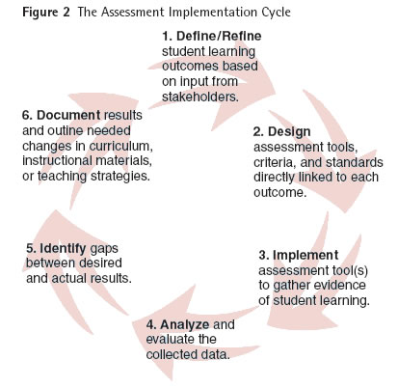
Assessment Possibilities
This presentation demonstrates the possibilities , power and potential of well -designed assessments.
SLOs
the expectations
Assessments
Collecting and Analyzing Data
Improvement

Slide 5
1. Reflection and research on course or program outcomes

Slide 6
What do you reflect upon when considering outcomes at these levels?
Courses
Programs
Institutional
Notes:
Let them respond

Slide 7
2. Clearly defined, measureable student learning outcomes

Slide 8
SLOs – Best Practices
Student Learning Outcomes (SLO)
define observable or measurable results that are expected subsequent to a learning experience
address knowledge (cognitive), skills (behavioral), or attitudes (affective)
describe overarching outcomes for a course, program, degree or certificate, or student services area (such as the library)
synthesize many discreet skills using higher level sophisticated thinking to produce something that applies what they’ve learned
Encompass analysis, evaluation and synthesis into more sophisticated skills and abilities

Slide 9
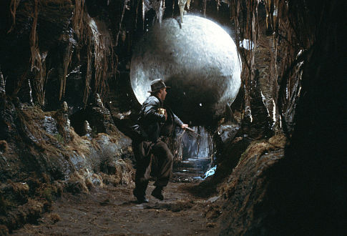
Envision this..
Learning outcomes provide a focus and a standard for the classroom and student service programs.
Assessment is a process that determines the students’ ability to meet those expectations.
Assessment data differs from grading because it looks at groups of students with a goal to improve teaching and learning.

Slide 10
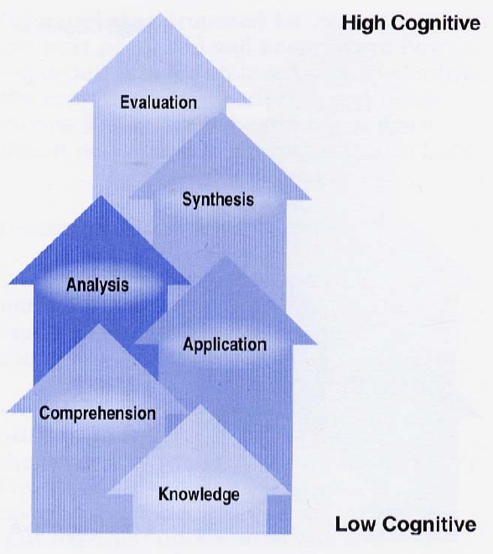

SLOs – Best Practices
Examine what is expected by colleagues, transfer institutions, professions
Create clear expectations, representing sophisticated higher level skills, knowledge and values
Determine the relationship to any previous or subsequent courses or programs

Slide 11

Differentiating between Objectives and Outcomes

Slide 12
Differentiating between
Goals
Objectives
And Student Learning Outcomes
Why differentiate?
How to differentiate.
Notes:
Input

Slide 13
The student will be able to bleed brake lines.
Goal
Objective
Student Learning Outcome
Don’t know

Slide 14
The student will be able to rotate and assess the status of a brake drum.
Goal
Objective
Student Learning Outcome
Don’t know

Slide 15
The student will be able to complete an entire successful brake job.
Goal
Objective
Student Learning Outcome
Don’t know

Slide 16
Begin by evaluating your existing SLOs
Are they really SLOs?
Is there a magic number?
Should all sections of courses have the same SLOs?
How do SLOs get reviewed?
How do SLOs feed into program review and Institutional Outcomes?

Slide 17
Learning outcomes articulate what the instructor or institution expect the students to be capable of doing after exposure to a course or service. SLOs…
guide class activities, class work, and exams
frame what and how content is covered.
help identify services that support student learning
are a nexus for faculty discussions on courses, services, and program review
indicate and direct valid and appropriate assessment methods

Slide 18
Appendix Resources
Appendix A
General Considerations in Designing SLOs
Appendix B
SLO Checklist

Slide 19
3. Carefully designed & conducted assessment

Slide 20

Assessment - Picture The Possibilities
Making visible the learning
Visualizing the pedagogy was effective
Analyzing whether certain students need other types of help
Determining the long-term effect of the course, program or service

Slide 21

Assessment Potential – selecting the Correct
Assessment Tool

Slide 22
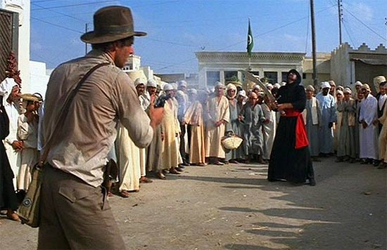

Slide 23

What tools are available?

Slide 24
Assessment Tools
Multiple Choice Exam
Licensing Exams
Standardized Cognitive Tests
Checklists
Essay
Case Study
Problem Solving
Oral Speech
Debate
Special Reports
Product Creation
Flowchart or Diagram
Portfolios
Exit Surveys
Performance
Capstone project or course
Team Project
Reflective self- assessment essay
Satisfaction and Perception Surveys

Slide 25
Appendix Resources
Appendix C
Choosing the Right Assessment Tool
Appendix D
The Case for Authentic Assessment
Appendix E
Assessment Checklist

Slide 26
Assessment Power
Think about how this skill, value or knowledge would be used outside of the classroom
Authentic – represents real world application
Valid – tests the outcome related to the content
Reliable – students taking the
Define success
Create a skills list
Make a rubric
Determine appropriate mastery
EXAMPLE: The student will be able to complete an entire successful brake job.

Slide 27
WYMIWYG
Are there explicit criteria?
Will the results be reliable?
Have you included qualitative and quantitative data?
Define the relationship to grading.
Have you considered content validity?
Is it authentic or real world?
Have you included multiple domains?
Do all students have the opportunity to show what they know?
Embed assessment – review what you are already doing does it need to be altered
Check the level of sophistication
Integrate or align assessments across courses, programs, services and the institution

Slide 28
Qualitative vs. Quantitative Data
Qualitative
Quantitative
Words
Categorization of performance into groups
Broad emergent themes
Holistic judgments
  Numbers
  Individual components and scores
  Easier calculations and comparisons plus presentation to a public audience

Slide 29
Grades vs Assessment
Paul Dressel (1976) has defined a grade as "an inadequate report of an inaccurate judgment by a biased and variable judge of the extent to which a student has attained an undefined level of mastery of an unknown proportion of an indefinite material.” Miller, Imrie, & Cox 1998, p. 24

Slide 30
Higher Level Thinking must be Assessed with Higher Level Assessments
Bloom’s Taxonomy
WEBB’S Depth of Knowledge
Recall
Basic Application
Strategic Thinking
Extended Thinking

Slide 31
What is Authentic Assessment?
Reflects Explicit Criteria
Exhibits Reliability
Represents Valid Content
Assesses Higher Level Learning
Simulates real world experiences
Includes Multiple Domains

Slide 32
Simulates real world experiences
Real World Assessment
Artificial Assessment
Qualitative and quantitative
Looks, feels and smells like an experience in life
Includes concepts and decision making
Something they would see at work
Quantitative only
Lacks realistic context
Decision-making is not encouraged
Something they recognize as purely academic

Slide 33
Visualize It!
EXAMPLE: The student will be able to complete an entire successful brake job.
Is the assessment :
authentic/realistic
valid
reliable
controlled with explicit criteria for success,
providing direct &/or indirect data
quantitative or qualitative
formative or summative
Brake Job
Evaluates
& Analyzes
Selects Correct Parts
Performs the Task
Checks for Results

Slide 34
Can this assessment provide data for any other outcome?
Program Outcome
VTEA Funding report
Institutional Outcome
Student Services

Slide 35
Assessment
Course
Student Services
Program
Institution

Slide 36
4. Analysis of Assessment Data

Slide 37
Appendix Resources
Appendix F
Grades as Data and Disaggregated by Race
Appendix G
Analyzing Direct Data & Indirect Data
Appendix H
Principles for Analyzing Data

Slide 38
Authentic Assessment and Context
Peter got a 55 on his exam – what do you think?
Suppose 35 is passing and 80 is a perfect score?
What if this was a standardized exam and Peter’s class average is 65?
Suppose the national average is 70?
Suppose the class average was 40 three years ago?
What if the score represented 2 discrete areas- where Peter got 65 for knowledge and 45 for real world application and the average was 55?

Slide 39
5. Assessment Report

Slide 40
6. Improved Practice

Slide 41
Appendix Resources
Appendix I
Examples of Improved Practice
  Course level
  Program level
  Institution level

Slide 42
Faculty Don’ts and DO’s
Faculty DON’Ts…
Faculty DO’s
Avoid the SLO process or rely on others to do it for you
Rely on outdated evaluation/grading models to tell you how your students are learning
Use only one measure to assess learning
Don’t criticize or inhibit the assessment efforts of others
Participate in SLO assessment cycle
Make your learning expectations explicit
Use assessment opportunities to teach as well as to evaluate.
Dialogue with colleagues about assessment methods and data.
Realize you are in a learning process too
Focus on assessment as a continuous improvement cycle.

Slide 43
Resources for Additional Questions
Thank you

