Slide 1
Building Student Success on a Powerful Student Experience
Review
April 25, 2013
Facilitated by:
Carol Thomas, General Manager
Laura Grandgenett, Senior IT Executive

Slide 2
Session objective:
Review the components of the State Center CCD Student Experience
Secondary objective:
Prepare District leadership to develop a technology vision to help the District thrive

Slide 3
What’s next
Draft Student Experience document
Focus Groups vet
SWOT relative to desired state
Proposed Student Experience to Board
Technology essential to achieve desired state
Technology Vision Statement drafted
Strategic Plan
Alignment

Slide 4
Review
What we covered…

Slide 5
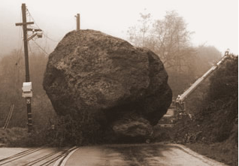
What gets in the way of student success?

Slide 6
Team Work:
What gets in the way of student success…
Answer the questions with 2 filters:
  …before enrollment?
  …after enrollment?
Identify 1 person to keep notes
Identify 1 person to report out to the entire group
20 minutes to brainstorm
5 minutes to prioritize the top 3
3 minutes to present to the group

Slide 7

What will it take
to be successful?
Mission
Strategic
Plan
Business
Process
Technology

Slide 8
Student-centered strategic objectives
Student Success
  1.2 Increase persistence & completion
  1.3 Comprehensive Student Services Delivery Plan
  1.5 Increase student engagement
Student Access
  2.2 Maintain & improve admissions, registration, counseling & orientation processes
Teaching & Learning Effectiveness
  3.3 Develop a comprehensive distance learning delivery plan

Slide 9
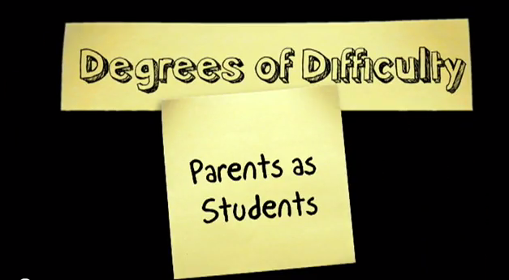

Slide 10
Team Work
Describe the student experience State Center should consistently deliver to its students?
20 minutes to identify the components of the desired experience
10 minutes to prioritize to the Top 3
5 minutes to prepare to tell your story
Identify 1 person to take notes
Plan and identify who will tell the story (can be multiple speakers)

Slide 11

Team Work
If resources were unlimited, what would the ideal student experience look like at State Center?
It’s all in the words…
20 minutes to discuss
Then discuss:
  How does that experience translate to student success?
  What would be impacted: graduation rates, persistence?
    15 minutes
10 minutes to summarize and prepare your top 3
Identify 1 person to take notes
Identify 1 person to present to the entire group
What words do you want students
to use when they describe their
experience at State Center CCD?

Slide 12
Results…
What you said

Slide 13
Here’s what you said…about students
Learn
Respect independence
Value education

Slide 14
Here’s what you said about… beliefs
Achieve
Model
Inspire
Prepare

Slide 15
Your turn…
In groups, take 15 minutes to review the document we are distributing
Ask yourself
  Does this capture the State Center experience?
  If so, is there a single word or phrase you might use to capture the essence?
  If not, what would you enhance?
Report back for discussion with the entire group.

Slide 16
Next steps
What we will be doing together

Slide 17
What’s next
Draft Student Experience document
Focus Groups vet
SWOT relative to desired state
Proposed Student Experience to Board
Technology essential to achieve desired state
Technology Vision Statement drafted
Strategic Plan
Alignment

Slide 18
Now…
Strengths
Weaknesses
Opportunities
Threats

Slide 19
SWOT ANALYSIS
S
Strengths
Advantages
Experience, knowledge
Unique caracteristics
Resources
Geographical advantage, location
Competence, capabilities
Quality, reputation
W
Weaknesses
Disadvantages
Gap in experience, knowledge
Financial position
Reliability and trust
Loss of key staff
Geographical factors
O
Opportunities
Strategic alliances, partnerships
Innovation
Technology
T
Threats
Loss af alliances and partners
Cost
Strong competition
Expectations

Slide 20
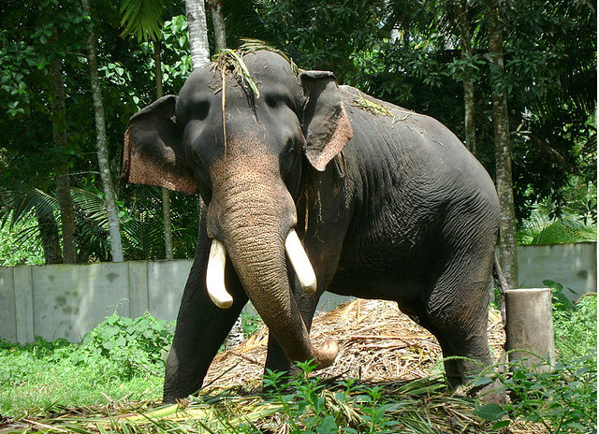
Elephants can’t dance

Slide 21
Thank you!

Slide 23
Mobile apps are an important part of our campus plan to enhance instruction & campus services
Small but steady gains in percentage of campuses view lecture capture as a key instructional resource
2010
2011
2012
The Campus
Computing Project
percentage who agree/strongly agree, fall 2010 - 2012

Slide 24
Activating Mobile Apps, Fall 2010-2012
Big gains
Impact of student expectations & consumer market experience
More (LMS & ERP) mobile app & service providers means a wide range of costs for deployment
2010
2011
2012
The Campus
Computing Project
percentage of institutions reporting mobile apps are active or will be deployed during the current academic year

Slide 25


Institutional Presence on Social Media
2009
2012
The Campus
Computing Project

Slide 26
Top Institutional IT Priorities, 2012
 | Campus Computing Survey (pct. reporting “very important”) | EDUCAUSE “Top 10 IT Issues” (panel assessment)
1 | Assisting faculty integrate technology into instruction (74%) | Updating IT professional skills and roles
2 | Providing adequate user support (70%) | Supporting trends towards consumerization and BYOD
3 | Hiring / retaining qualified IT staff (69%) | Developing a campus-wide cloud strategy
4 | TIE: Providing online ed via the web and implementing/supporting mobile computing (61%) | Improving operational efficiency through the use of IT resources
5 | Upgrading/enhancing network & data security (54%) | Integrating IT into institutional decision-making
6 | Financing the replacement of aging IT (50%) | Using analytics to support institutional outcomes
7 | Upgrading/enhancing the campus network (42%) | Funding IT strategically
8 | Migrating to Cloud computing (33%) | Transforming the institution’s business with IT
9 | Upgrading/enhancing administrative IT / ERP systems (24%) | Supporting the research mission through HPC, large data, and analytics
10 | Upgrading/enhancing emergency comm. (16%) | Establishing and implementing IT governance
The Campus
Computing Project

Slide 27

Emerging technology: It’s in your hands

Slide 28
Q&A
Discussion

Slide 29

We are educating students for jobs that don’t exist, using technology that hasn’t been invented, to solve problems that haven’t been identified.”
Shift Happens, YouTube, 2008
…and we’re doing it with
less of everything.

Slide 30

Further challenged by distinct ethnic &
socio-economic population in each of
2 colleges & 4 centers

Slide 31
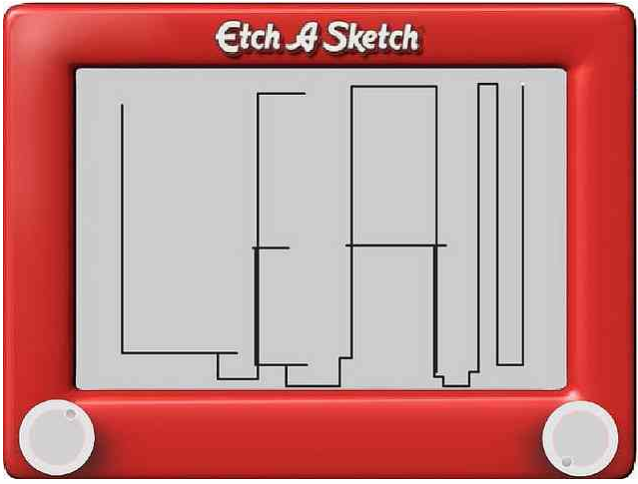
We begin with them…
Where do we begin?

Slide 32
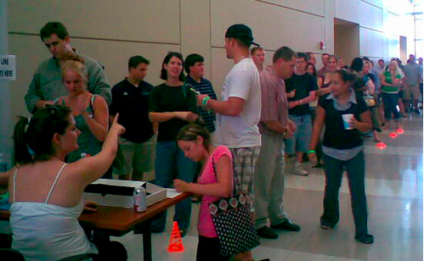
Who are they?
Notes:
You Tube video:
Vision of Students Today

