Slide 1

Integrated Budget Process as Evidence of Institutional Effectiveness
Presented by Donna Berry and Stephanie Curry

Slide 2

Outline
Accreditation Warning
Response to Recommendation
Integration of Program Review and Strategic Plan into Budget Planning
Collaboration with all constituency groups
Transparency and Broad Participation
Incorporation of process with Perkins, Instructional Equipment, and Lottery funding
Continuous Evaluation of the Process

Slide 3

Accreditation Warning
As recommended by the 2005 Accreditation Team and to build on its achievements to date in developing program review and improving institutional planning, the college should develop a practical, integrated planning model with the following characteristics:
A focus on a limited number of mid- to long-term initiatives to improve student learning and student support services.
A plan with concrete strategies and actions that are specific, measurable, attainable, results-oriented and time based, and that specify individuals or groups responsible for their completion.
A process that clearly ties this planning model to the college’s resource allocation processes.
Processes for regularly assessing not only the progress in achieving the goals of the plan but also the effectiveness of the integrated planning model itself.
A model that is inclusive of all institutional planning activities and that clarifies the functions of program review and the various resource committees.
A planning model that clarifies the relationship of the planning processes at Reedley College and the other planning processes of the State Center Community College District.

Slide 4

Response to Recommendation
Established Collaborative Partners immediately, including the academic senate and SLO/Program Review Coordinator
Review of other Resource Allocation planning models
College wide discussion
Recommendation was a complete overhaul of our previous top down approach to a bottom up process from the department/program level
Process includes prioritizations, justifications, and review of historical actuals (link to worksheet)
Integration of Budgeting Process into Integrated Planning Cycle
One time Emergency funding requests require the same justifications and planning links so that all resource request are going through the same process

Slide 5
Resource Allocation Worksheet

Slide 6

Integration of Program Review and Strategic Plan into Budget Planning
Established forms that directly linked resource requests to Program Review and Strategic Plans
Resource Allocation Requests need to be linked to substantiated program review goals, which are based on qualitative, quantitative and SLO data assessment
Resource Allocation Requests must also be linked to the short and long term strategic plan goals/drivers, which are informed by our Mission
Human Resource Staffing requests must also contain these elements

Slide 7
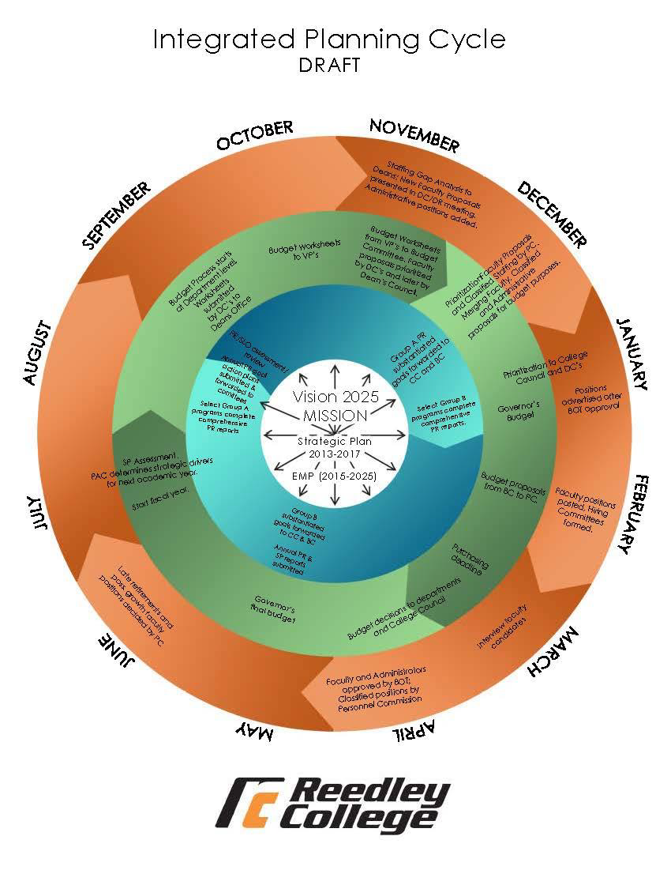

Integrated Planning Cycle

Slide 8

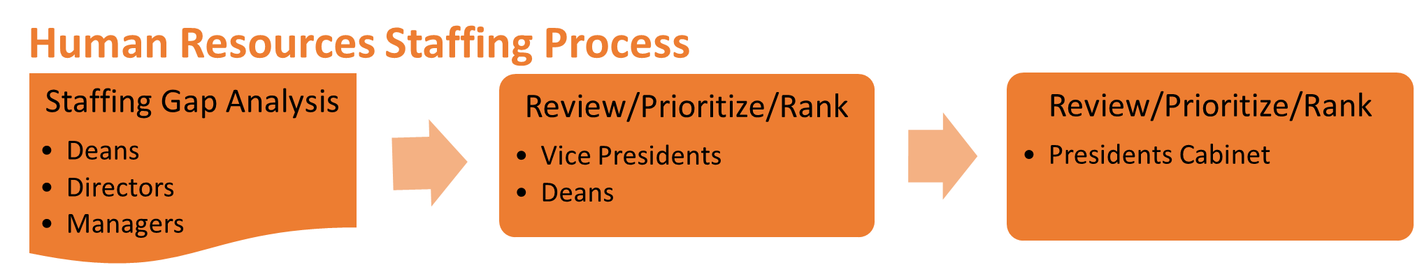
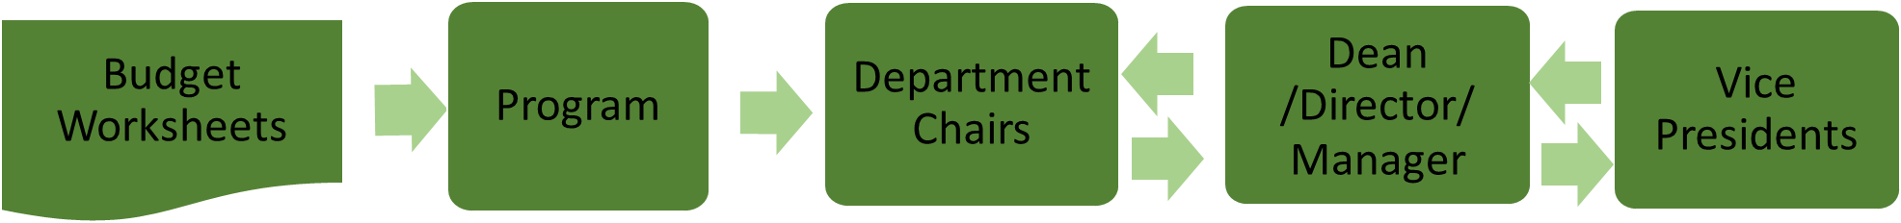



President’s Advisory Council
President’s
Cabinet
Budget Committee
President

Slide 9
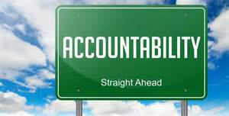
Transparency and Broad Participation
All constituents now know what their budgets allocations are
Recommended allocation worksheets are returned back to programs with comments, feedback, and tentative budget
Constituents gain accountability and Ownership of their budgets
Programs understand the direct connection between resource allocation and planning
Next Steps
  Budget monitoring Training
  Categorical/Grant Processes alignment

Slide 10


Incorporation of process with Perkins, Instructional Equipment, and Lottery funding
Perkins eligible items are identified through the process and require the same links to program review and strategic planning
The evaluation process and detailed information on the worksheets has allowed us to formalize the Perkins Process from a top down approach to a collaborative discussion with CTE programs all included
Detail approach from our worksheets also allows us to identify and prioritize Instructional Equipment needs
Lottery and other funding, such as strategic initiative funding can be identified using the same process

Slide 11

Continuous Evaluation of the Process
Budget Development process includes a formal annual review of the process every April
  Budget survey to participants
  Agenized evaluation discussions
  Annual evaluation report is produced to show evaluation and recommended changes
Substantive recommendations are vetted through constituency review process

Slide 12

Examples and Questions
Classroom Furnishings
Art 3D Printers
  Questions ?

