Slide 1
Strategic Alliance
Monday September 19, 2016

Slide 2
Purpose
Strategic Planning
District and College Alignment
Accreditation
Context
The Alliance is overall direction in planning.
The Alliance is not location specific or bond specific.
Notes:
Different perspectives – add to the big picture. Tonight is not about special interests it is to add to the puzzle. Merging of expertise! Not to advocate but to inform – difference between persuasion and information speeches… same thing here – each person has specific knowledge based on your area of expertise – that information is vital and helps State Center but at the same time we serve a diverse community – recognize the diversity and needs of all the participants.

Slide 3
Outcomes for the Strategic Alliance
Mission Statement
Values
Vision Statement
Direction on Strategic Drivers

Slide 4
District Overview

Slide 5
Enrollment Trends
 | 2012-2013 | 2013-2014 | 2014-2015 | 2015-2016
District | 44,972 | 45,527 | 49,239 | 50,786
Location | 2015-2016 Enrollment
Fresno City College | 34,185
Reedley College | 10,612
Clovis Community College | 9,155
Madera Community College Center | 4,439
Oakhurst Community College Center | 1,269

Slide 6
Degrees & Certificates
Degrees | 2011-2012 | 2012-2013 | 2013-2014 | 2014-2015
 | 1530 | 1893 | 1912 | 2065
Certificates | 2011-2012 | 2012-2013 | 2013-2014 | 2014-2015
 | 836 | 815 | 1114 | 1273
Programs Offered Districtwide | 483

Slide 7
Mission Statements
Document indicates the purpose of our institution
Written reminder for internal and external stakeholders of the core mission of State Center Community College District
Education code and Accreditation standards
Primary mission of community college include:
Accessible – open enrollment
Transfer, Career Technical Education, and Basic Skills
Serve our local communities

Slide 8
Education Code
ARTICLE 2. Comprehensive Mission Statement [66010.1 - 66010.7]
The missions and functions of California’s public and independent segments, and their respective institutions of higher education shall be differentiated as follows:
(a) (1) The California Community Colleges shall, as a primary mission, offer academic and vocational instruction at the lower division level for both younger and older students, including those persons returning to school.
(A) The provision of remedial instruction for those in need of it and, in conjunction with the school districts, instruction in English as a second language, adult noncredit instruction, and support services which help students succeed at the postsecondary level are reaffirmed and supported as essential and important functions of the community colleges.
(3) A primary mission of the California Community Colleges is to advance California’s economic growth and global competitiveness through education, training, and services that contribute to continuous work force improvement.

Slide 9
Mission Statements
Individual packets
Sample Mission Statements
Survey Results: Top Five words
Full list of possible word choices
As a group craft a Mission Statement for SCCCD
When agreement is reached write Mission Statement on the flip chart AND on your individual Mission Statement form
Notes:
Need a time limit

Slide 10
Values
Individual packets
Survey Results: Top Five words
Full list of possible word choices
As a group select no more than five values
When agreement is reached write list of values on the flip chart AND on your individual forms
Notes:
Need time limit

Slide 11
Alliance Explained
Definition
How the Alliance method will work tonight…
Hosts
Participants
Changing tables

Slide 12
Alliance Begins
Hosts
Lead introductions
Present the Mission Statement and Values that your table created
Round table discussion about differences between the table mission and values and the new participants mission and values
Merge the information together
Create a new Mission Statement
Create a new list of Values
When finished Hosts write the Mission Statement and Values on flip chart – to be picked up by synthesizing team
Notes:
Hosts please put the table number on your flip chart
Need time limit

Slide 13
Break – 10 minutes

Slide 14
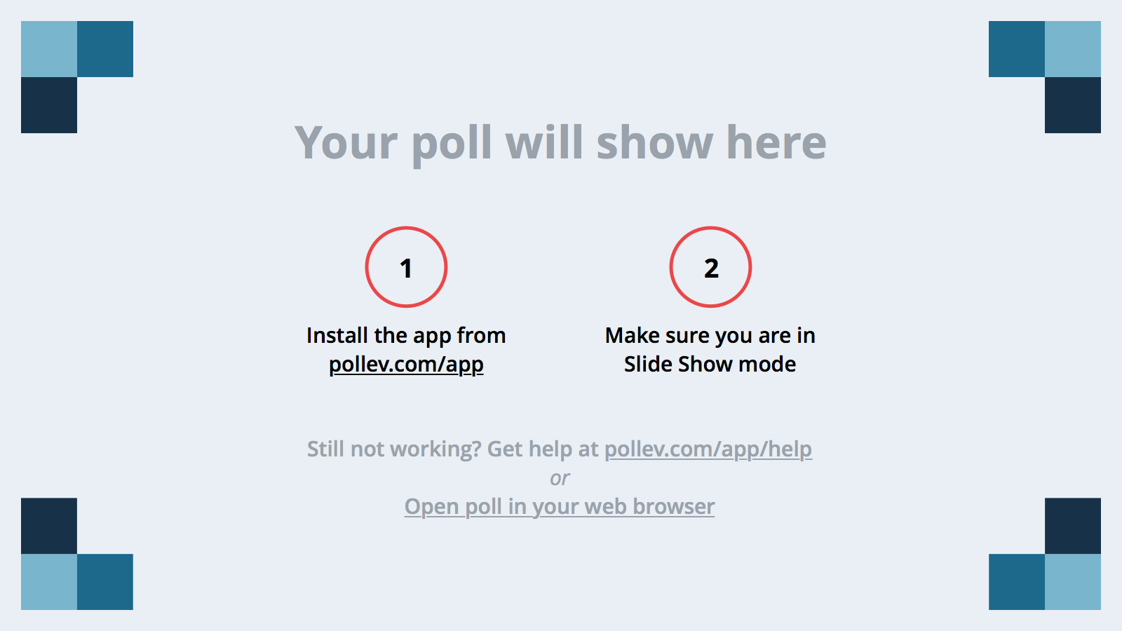
Notes:
Poll Title: If you could take a vacation? https://www.polleverywhere.com/multiple_choice_polls/1MdzEsQFTsDwxO0

Slide 15
Vision Statement
Individual packets
Sample Vision Statements
Survey Results: Top Five words
Full list of possible word choices
As a group craft a Vision statement
When agreement is reached write Vision Statement on the flip chart AND on your individual forms
Due to time constraints these will be collected by the synthesizing team!
Be Creative!

Slide 16
Poll Everywhere
Mission statements to choose from

Slide 17
Poll Everywhere
Values to choose from

Slide 18
Dinner

Slide 19
Three Goals
Excellence in Education
Institutional Effectiveness
Leadership in Higher Education and
Community Collaboration
Notes:
How we came up with these – last November
Explain the process – these are overarching goals as an institution!
When you have your goals you can then think about strategies to get there. Strategic planning basic four elements – We can do better – end game further out, internal scanning, external scanning – then putting those together to make decisions to move the organization forward.
Explain each of the three goals – in terms of a district.

Slide 20
Soccer Formation 3 3 4
Notes:
Portuguese woman with a microphone, an audience and talking about goals some of you knew the Euro cup was bound to show up in the conversation.
3 3 4 formation is not used often in soccer but it means a strong offensive attack formation

Slide 21
Strategic Drivers
Drivers
Things the district can strategically do
Drivers give a PUSH
Table packets contain envelopes
Hosts open up the packets, take Goal 1 out
Distribute post it notes
Individual activity not a table activity
Brainstorm as many drivers as possible – one driver per post it note
Notes:
Hands on pragmatic areas – what can we do? Goals are up here but drivers are where the action occurs. This is where your individual knowledge really becomes key to this process.
From your vantage point there may be areas that you see as opportunities for growth, change or improvement. What could the district do to push for a positive change in those areas.
Your suggestions of what the district can do to strategically drive the overall goal. (keep in mind that we all have different meanings and different areas are under this one goal – give examples – teachers/quality of professional development, administrators/more completion, community members – job ready skills)
Five minutes for the individual brainstorming time.

Slide 22
Driver Alliance
Hosts
Lead a discussion regarding the possible drivers
Each table select their top 3 drivers – put on the flip chart
Retain ALL ideas – place ALL of the post it notes back into the envelope
Notes:
Set time limit – five minutes for Goal 2 brainstorming

Slide 23
Poll Everywhere Vision

Slide 24
Repeat process for the next two goals
Goal 2
Brainstorm
Alliance
Goal 3
Brainstorm
Alliance

Slide 25
Report out
Each table will select someone (Host or Participant) to report out
One driver per goal
Each table participant will ONLY give three drivers verbally

Slide 26
Final Thoughts
Exit Survey coming in the next week
Chancellor Parnell
Board Trustee adjourns the meeting.

