Slide 1
PAC Strategic Workshop
Summer 2016
July 29th, 2016

Slide 2

Ground Rules
Everyone participates; no one dominates
Be comfortable, but be respectful of time
Focus on the task at hand (cells off!)
Use questions to network, share, learn
Listen with an open mind; be receptive
Trust the process
Have fun—laugh, enjoy, learn!

Slide 3
Outcomes for the day
Sunset 2013-2017 Strategic Plan
Framework for new District and College Strategic Plans

Slide 4

Notes:
https://www.youtube.com/watch?v=9YPQARBgHS8

Slide 5
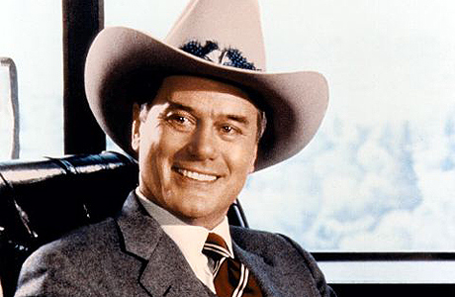

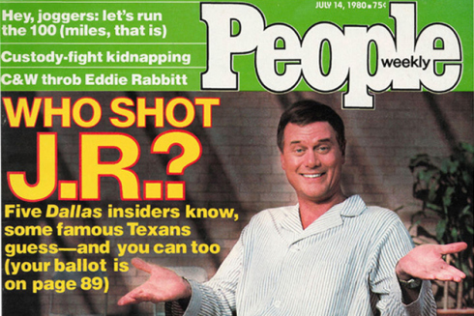

Who shot JR?
Cliff hanger and why it drives us crazy
Closure
Notes:
3rd season finale – The house divided episode.

Slide 6
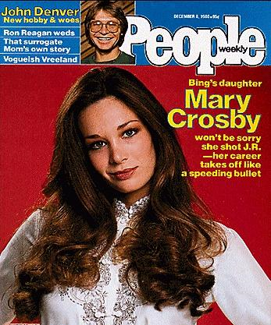
Spoiler Alert
Why did it work?
Delayed gratification
Natural human instinct that requires closure.

Slide 7
Binge fest…
Disneyland in 3 hours – even though you have 3 days?
Have you ever been introduced to a TV show or series and you actually sat down and watched several episodes in a row?
What about a book – do you ever rush to get to the end?
Do you ever start planning your next book, show or adventure?
Welcome to the end of our Strategic Planning

Slide 8
Drivers 2015/16
  ** 2.1 Evaluate course offerings to ensure sequencing that allow students to finish a program in a reasonable amount of time.
  2.3 Provide broad-based instructional support services relevant to the diverse needs of the students.
  2.4 Maintain a safe environment conducive to learning while providing services and activities that maximize the opportunity for educational and personal growth.
  6.4 Maintain and improve communication between Reedley, Madera, and Oakhurst and their surrounding communities.
  Met, Met with caution or Unmet???
Notes:
Hand out SMART forms each paper to discuss what has been done and decide if the drivers have been met, met with caution, or unmet
Report out from each table – gather the data from them.

Slide 9
Outcomes 2015/16
  4.3 Increase the number of quality work and internships experiences, apprenticeships, and job shadowing and service learning opportunities.
  5.6 Utilize, improve and maintain technology and facility infrastructure to support academic success.
  6.1 Engage in open and clear communication between Reedley College and the district.
  Met, Met with caution or Unmet???
Notes:
Hand out SMART forms each paper to discuss what has been done and decide if the drivers have been met, met with caution, or unmet

Slide 10

Where are we?
What will we do – do we have a driver – how many are left?
Brainstorm how we will accomplish them?
Notes:
Break after this slide

Slide 11
Break for lunch

Slide 12
Hope Springs Eternal… Vision Casting
Dreaming is free, that is why we have to dream…
You may not get your dreams but you have to have them. Dreaming big is what moves us forward to reach high, be better, and do more than anyone (including ourselves) ever thought possible.

Slide 13



Portugal wins the Euro Cup 2016

Slide 14
Time for Reedley College to Dream Big
Brainstorm at each table
Report out… the bigger the better

Slide 15
District Plan….
Flexible and concise
Charrette in September 19
Working on the wording for Mission, Vision, and Values
Established three goals

Slide 16
District Goals
Excellence in Education
Institutional Effectiveness
Leader in higher education and community collaboration

Slide 17
District Plan
Timeline – remains the same
Charrette for college to be held in late January, early February
  3 locations – Reedley, Madera, and Oakhurst

Slide 18
Reedley College Strategic Plan
Vision 2025
WIG
Educational Master Plan
Mission
Vision
Values
Institutional Learning Outcomes
Notes:
Reread the goals for vision 2025, the wig, the mission, vision and values – and the ILO’s

Slide 19
Brainstorming
Starting points
  Mission
  Vision
  Values
  Goals

Slide 20
Building the framework –
Strategic Plan 2017-2021
Strategic Planning Fundamental Tenets
Where are we?
What external factors will affect us?
Future focus?
Conscientious decision-making

