Slide 1
PAC Strategic Workshop
Summer 2015
August 6th, 2015

Slide 2

Ground Rules
Everyone participates; no one dominates
Be comfortable, but be respectful of time
Focus on the task at hand (cells off!)
Use questions to network, share, learn
Listen with an open mind; be receptive
Trust the process
Have fun—laugh, enjoy, learn!

Slide 3
Stories…
Share significant event that changed your path
Share significant people who changed your views
It takes a village
Organizations are living things, they are products of events and people who have molded and shaped them over time.
Strategic Planning

Slide 4
Drivers 2013/14
  3.2 Improve courses/programs through multiple measure analysis
  5.2 Ensure instruction and services are equitable and consistent across RC locations
  5.3 Staffing plan aligned with district

Slide 5
Drivers 2014/15
  5.2 Ensure instruction & services are sufficient, equitable & consistent across RC locations.
  1.4 Develop strategies to address unique needs of students to aid their academic success.
  4.1 Assess, maintain, & develop effective & relevant CTE programs in collaboration with business & industry partners.
  Met, Met with caution or Unmet???
Notes:
Hand out SMART forms each paper to discuss what has been done and decide if the drivers have been met, met with caution, or unmet
Report out – if met they go on window side – if unmet they go back on the wall

Slide 6
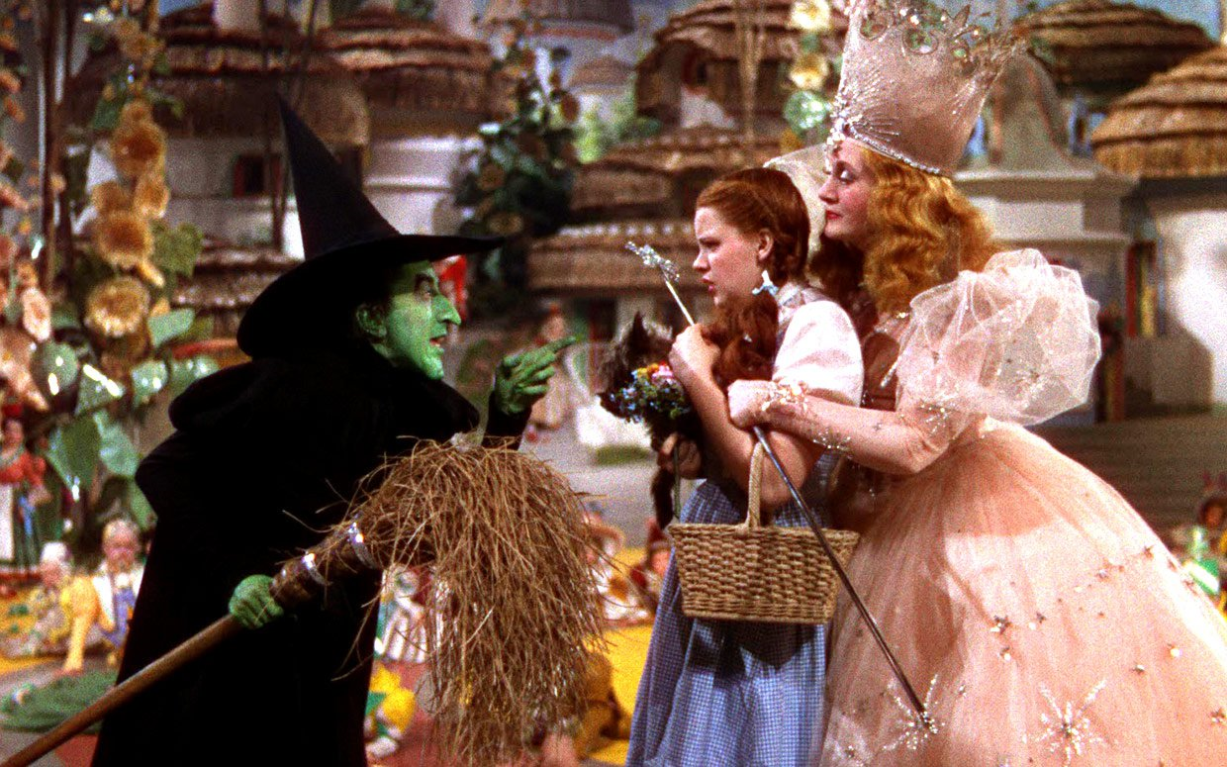

Same story… different story…
Different perspectives

Slide 7
Outcomes
Five outcomes were chosen in the last two years
  1.3, 2.1 (both years), 3.1, 3.3 and 6.2
Each table preassigned to two
Brainstorm what has been done to support these outcomes in the last two years, and decide if your group thinks they have been MET, MET with Caution or UNMET
  If unmet what needs to be done?
Report out
Notes:
Each outcome will be called out – the tables that had them will report out what has been done and they will say if they felt it was met, met with caution or unmet – if unmet what needs to be done?

Slide 8
1.3 Increase students’ campus and community engagement in order to facilitate persistence and completion rates.
What has been done?
Met, Met with Caution or Unmet?
Notes:
If met – move it to the window side, if unmet what needs to be done? Is it easy or hard?

Slide 9
2.1 Evaluate course offerings to ensure sequencing that will allow students to finish a program in a reasonable amount of time.
What has been done?
Met, Met with Caution or Unmet?
Notes:
If met – move it to the window side, if unmet what needs to be done? Is it easy or hard?

Slide 10
3.1 Align curriculum to increase certificates and degree completion
What has been done?
Met, Met with Caution or Unmet?
Notes:
If met – move it to the window side, if unmet what needs to be done? Is it easy or hard?

Slide 11
3.3 Provide and support opportunities for faculty development that foster innovation.
What has been done?
Met, Met with Caution or Unmet?
Notes:
If met – move it to the window side, if unmet what needs to be done? Is it easy or hard?

Slide 12
6.2 Promote communication and collaboration about college programs, services and activities between Reedley, Madera, and Oakhurst.
What has been done?
Met, Met with Caution or Unmet?
Notes:
If met – move it to the window side, if unmet what needs to be done? Is it easy or hard?

Slide 13
If outcomes are met – they are moved to the window
If outcomes are not met – what can we do?
As a body decide if it is something we could put on a SMART form and do in addition to our drivers this year yes or no?

Slide 14

Notes:
https://www.youtube.com/watch?v=hO8MwBZl-Vc
Set up the video – there is a commercial on it – so set it up.

Slide 15

Where are we?
Started with 25 objectives – take a highlighter
Drivers done?
Outcomes done?
Remaining ?
Read them – are any others done?
For Example… 5.4 is done!
5.4 Reedley, Madera, Oakhurst will support Willow International in its efforts to become a college.
Discussion
How many are remaining?

Slide 16
Voting Time
Dot stickers passed out
Vote on the left side of the posters
Priority list
Notes:
Second voting if necessary – top 6 only (can be less if necessary)

Slide 17
Affinity Diagram
Three Drivers
1.
2.
3.
Three Outcomes
1.
2.
3.

Slide 18
Opening Day Agenda
Planning Update
Vision 2025 EMP
Strategic Plan
Notes:
Vision 2025 goals handed out, EMSI gap analysis explanation handed out – plan will be written with recommendations at the end of the document – recommendations will be informed from both internal and the external scan – this is the opportunity for internal input of what we should be doing.

