Slide 1
Adjunct Faculty Orientation Workshop Thursday, August 11, 2016

Slide 2
Overview
Welcome and Introductions –Jan Dekker
Academic Senate-Stephanie Curry
SLOs/Accreditation and Institutional Effectiveness-Eileen Apperson-Williams
DSPS Update-Linda Reither
Student Conduct/Classroom Management/Plagiarism
Claudia Habib
Nuts & Bolts –David Clark
2016-2017 Faculty Handbook Highlights-Todd Davis
Adjunct Evaluation Process –Marie Harris
Faculty Responsibilities- Jan Dekker

Slide 3
Nuts & Bolts (Just the essentials!) CCI 217-Adjunct Faculty Workroom

Slide 4
Important Dates
August 15 (M) Start of Fall semester
August 17 (W) Syllabi due to Deans office
August 26 (F) Last Day to Drop full-term class to get refund
September 2 (F) Last Day to register for full-length class or drop to avoid a “W”
September 5 (M) Labor Day (no classes held, campus closed)
September 16 (F) Last day to change a fall class to/from a Pass/No-Pass grading basis
October 14 (F) Last day to drop a full-term class
October 17-December 16 (M-F) Short-Term classes, second nine weeks
November 11 (F) Veterans Day (no classes held, campus open)
November 24-25 (Th-F) Thanksgiving holiday (no classes held, campus closed)
December 12-16 (M-F) Final exams week
December 19 (M) Grades due by noon

Slide 5
Course Outline of Record
It is extremely important that the Course Outline of Record be followed, as it has been approved by the department, the Curriculum Committee and the State Chancellor’s Office.
It also assures consistency among instructors and from one semester to the next.
RC Home page-faculty & Staff-Curriculum Website Course Outline of Record
http://www.curricunet.com/reedley/

Slide 6
First Class Session
It would be wise to wait at least 10 minutes before taking attendance
Take the time to distribute and go over the course syllabus
“No Show” students should be dropped to make room for students waiting to add. Add students from the waitlist first, starting with #1. Waitlisted students must go through the same add procedure as walk-ins using authorization codes
Class should meet the entire class period. Advice: Give the students an assignment

Slide 7
Participation Points vs Attendance Points
-PARTICIPATION POINTS is a good way to encourage regular attendance. You must provide, detailed in your syllabus, precisely how these participation points will affect the grade. Alternative: drop the lowest homework or quiz grade when attendance is 90%
-Be careful to refer to it in your syllabus as PARTICIPATION POINTS and not as attendance points

Slide 8
Academic Dishonesty Statement
It is suggested that the following paragraph be included in your syllabus:
“Because cheating, plagiarism, and collusion in dishonest activities erode the integrity of the college, each student is expected to exert an entirely honest effort in all academic endeavors. Academic dishonesty in any form is a very serious offense and will incur serious consequences.” (RC Catalog page 45)

Slide 9
Student Code of Conduct Policy
Board Policy 5410 and Educational Code 76032 authorizes an instructor to remove a disruptive student from his or her class for the day of the removal and the next class meeting. The instructor shall immediately report the removal to the Dean of Student Services. During the period of removal, a student shall not be returned to the class from which he or she was removed without the concurrence of the instructor of the class. (RC catalog page 46)

Slide 10
2016-2017 Faculty Handbook
AAUP statement
Emergency procedures
Syllabus
Classroom care
Absences
Mail and Printing

Slide 11
AAUP Statement
Ethics
Seek and state truth
Encourage free pursuit of learning
No discrimination or harassment
Seek to be effective teachers

Slide 12
Emergency Procedures
1st To Know – sign up through WebAdvisor
SCCCD Police Ex. 5911 or 244-5911
New Red SCCCD Emergency Procedure Posters in every classroom

Slide 13
PHONE EMERGENCY BUTTON
PUSHING RED BUTTON TAKES YOU DIRECTLY TO SCCCD POLICE.
YOU WILL NOT HEAR ANYTHING, THEY WILL REMAIN QUIET WHILE ASSESSING THE SITUATION
IF NEEDED THEY MAY CALL YOU BACK
THIS BUTTON IS ONLY FOR EMERGENCIES

Slide 14
Syllabus
Syllabus Checklist
Must correspond to official course outline of record
A copy of the class syllabus is to be sent via e-mail to your division dean’s aide no later than Wednesday, August 17th, 2016
Be sure to include:
Instructors Full Name
Label it - “Syllabus”
Class Name, and schedule # - ex. ENGL1A-#23456
- Semester - “Fall 16”
- Class meetings: Days, Time and Location
An example of a syllabus can be found in the faculty handbook

Slide 15
Care of Classroom
Check classroom
Leaving: Leave desks and chairs in state you found them
Always: Clean the white boards
Reset alarm
Close windows, Lock room
Repairs: Done via submission of “schooldude” form

Slide 16
Absences
Reedley Campus
Before 8 a.m. call 638-0306 or 637-2531
8 am-5pm contact your deans office
After 5 p.m. call Administrator on Duty – 779-5447
Fill out academic absence form within 2 days
Sick leave-Totals can be found on webadvisor

Slide 17
Mail and Printing
Mailboxes
Located in the Printing Services Building
Need Tiger One Card to access
Printing Services
Reedley
Request form - rcprint@reedleycollege.edu
E-mail both form & document
Be mindful of copyright laws
Copier in lobby limited to 10 copies!!!!

Slide 18
Evaluation Process
Evaluated 1st semester of teaching or service
Evaluated again during 2nd and/or 3rd semester of teaching or service
Evaluated over every six (6) semesters of teaching or service thereafter

Slide 19
Evaluation Process
Evaluation will include:
Classroom visitation(s) by peer evaluator and immediate supervisor or his/her designee
New Form
Student questionnaires
Results discussed with unit member
Evaluatee shall receive a copy of the final written evaluation at the completion of the semester

Slide 20
Duties and Responsibilities

Slide 21
AR 7122
Duties and Responsibilities of Instructors
Primary Duty: Teach
Department Meetings
Participate, Engage: Clubs, STEM Conference, Green Summit, Safari Days

Slide 22
Highlights
Be present in the classroom during the time classes are officially scheduled
Give final examinations as announced in the published examination schedule
Follow Course Outlines of Record (COR)
Make systematic evaluations of student progress consistent with established SLO’s
Connect with your colleagues and your Department Chair

Slide 23
Participate in SLO assessments
Maintain accurate rosters
Submit grades and paperwork on time
Positive Attendance, submit to D.O.
Follow the Faculty Handbook
????: ask a colleague, then your department chair, then your dean

Slide 24
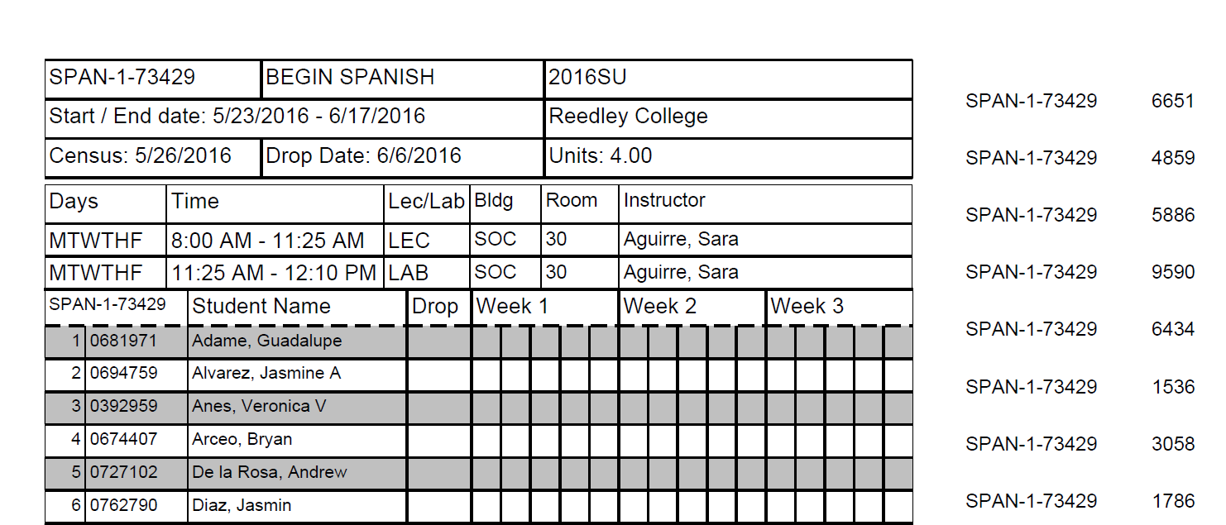
ROSTER EXAMPLE
CENSUS DATE
Certify Roster ON this date
Last day for student to add with add code
Last day to drop to avoid a “W”
DROP DATE
Final Drop Date; Last day to drop with a “W.” Letter grade must be assigned after this date (A,B,C,D,F or I)

Slide 25
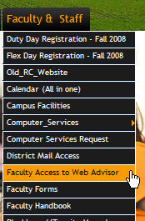
WebAdvisor
Grades
Roster Updates
Early Alert
Grade and Attendance Data
Submission
For assistance with your WebAdvisor password please contact:
WebAdvisor Support at 442-8240

Slide 26
Stipend
Make sure you have signed in with name and ID # in order to receive your stipend.

Slide 27
Questions???

