Slide 1

My New Puppy

Slide 2
High Level
Strategies for Increasing Student Completion of College Level Math Courses
Jim Ryan and Jim Gilmore
Clovis College and Reedley College
Mathematics Department

Slide 3
Field Trips and Conferences
Aligning Math Together, UC Davis, 3/2/16
CVHEC CCA Complete College America Game Changers, Clovis - Herndon Campus, 3/4/16
San Mateo College, 8/31/16
Cabrillo College, 8/31/16
California Acceleration Project, 9/9-11/16, Modesto
Common Assessment Initiative, 9/16/16, Fresno
SCCCD District Wide Assessment Collaboration, Clovis Herndon Campus, 9/17, 11/2/17, 12/15/16
Victor Valley College, 10/10/16
Pearson Napa Event Pre-Statistics, 11/4/16 Napa
AMATYC, 11/17-20/16 ,Denver

Slide 4
Group Meetings
Reedley College Counseling, 9/7/16
Math Department Reedley, 9/16, 10/16, 11/16
Chemistry Department, 9/12
Business Department, 9/27/16
Reedley High School Math Coordinator, 9/16, 10/16
Dean of Math and Science Reedley College, 11/15/16
President of Reedley College 11/9/16
Fresno City College 1/17
Reedley College Flex Day 1/17

Slide 5
Completion of Transfer-Level Math
REEDLEY COLLEGE
Fall 2013-Spring 2016
Students’ Initial Math Enrollment | % Completing Transfer-Level Math in 3 Years
Transfer Level | 82% = 191
One Level-Below Transfer | 21% = 502
Two Levels Below Transfer | 11% = 254
Three or More Levels Below Transfer | 4% = 81
Overall | 14.8% 1028/6962

Slide 6
Not all of our Students Intend to Transfer
(CCCSE 2016), 56.3% of the students intend to transfer
6962 students
3920 transfer
1028 (26.2%) actually completed a transfer level math course in three years.

Slide 7
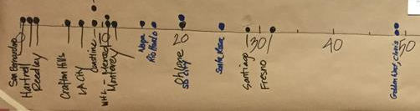
Percentage of Incoming Students that Place into Transfer Level Math
At Reedley College it is 4% and Clovis is 48%.
Only three colleges of 20 at the CAP conference placed above 30%.(Fresno and Clovis are included)
Only one college below Reedley College.

Slide 8
The Need for a Better Solution - Equity
Reedley College
Student Placement in Math Curriculum
Fall 2016
New, incoming students who participated in placement & enrolled in any course | All Assessed/ Placed |  | Eligible for transfer level |  | Eligible for 1 level below |  | Eligible for 2 levels below |  | Eligible for 3+ levels below
 | % | # | % | # | % | # | % | # | % | #
All | 100% | 6962 | 3% | 233 | 34% | 2389 | 33% | 2307 | 29% | 2033
African American | 2% | 139 | 0% | 0 | 22% | 30 | 39% | 54 | 39% | 55
Asian | 4% | 258 | 23% | 60 | 26% | 68 | 17% | 43 | 34% | 87
Hispanic | 75% | 5252 | 2% | 126 | 34% | 1776 | 35% | 1839 | 29% | 1511
White | 15% | 1046 | 3% | 36 | 40% | 413 | 29% | 302 | 28% | 295
Other | 4% | 267 | 4% | 11 | 38% | 102 | 26% | 69 | 32% | 85

Slide 9
Potential Impact on Equity (Math Transfer Level) From Placement

Slide 10
Three Strategies for Increasing Student Completion in College Level Mathematics
1. Changing Placement Policies
2. Implementing Co-Requisite Models
3. Redesigning Remedial Courses

Slide 11
Strategy 1
How Good is the Assessment Test?
When a transfer student is placed by Accuplacer, does it accurately predict their success?

Slide 12
Predictive validity of Tests
(transfer level) Multiple Measures Assessment Project (MMAP)
Test | Correlation with Grade Point
Accuplacer – English | .10
Accuplacer – Math | .09 - .19

Slide 13
From Bostian (2016), North Carolina Waves GPA Wand, Students Magically College Ready. Adapted from research of Belfield and Crosta, 2012

Slide 14
Multiple Measures
The College Board agrees that the most successful placement models are those that take a comprehensive approach [with] multiple variables, including high school GPA
Multiple measures
  provide a more complete picture of student ability
  provide a way to increase the accuracy of placement, particularly reducing under-placement http://bit.ly/CCRCPlacementAccuracy
  are required by law
http://bit.ly/MMACCU http://bit.ly/MMUSDOE

Slide 15

Predicting transfer-level grades
Test vs GPA
Test | Correlation with GPs
Accuplacer – English | .10
Accuplacer – Math | .09 - .19
11th Grade GPA - English | .37
11th Grade GPA – Math | .38
Notes:
538 did not create a better survey, but used average of other polls to predict election outcomes with high accuracy

Slide 16
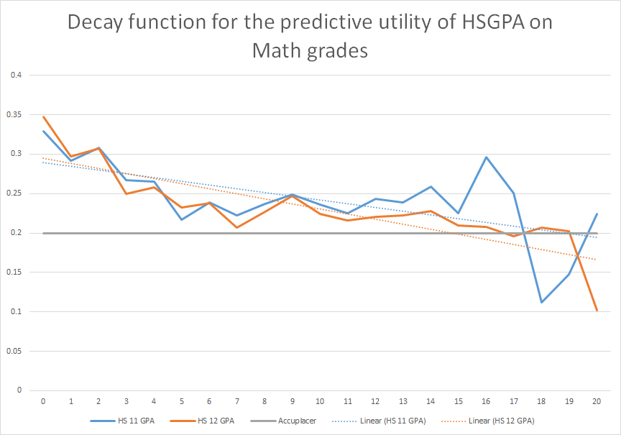
  High school GPA is good for many years
Correlation between Predictor and 1st CC Math Grade
Semesters of Delay (approx. 6 months each)
Notes:
Terrence

Slide 17
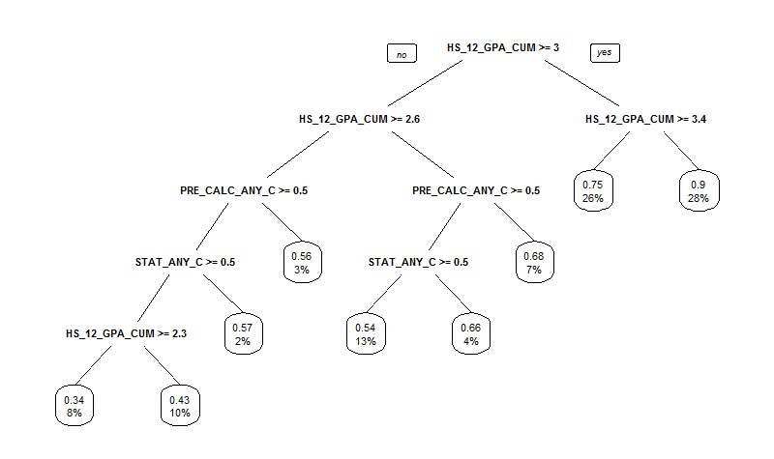
  Example Decision Tree
  (transfer-level Statistics)
50%
60%
70%
Internal Node / Split
Success rate
Percent of sample in leaf
Leaf

Slide 18
Reedley College Placement Rules for (STEM)
Level (Minimal final HS course level required for placement) | Direct Matriculants (Up through 11th grade) | Non-Direct Matriculants
MATH 5A Analysis I Passed Pre-Calculus or Trigonometry or Math 4 (or higher) | HS 11 GPA>=3.6 HS 11 GPA>=3.2 AND Pre-Calculus, C (or better) HS 11 GPA>=3.2 AND Math 4, C (or better) | HS 12 GPA>=3.5 HS 12 GPA>=3.1 AND Calculus*
MATH 4B Pre-Calculus Passed Algebra II or Math 3 (or higher) | HS 11 GPA>=3.4 HS 11 GPA>=2.6 AND Calculus* | HS 12 GPA>=3.3 HS 12 GPA>=3 AND Algebra II CST>=340 HS 12 GPA>=3 AND Math 3 CST>=340 HS 12 GPA>=3 AND Calculus C (or better)
MATH 4A Trigonometry Passed Algebra II or Math 3 (or higher) | HS 11 GPA>=3.4 HS 11 GPA>=3 AND Pre-Calc C+ (or better) HS 11 GPA>=3 AND Math 4, C+ (or better) HS 11 GPA>=3 AND Alg II, B (or better) HS 11 GPA>=3 AND Math 3, B (or better) | HS 12 GPA>=3.3 HS 12 GPA>=2.8 AND Pre-Calculus, C (or better) HS 11 GPA>=2.8 AND Math 4, C (or better)

Slide 19
Reedley College Placement Rules for (Non-STEM)
Level (minimal final HS course level required for placement) | Direct Matriculants (Up through 11th grade) | Non-Direct Matriculants
MATH 45 Contemporary Mathematics Passed Algebra I or Math 2 (or higher) | HS 11 GPA>=3.3 | HS 12 GPA>=3.2 HS 12 GPA>=2.9 AND Statistics C (or better)
MATH 11 Statistics Passed Algebra I or Math 2 (or higher) Passed at Reedley 11/16 1/5/17 Reedley voted to change the model to Passed Algebra II (or higher) | HS 11 GPA>=3.0 HS 11 GPA>=2.3 AND Pre-Calculus C (or better) HS 11 GPA>=2.3 AND Math 4 C (or better) | HS 12 GPA>=3.0 HS 12 GPA>=2.6 AND Pre-Calculus C (or better) HS 12 GPA>=2.6 AND Math 4 C (or better)

Slide 20
Reedley College Placement Rules for (STEM)
MATH 103 Intermediate Algebra (CB21=A) Passed Algebra I or Math 2 (or higher) | HS GPA>=2.8 | HS 12 GPA>=2.9 HS 12 GPA>=2.5 AND Algebra II CST>=302 HS 12 GPA>=2.5 AND Math 3 CST>=302 HS 12 GPA>=2.5 AND Pre-Calculus C (or better) HS 12 GPA>=2.5 AND Math 4 C (or better)
MATH 201 Elementary Algebra (CB21=B) (No minimal final HS course level required for placement) | HS 11 GPA>=2.4 | HS 12 GPA>=2.5 HS 12 GPA>=2.0 AND Algebra I CST>=302 HS 12 GPA>=2.0 AND Math 2 CST>=302 HS 12 GPA>=2.3 AND Algebra II C (or better) HS 12 GPA>=2.3 AND Math 3 C (or better)

Slide 21
Reedley College Placement Rules for (Non-STEM)
MATH 256 Topics in Algebra (CB21=C) (No minimal final HS course level required for placement) | HS 11 GPA>=2.0 | HS 12 GPA>=2.1 HS 12 GPA>=1.6 AND Algebra I Cluster 1*>=8
MATH 250 Arithmetic Review (CB21=D) (No minimal final HS course level required for placement) | Everyone else | Everyone else

Slide 22
Implementing a Co-requisite Model for Statistics – Strategy 2
The City University of New York did a randomized controlled experiment in which students placed into elementary algebra enrolled in a college-level Statistics course with supplemental instruction from student tutors.
56% passed the course
Their pass rates were nearly 20 percentage points higher than the group that enrolled in Elementary Algebra
A year later, the group that enrolled in statistics had completed college-level math at more than three times the rate of students enrolled in algebra
These improvements were experienced by every racial group, with no significant differences between groups.

Slide 23
Of the 31,959 students who started only 3,383 enrolled and finally only 2334 of those students completed the transfer level course. (MMAP talk September 2016)

Slide 24
What can we do?
Reduce the exit points
Better placement of students

Slide 25
Reducing The Exit Points.
One reason behind both multiple measures placement and statistics pathways is to cut down on the number of exit points for the students.

Slide 26
Statewide: 2,334 finished a transfer level course of the 16,362 who are listed here two levels below. 14.2% statewide.

Slide 27
How does our data compare to the 14.2%?
Of those students who start in Math 201 only 31% of our students pass a transfer level course in 4 years. (Note: The 14.2% is a shorter time period but this is just for comparison.)
So 31% looks pretty good if we compare, But, . . . . .
What happened to the other 69% of our students who started in Math 201 and never passed a transfer level course?
I am missing our actual data. Somebody has it. I believe it is also on my old computer that I cannot get into right now.

Slide 28
31 % of our students make it through in four years and 69% of them do not.
Math 201 Beg Alg
Math 103 Int Alg
Any Transfer Level 31%

Slide 29
Pre-Statistics – Strategy 3
Add Pre-Statistics and reduce the exit points.

Slide 30
The CSU and UC systems approve any pathway with our current statistics courses unchanged.
The current CID vetting of Math 110 (Statistics) concluded September 16, 2016
The new CID has the following statement about statistics.
Required Prerequisites: Intermediate Algebra or CSU accepted *statistics pathway curriculum.
At present there are two mechanisms to become accepted:
the proposed statistics course has been accepted to meet CSU General Education Breadth Area B4
the pathway has been accepted by the CSU Chancellor's Office process per its October 20, 2015 memo (Statistics Pathways in CSU Quantitative Reasoning)

Slide 31
Math 211 Pre-Statistics course
Math 201
Math 103
Math 11 or
Stat 7
The business department has not been consulted about Stat 7 yet. Stat 7 does have the same CID as Math 11.
Math 211
Math 11 or
Stat 7
The Math 211 curriculum has not been sent to the Clovis curriculum committee. A Math 211 course has already been submitted to the Reedley College curriculum committee and accepted by ECPC and has Board approval.

Slide 32
Math 211 Pre-Statistics – who can take it?
Eligible for Math 201
Non-STEM
Not Business
Eligible for Math 201
Not Education
Not any major requiring courses with Math 103 as a pre-requisite.

Slide 33
If* the CID is changed for Math 45 in the future. (It has not changed yet.)
Math 201
Algebra 1
Math 103
Algebra 2
Math 45
Humanities and others
* Warning! The CID for Math 45 has not changed yet!
Math 211
Pre-statistics
Math 45
Humanities and others

Slide 34
STEM and Education major pathways won’t change with Math 211
Math 201 and Math 103
Algebra 1 and Algebra 2
Geometry?
Math 4A - Trig
Math 5A, 5B, 6, 7
Calculus Sequence
Math 201
Algebra 1
Math 103
Algebra 2
Math 10A and Math 10B
Liberal studies

Slide 35
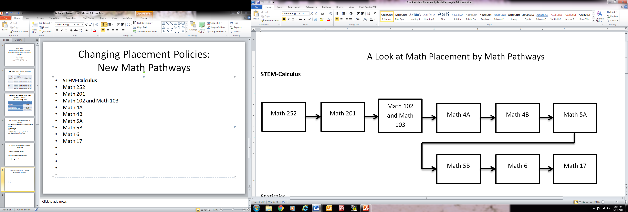
Math Pathway - Reedley

Slide 36
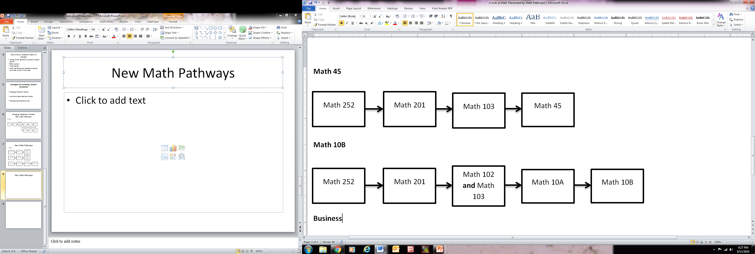
Math Pathways - Reedley

Slide 37
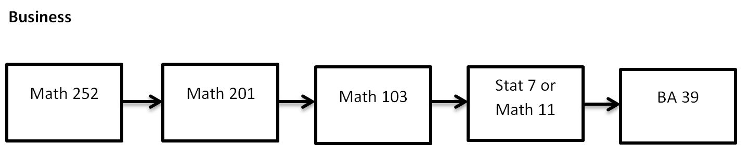
Math Pathway - Reedley

Slide 38
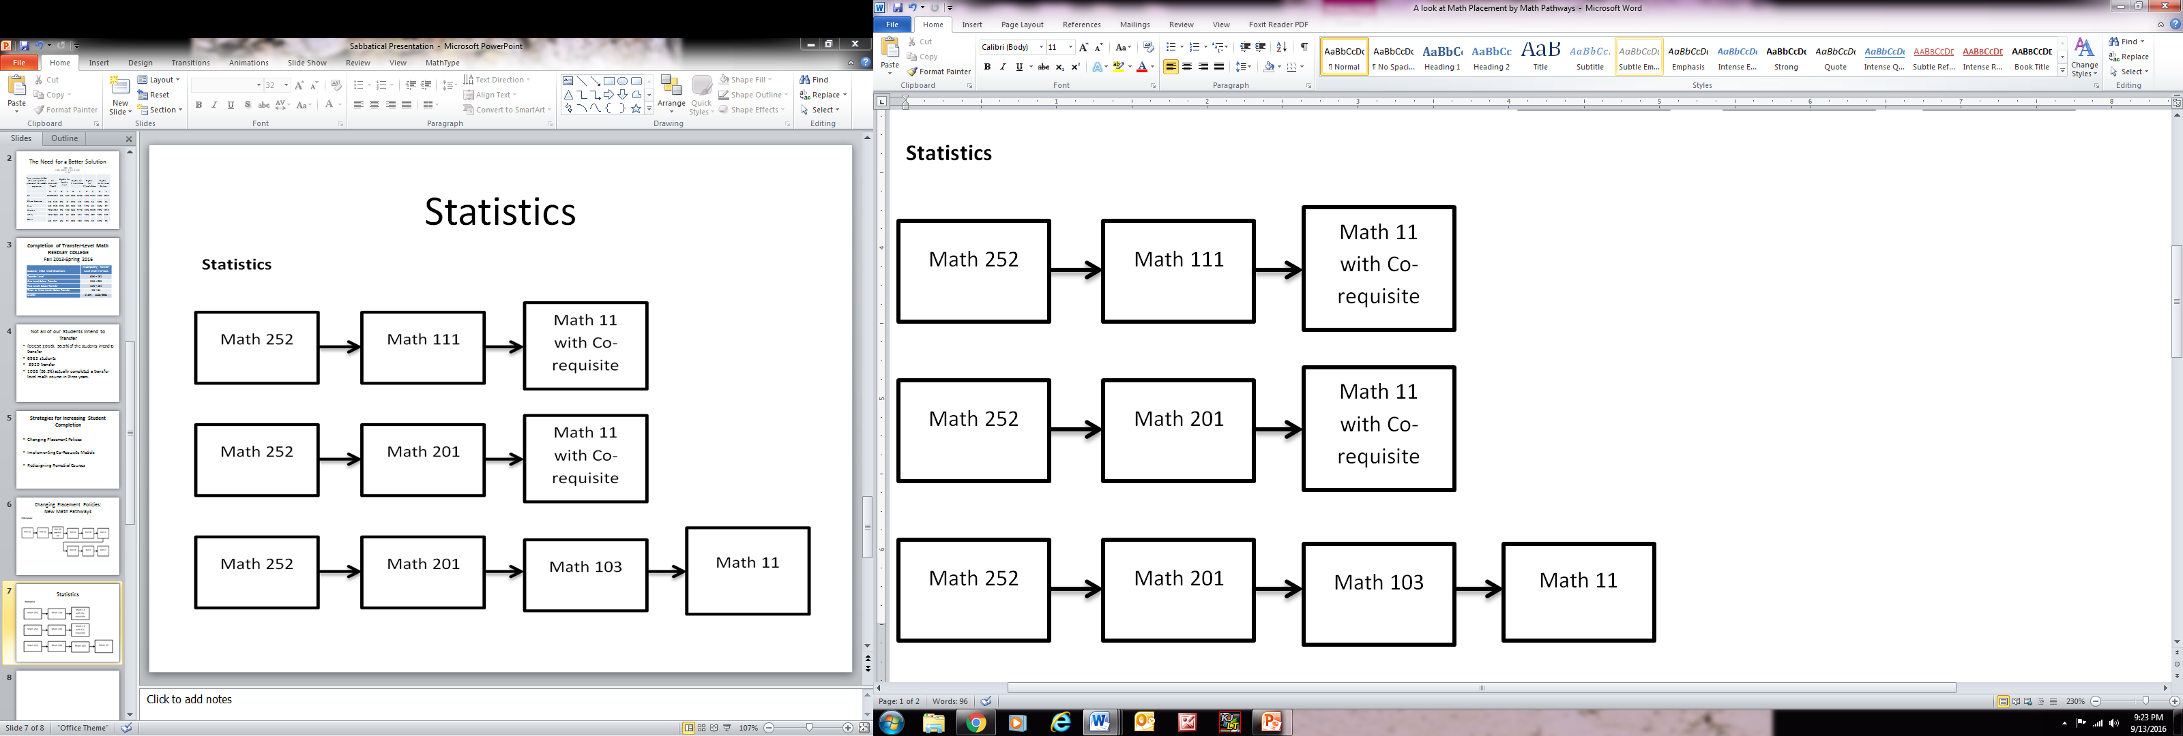
Math Pathways - Reedley

Slide 39
Math Pathways - Reedley

Slide 40
Math Pathways - Reedley
Statistics
Math 250 or Math 256 or Math 252 Arithmetic/ Pre-Algebra
Math 211 Prestatistics
Math 11C Statistics with Co-requisite

Slide 41
Math Pathways - Reedley
Statistics
Math 250 or Math 256 or Math 252 Arithmetic/Pre-Algebra
Math 201 Elementary Algebra
Math 11C Statistics with Co-requisite
Math 211 Prestatistics

Slide 42
Math Pathways - Reedley
Statistics
Math 250 or Math 256 or Math 252 Arithmetic/Pre-Algebra
Math 201 Elementary Algebra
Math 11 or Math 11C Statistics with Co-requisite
Math 103 Intermediate Algebra

Slide 43

Change Can be Hard.

Slide 44
Math Pathways - The Future
Statistics
Math 250 or Math 256 or Math 252 Arithmetic/Pre-Algebra
Math 11 or Math 11C Statistics with Co-requisite
Math 201 Elementary Algebra

Slide 45
Math 211 – Student passes and changes their major?
We cannot spend all our time figuring out all the different scenarios when students change their major, but
If a student takes Math 211, the mathematics department is proposing that student take Math 103 w/co-requisite course (Clovis) that would then allow them the flexibility to change their major to STEM, business, or education.

Slide 46
Business Major Example
Standard Pathway
Math 201
Algebra 1
Math 103
Algebra 2
Stat 7
BA 39 Finite

Slide 47
Math 211 students who switch to Business after completing Math 211.
Math 211
Pre-statistics
Math 103 Alg 2
w/co-requisite
Stat 7
BA 39 Finite
The Math department (Clovis) has proposed this scenario.

Slide 48
Math 211 students who change their majors after completing Statistics.
Math 211
Stat 7 or Math 11
Math 103 w/co-requisite
BA 39
This does not cut down on the number of exit points for this student, but, hey, they changed their major.
Is there an issue with students taking Math 103 after statistics since Math 103 will be listed as ONE of the pre-requisites to statistics?

Slide 49
Students entering eligible for Math 103 (Algebra 2) and NOT eligible for statistics.
These students should likely take Math 103 to insure all of their options for majors are open.
But Math 211 is available to them. We should lay out all the options and let them choose since they could possibly choose Math 211 without counseling.

Slide 50
Students entering eligible for Math 103 and NOT eligible for statistics.
Math 103 Algebra 2
Math 11/Stat 7 and BA 39
Math 4A (Math 102)
Math 10A/Math 10B
Math 45
Math 103 allows for flexibility if and when a student changes their major.
Switching majors may cause a student to go back to Math 103
Math 211
Pre-statistics
Math 11 or
Stat 7

Slide 51
What is in the Pre-Statistics Curriculum?
We identified all of the topics needed for Statistics from the outlines of:
Beginning Algebra, Math 201.
Intermediate Algebra, Math 103.
We then looked through the outline of Statistics and identified other topics to be included in the Pre-Statistics course.

Slide 52
Pre-Statistics Objectives
Practice basic calculations with numbers and simplify polynomials recognizing order of operations in statistical formulas.
Solve and simplify algebraic and linear equations and inequalities.
Create and interpret statistical graphs including pie charts, histograms, and scatter plots.
Graph linear functions.
Simplify basic radicals in a statistical context.
Interpret slopes and y-intercepts of linear equations.

Slide 53
Pre-Statistics Outline Section 1
Perform operations with real numbers with and without calculators. Perform simple polynomial operations.
A. Number Systems and Operations
B. Addition, subtraction, multiplication and division of real numbers
C. Calculator techniques, square roots, square roots with summation notation, recognizing order of operations in statistical formulas, factorials.
D. Ordering and converting decimals, percentages and fractions.
E. Rounding concepts.
F. Add like terms and perform simple operations with polynomials. - necessary topics for statistical formulas. (Weighted Mean, etc.)
G. Multiplication and division with exponents – necessary items for statistical formulas.

Slide 54
Pre-Statistics Outline Section 2
Simplify algebraic expressions and solve linear equations and inequalities
A. Simplifying expressions
B. Substitution into statistical formulas that are algebraic in nature.
C. Solving equations using the addition and multiplication properties of equality
D. Applying the addition and multiplication properties to solve formulas
E. Applying the addition and multiplication properties to solve inequalities
F. Solving equations with fractions
G. Solving proportions

Slide 55
Pre-Statistics Outline Section 3
Create and Interpret Statistical Graphs
A. Measures of central tendencies
B. Measures of spread
C. Multiple statistical graphs, bar charts, histograms, pie charts, scatter plot, box plots, normal curve, etc.
D. Extract information from graphs and tables - Complement rule
E. Inequalities related to area under the normal curve.
F. Statistics applications. Designing observational studies and experiments.

Slide 56
Pre-Statistics Outline Section 4
Graph linear equations in two variables.
A. Finding solutions to linear equations in two variables
B. Finding axis intercepts and using them to graph a equation
C. The equation of a line, linear models, regression, linear function notation, making predictions.
D. Applications - Describing points, slope in context, and intercepts using complete sentences.
E. Calculate vertical deviation of a point from the line

Slide 57
Pre-Statistics Outline Section 5
Simplify radical expressions in a statistical context.
A. Rational exponents – ½. 1/3, geometric mean and growth rates for exponential functions.
B. Simplified form for radicals

Slide 58
Pre-Statistics Outline Section 6
Optional Topics (if time permits) Generalize arithmetic and geometric sequences and find the kth term of a binomial expansion.
A. Binomial Expansion, Pascal’s Triangle
B. Probability – combinations and permutations, sample space, independent and dependent events
C. Standard Deviation
D. Exponential Functions and logarithms – regression and discussion of growth rates. Geometric Mean.
E. Expose students to playing cards and board games to learn about probability concepts (suits, face cards, dice).
F. Reading cumulative standard normal distribution tables.

