Slide 1
2017 Institutional Set Standards (ISS) Update
Purpose of IEPI Requirement

Slide 2
Topics to Cover
Recap of ISS developed in 2016
Check for understanding
Our 2016 goal outcome
The discussions
2017 Drafted Goals

Slide 3
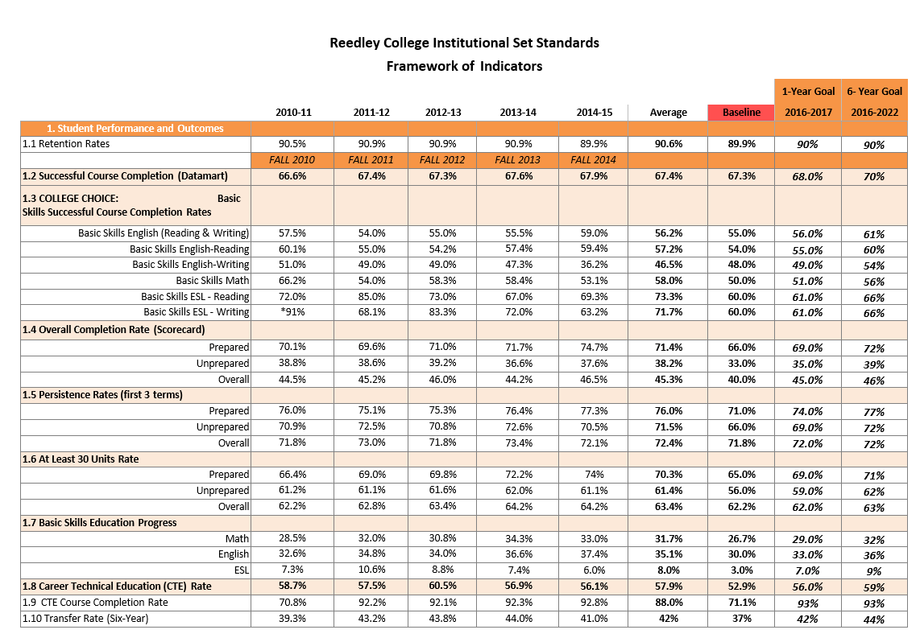
Year 2016

Slide 4
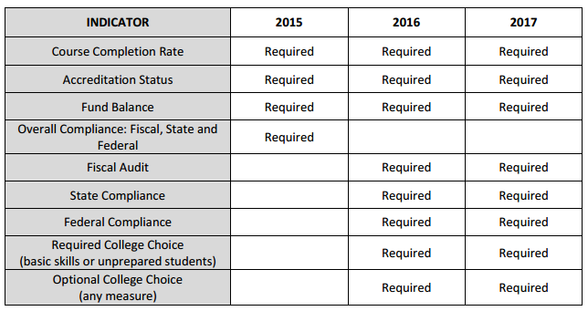
Required by IEPI

Slide 5
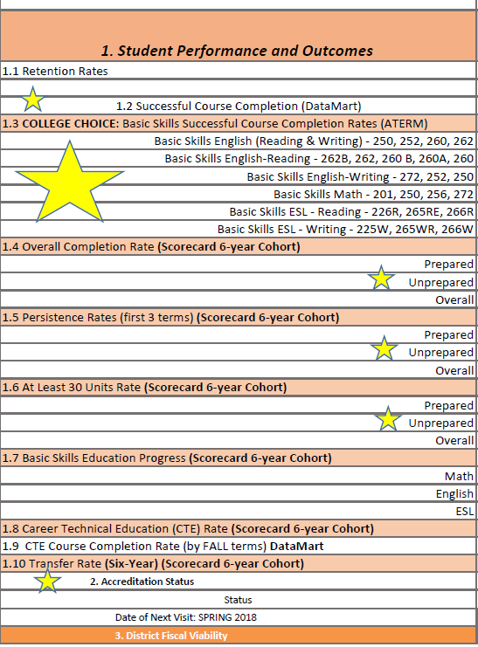
Fall Data
VS
Student Success Scorecard
FALL DATA

Slide 6
Fall Data
VS
Student Success Scorecard
SCORECARD

Slide 7
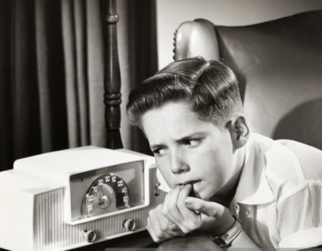
How did we do??

Slide 8
Reedley College in comparison with State and District
-5-Year Trend

Slide 9
Reedley College in comparison with State and District
-5-Year Trend

Slide 10
